Slide 1
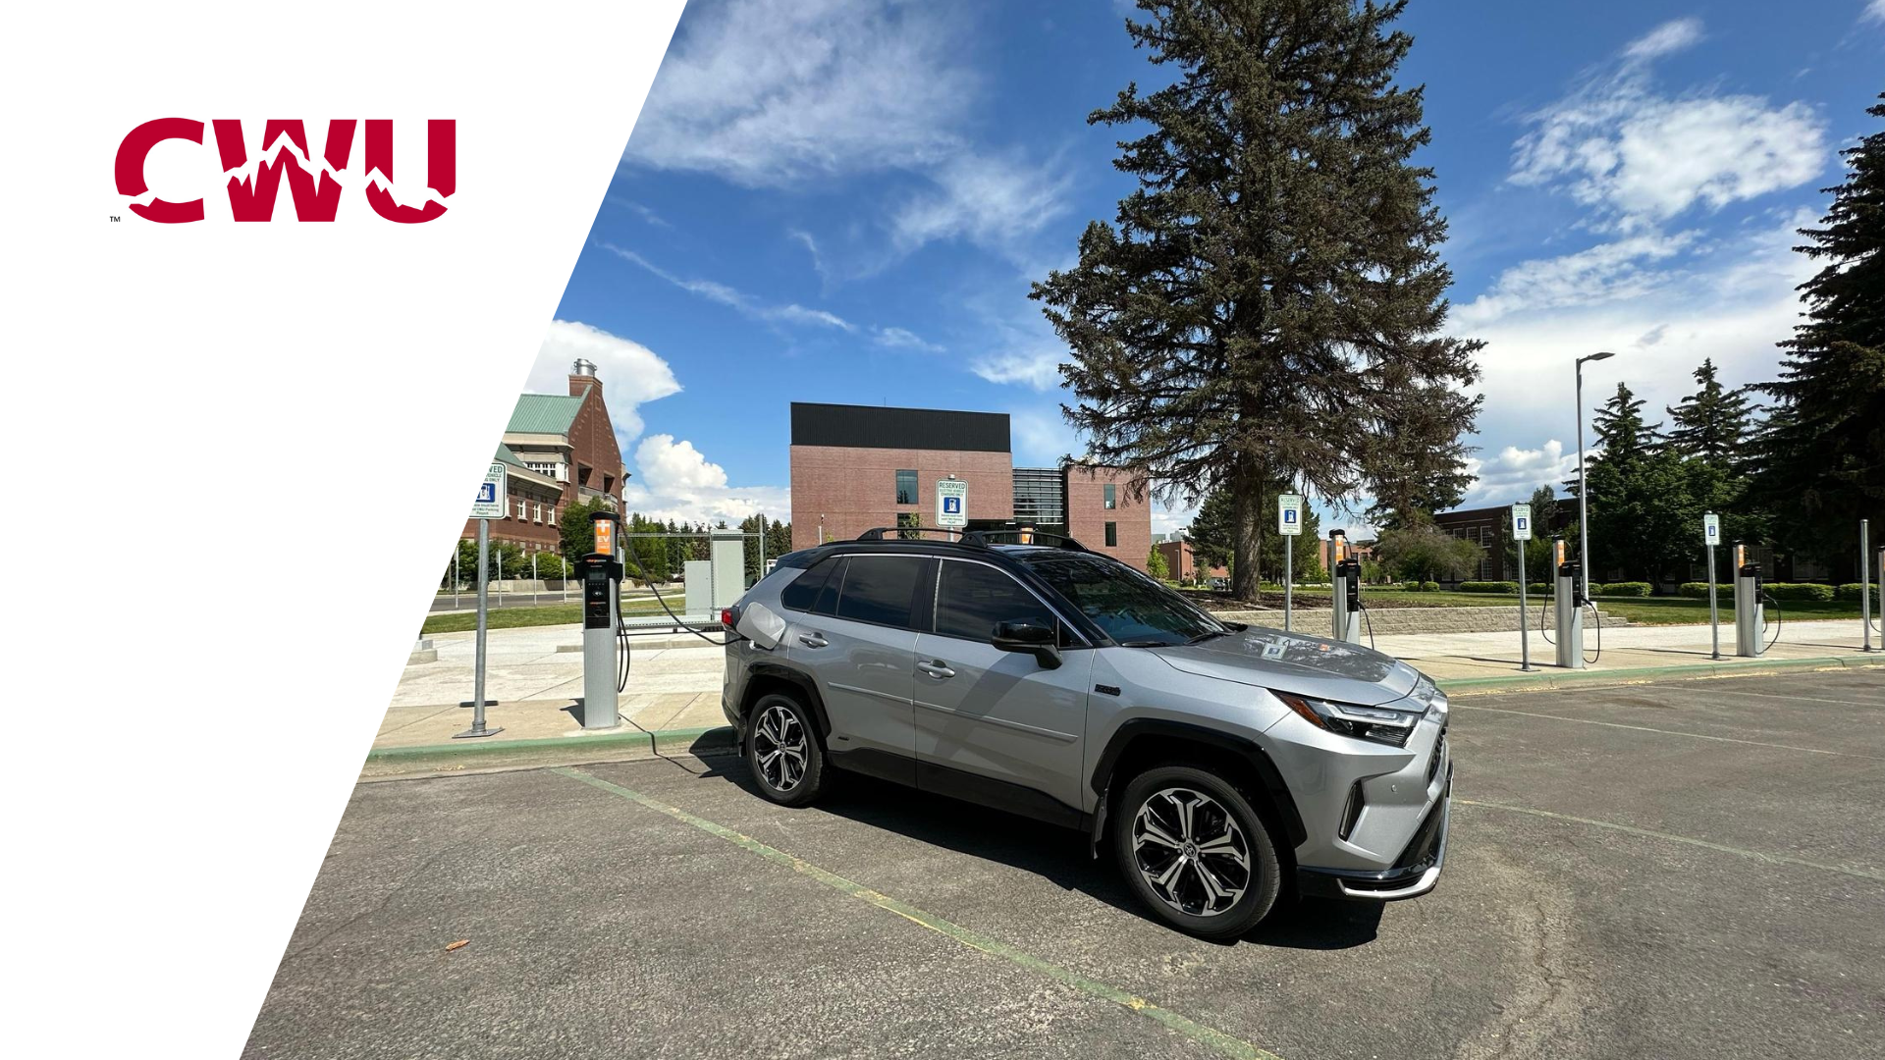
Electric Roll
Notes:
Julian

Slide 2
Agenda
Problem Statement
What is it CWU is trying to solve?
Alternatives
3 alternatives, 3 different timelines
Decision Criteria
How we scored the alternatives
Recommendation
Alternative we recommend to CWU
Questions?
Notes:
Julian

Slide 3
CWU Mission
In order to build a community of equity and belonging, Central Washington University nurtures culturally sustaining practices that expand access and success to all students. We are committed to fostering high impact practices, sustainability, and authentic community partnerships that are grounded in meaningful relationships.
Notes:
Julian

Slide 4
Problem Statement
To meet its climate action goals and be eligible for upcoming grant funding, CWU needs a plan for installing electric vehicle chargers (EVCs) at its Ellensburg campus.
Notes:
Julian

Slide 5
Alternatives
 | # of Locations | # of Chargers/Location | Timeline
Alternative 1 | 1 | 6 dual-heads | 1-2 years
Alternative 2 | 2 | 3 dual-heads | 2-3 years
Alternative 3 | 3 | 2 dual-heads | 3+ years
Notes:
Rachel
As you may have noticed, we opted for dual-head chargers. As of now Central does not have any dual-head chargers on campus but the benefits are astonishing.
20% more expensive but you get double the charging capacity.
You also may notice that our alternatives have longer roll-out plans. Slower roll out gives EV charging technology time to evolve. Allows for demand to catch up with supply, also known as the equilibrium point. This also central to leverage resources like time and money, which is good situation for CWU to be.
'Arbitrage'

Slide 6
Alternative 1
1 Location – 6 Dual Headed Chargers
1-2 Year Rollout
Notes:
Rachel

Slide 7
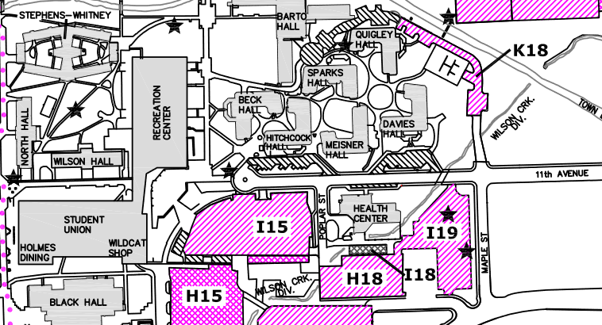

Location: SURC
6 level 2 dual-head Electric Vehicle Chargers (EVC) in I-15
Charging Station Land Use: 480 sq ft to 590 sq ft
- Note: includes ADA spaces
Notes:
Rachel
Our first alternative is to consider installing six dual-head chargers all within one or two years by the Student Union & Recreation Center in parking lot I-15. It should be noted that ADA spaces are included in this plan for equal access to these chargers.
The SURC is the largest building on the Central Washington University campus. It is centrally located with easy access to parking lots, like lot I-15 where we would install these chargers, as well as primary city streets, academic buildings, and residence halls.

Slide 8
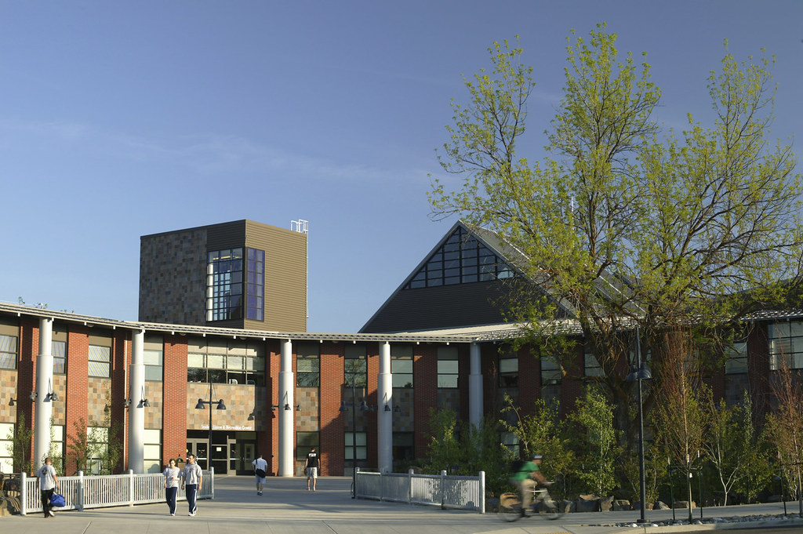
Why the SURC?
Why?
Frequent traffic from students, faculty, and community members
Versatile space encouraging diverse events and audiences
Lack of chargers on this side of campus
Notes:
Rachel
In addition to its size and location, the SURC serves as a versatile space where students, faculty, and community members all come together. Additionally, this side of campus lacks any EV infrastructure and could really benefit from these six dual head chargers.
The SURC provides accessibility, ample parking space, and sufficient capacity in the area. Installing electric vehicle charging (EVC) stations not only addresses the diverse needs of students, faculty, families, and visitors but also holds immense amounts of potential in contributing to the university's climate action goals.
Over the next few slides, Michael will discuss why spreading out the chargers between the SURC and another location might be beneficial.

Slide 9
Alternative 2
2 Locations – 3 Dual Headed Chargers Each
2-3 Year Rollout
Notes:
Michael
Thank you Rachel, With this alternative, we decided to place 3 Dual head chargers in two locations with a timeframe of 2-3 years.

Slide 10
Location 1: SURC
3 dual-head Electric Vehicle Chargers (EVC) in I-15
Charging Station Land Use: 240 sq ft to 295 sq ft
- Note: includes ADA spaces
Timeline: 2-3 year rollout
Notes:
Michael
Rachel did a great job highlighting how the SURC is a great location for dual head EV Chargers. However, we thought it might be better to spread the chargers around campus, to ensure that everyone has a chance to recharge.

Slide 11
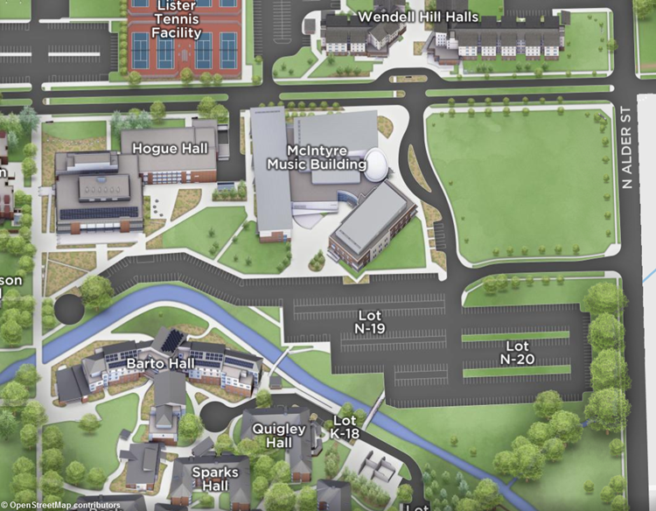
Location 2
McIntyre Music Building
3 dual headed chargers in parking lot N-19
McIntyre Music Building has approx. 294 standard and 12 ADA spots (12,420 sq ft).
Frequent events where out-of-town visitors fill the 600-seating concert hall
Range: 240 sq ft to 295 sq ft
Timeline: 2-3 year rollout
Notes:
Michael:
The Music hall is a great secondary location for this project, as it is a popular location for students, as well as parents and out of towners when they stop in for a recital or play.
We believe that parking lot Parking lot N-19 will be the best spot to locate the new chargers including an ADA accessible spot. After enjoying your show, you can drive off with a charged battery without any downtime.

Slide 12
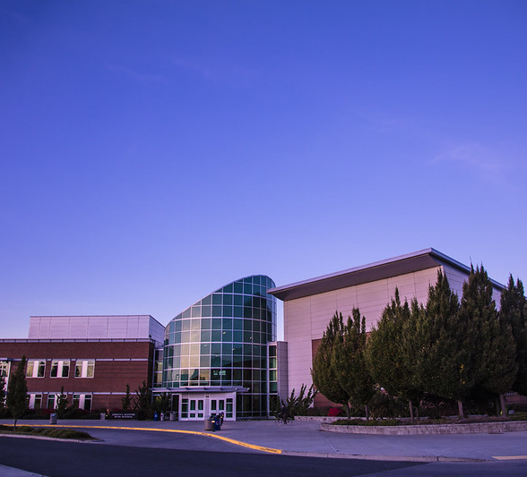
Why the McIntyre Music Building?
Recitals, concerts, auditions attract the community
Year-round events
Notes:
Michael
According the official CWU Music Building Performance schedule, CWU will have completed 46 event days, often averaging more than one show a day, just in Fall quarter of 2023. This alone will attract students, parents, faculty, and community members. The music program is a huge attraction to the school, and would be a great on campus location to house EV chargers for the Ellensburg area. Solomon will now introduce Alternative 3.

Slide 13
Alternative 3
3 Locations – 2 Dual Headed Chargers Each
3+ Year Rollout
Notes:
Solomon

Slide 14
Location 1: SURC
2 level 2 dual-head Electric Vehicle Chargers (EVC) in I-15
Charging Station Land Use: 240 sq ft to 295 sq ft
- Note: includes ADA spaces
Timeline: 3+ year rollout
Notes:
Solomon

Slide 15
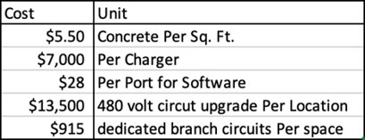
Location 2:
McIntyre Music Building
2 dual headed chargers in parking lot N-19
McIntyre Music Building has approx. 294 standard and 12 ADA spots (12,420 sq ft).
Frequent events where out-of-town visitors fill the 600-seating concert hall
Range: 240 sq ft to 295 sq ft
Timeline: 3+ year rollout
Notes:
Solomon

Slide 16
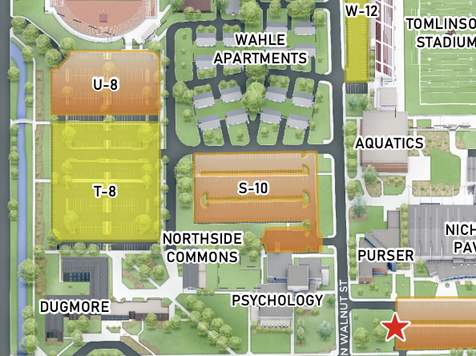
Location 3: Psychology Building
2 level 2 dual-head Electric Vehicle Chargers (EVC) in S-10
The Psych Building is next to the student village
204 total parking lots
- Note: includes ADA spaces
Timeline: 3+ year rollout
Notes:
Solomon

Slide 17
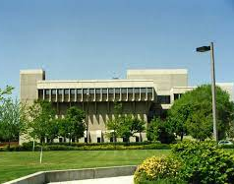
Why the Psych Building?
The Psych Parking lot is close to Tomilson Stadium, the Recreation Sports Complex and student housing at Whale complex
Chargers will be accessible to visitors at the stadium during sport events, students living in housing and those attending events at the Sports Complex
Notes:
Solomon

Slide 18
Decision Criteria
Resource Usage
Equity and Ethics
Return of Investment
Notes:
Fernando

Slide 19
Decision Criteria #1
Resource Usage: 25%
Physical Space
Energy
Each dual head charger occupies 2 parking spaces
Each lot with chargers should designate 1 parking space with ADA accessibility
Standard parking space under WA State regulations is 8' x 5'
All chargers in the given alternatives will be Level 2 chargers
Each dual head charger uses 208V of electricity (104V per parking space)
Total of 1,248V of electricity per alternative
Diverting power to separate locations deemed not significant
Notes:
Fernando

Slide 20
Decision Criteria #2
Equity and Ethics: 35%
The Price of EVs
New Clean Vehicle Credit
Cheapest EV after tax credit: $19,995
$7,500.00 new clean vehicle credit
Economies of Scale
What is our market?
Demand trending up, price going down
Students, faculty, visitors
Notes:
Luke
The Price of EVs: cheapest in 2023
Economies of Scales: As demand and technologies increase, the price will go down.
New Clean Vehicle Credit: Starting in January 2024, EV buyers can use the $7,500 credit directly to the car dealership.
EV Battery Price Trends: Currently $160/kWh, $80/kWh by 2025. - Affordable EVs

Slide 21
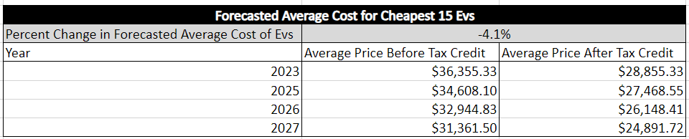
Decision Criteria #2 cont.
Notes:
Luke

Slide 22
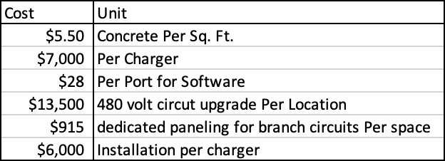
Decision Criteria #3
Return of Investment: 40%
Pricing
Costs
Electrical Services
Table 1.3
*These are national averages without consultation from a contractor. Costs may change based on location, time of year, demand, and availability.
Notes:
Hinako:
Pricing: Depends on the brand and type. Level 2 EV Charger: $6,000-$8,000. Installation: $2000-$10,000/charger
Costs: Table
Electrical Services: The price of electricity will be the greatest and most significant cost in the total cost estimate. If there are multiple locations of electric vehicle parking spots, there will be multiple main power circuits. If all electric vehicles are in one location, there will only be one main power circuit, and therefore a decrease in total cost.
Power Circuit Upgrade Cost: $12,000-$15,000
Dedicated Branch Circuits Cost: $870-$960

Slide 23
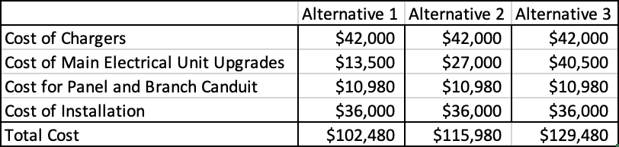
Decision Criteria #3 cont.
Estimated total upfront cost calculated as ROI
*These are cost estimates based on the current research found by the ITAM cohort. Complete cost estimates will need extensive additional research that is outside the scope of this study.
Table X.2
Notes:
Hinako

Slide 24
Resource Usage Scoring (25%)
How much space will the EVCs occupy in each respective parking lot?
Alternative 1 (3.8%) : 1 point
Alternative 2 (2.2%) : 2 points
Alternative 3 (1.9%) : 3 points
Score | Percentage
1 | 3% or Higher
2 | 2% - 3%
3 | 1% - 2%

Slide 25
Equity & Ethics Scoring (35%)
Expected cost of affordable EV’s within our alternative timeline
Score | Forecasted Price of Affordable EV’s
1 | $30,000 +
2 | $25,000 - $30,000
3 | $20,000 - $25,000
Alternative 1 (1-2 years) : 2 points
Alternative 2 (2-3 years) : 2 points
Alternative 3 (3+ years) : 3 points

Slide 26
Return of Investment Scoring (40%)
How much we expect the EVC’s and their installation to cost
Score | Total Cost Estimate
1 | $120,000 – $130,000
2 | $110,000 – $120,000
3 | $100,000 – $110,000
Alternative 1 ($102,480) : 3 points
Alternative 2 ($115,980) : 2 points
Alternative 3 ($129,480) : 1 point

Slide 27
Our Recommendation
Alternative 3
3 Locations – 2 Dual Headed Chargers
3+ Year Rollout
Notes:
Luke

Slide 28
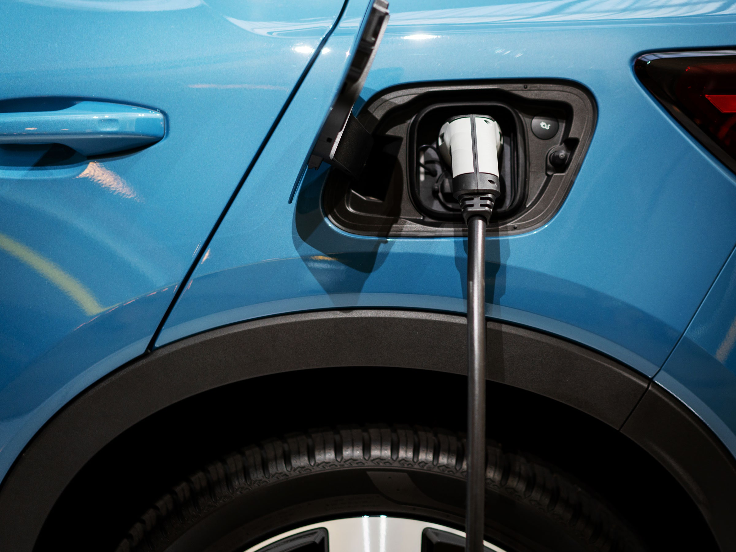
Why Alternative 3?
Gives the university the most time (3+ years)
Possibility of new technology in coming years (lower EVC costs, faster charging)
Electric vehicle prices continue to fall; demand expected to increase
Conserves space (maximum of 215 sq ft in each of the 3 parking lots)
Notes:
Luke V

Slide 29
Questions?
Notes:
Paper team lead researcher taylor

Slide 30
Thank you Jeff for giving us this research opportunity!
Notes:
taylor

Slide 31
Notes:
taylor

