Slide 1
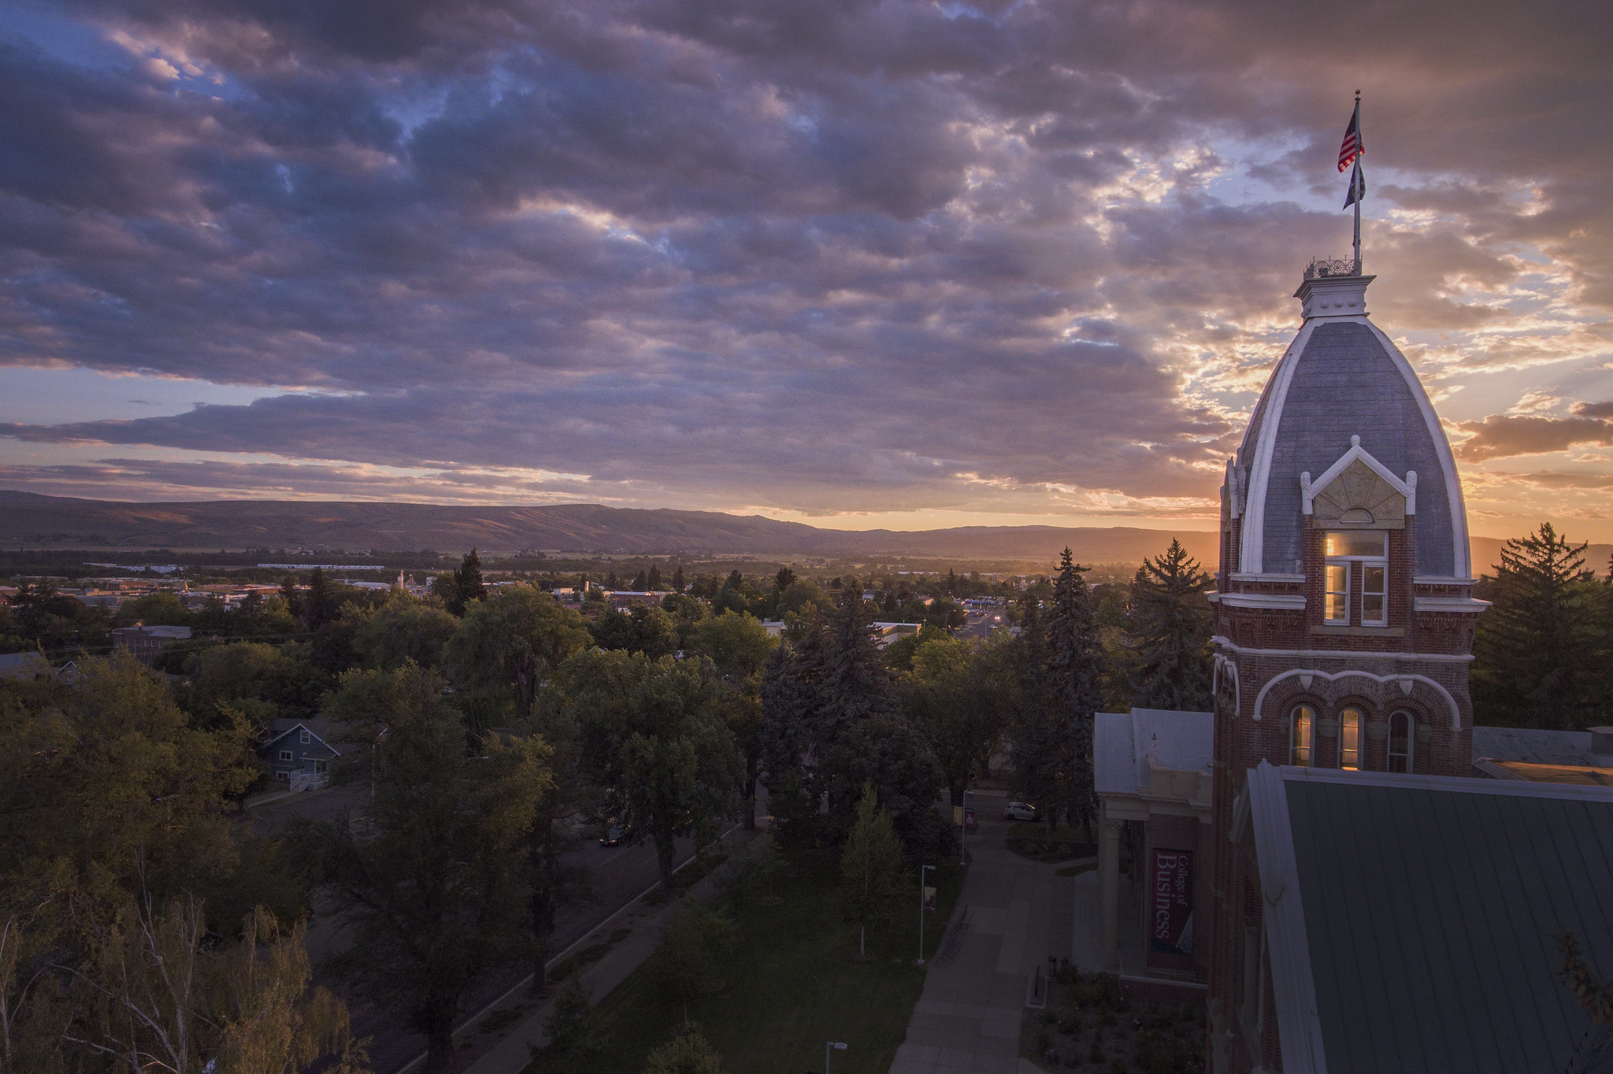
Micromobility: Considerations for Maintaining CWU’s Climate Change Commitments
ADMG 501, Fall 2024
Notes:
[Potential Sponsor A], [Potential Sponsor B], Jeff: Thank you for reaching out to our class regarding CWU’s climate commitments and implementing a micromobility program on CWU’s Ellensburg campus. {SLIDE}

Slide 2
Introduction
Climate change is an ever-present issue that faces humanity.
A key method for CWU to reduce its negative impact on climate change is to reduce the carbon emissions produced by students commuting to, from, and within the Ellensburg campus.
.
Notes:
While students need to commute to and from campus, there is room to reduce the amount of intracampus commuting that occurs. By implementing micromobility measures and programs that utilize the EPA’s Community Change Grant, CWU can reduce its overall negative effect on climate change. {SLIDE}

Slide 3

Problem Statement
What kind of Ellensburg Campus micromobility program can best help CWU meet its emission reduction commitments?
Notes:
This leads us to ask: what kind of Ellensburg campus micromobility program can best help CWU meet its emissions reduction commitments? {SLIDE}

Slide 4



Current Standards
Through a combination of Administrative Codes, Washington State has taken significant steps towards defining the relevant and allowable terminology public institutions must use when discussing or implementing micromobility.
WAC Title 478:
A compact device for personal mobility which is not considered a vehicle. Including but not limited to roller skates, scooters, bikes, and skateboards.
Electric Personal Assistive Mobility Device (EPAMD):
A device fitting the description of a micromobility device that is powered by a motor.
Additional Notes:
Devices must not exceed a top speed of 20/mph
Must weigh less than 100lbs.
Notes:
To help identify the most practical solutions for micromobility implementation it’s important to understand the existing standards that define such infrastructure for public institutions. At present that includes Washington Administrative Code and procedures for all public agencies, including universities. The primary standard is defined in WAC Title 478 and subsections. Other code not reflected here might include policies and procedures for revisions to traffic flow and public access. It’s important to understand, internalize and adhere to these standards when seeking public funding and when developing implementation to best protect CWU from legal and financial risk and to promote a productive, compliant environment for all users.

Slide 5
Peer Institutions
For their part, peer institutions have taken multiple approaches toward implementing infrastructure.
University of Washington:
Vendor agreement with Lime
&
Uwild “U BIKE” long term bike rentals, weekly and quarterly at a set price.
Washington State University:
Partnered with Pullman to provide 100 escooters and 50 ebikes to campus.
Devices are available at a $1/rental and $0.29/minute fee.
Oregon State University:
Partnered with vendor Veo providing ebikes and seated scooters which are more accessible.
Devices utilize geo-fencing feature.
WWU & EWU:
No implementation.
Users are encouraged to bring their own devices and to utilize registration to prevent theft.
Joint Taskforces:
Motivated and unmotivated users report investment in proper infrastructure like bike lanes as the most important issue.
Some users deterred by bad weather or terrain will become motivated after positive experiences with the device.
Notes:
For their part, a number of institutions in the state and in the region have taken different, individualized approaches to implementing micromobility on campus.

Slide 6
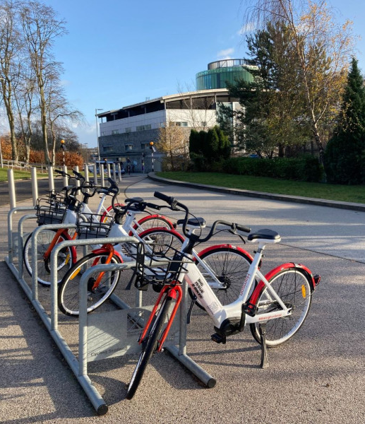
Survey of Needs
Of 34 respondents, a simple majority responded they are inclined to use eBikes & eScooters over other micromobility options.
The primary disincentivizing factors are Safety, Cost, and Weather
“Would having more micromobility options encourage you to leave your car at home…?”
  Yes: 25
  Maybe: 5
  No: 2*
  *These respondents also indicated they are not students

Slide 7
Measures of Carbon Emission
Direct Vehicle Costs
Indirect Vehicle Costs
 | Cost Per Mile ($USD)
Fuel Cost | $0.18
Depreciation | $0.11
Maintenance | $0.10
Insurance | $0.15
Parking Pass | $0.02
Total Direct Cost | $0.56
 | Cost Per Mile ($USD)
Social Cost of Carbon | $0.08
Health Benefits | $0.05
Total Indirect Cost | $0.13
Total Cost Per Mile: $0.69
Notes:
Social Cost of Carbon: Represents the economic damages caused by vehicle emissions.
Health Benefits Foregone: Represents lost benefits of active transportation, like walking or biking.

Slide 8





Ethical Challenges
For micromobility program at Central Washington University to be effective, ethical challenges that must be addressed.
Equitable Access:
Designing solutions that cater to all students, faculty and staff including those with disabilities or without smartphones.
Affordability:
Ensuring that the costs remains accessible to low-income users.
Accessibility for Individuals with Disabilities:
Providing devices and infrastructure that accommodate all abilities.
Environmental Justice:
Avoiding unintended environmental burdens from batteries or energy use.
Infrastructural Disparity:
Addressing unequal access to bike lanes or parking spaces across the campus.
Notes:
We need to acknowledge a wide range of users with differing interests. Although we all share a common goal of reducing carbon emissions, the methods to achieve this can vary significantly.

Slide 9




Ethical Solutions
To ensure equitable access on the Ellensburg campus, implementing practical solutions is essential
Spatial:
Effective micromobility design should eliminate spatial barriers in order to encourage student use.
Physical:
Any program should prioritize accessibility for individuals with disabilities and consider physical differences such as height and strength.
Technology:
Options for non-smartphone access should be available.
Attention to visual design is important for inclusivity, especially for color-blind users.
Cost:
To promote micromobility among students, faculty, and staff pricing should be reasonable.
Notes:
Despite the rapid growth in the number of micromobility programs, many residents still lack access to these services (Aman et al., 2021).
Spatial: For example, placing devices only at the south end of the campus could limit access for residents of Northside Commons. In addition, stations should be located in visible and safe areas, complemented by clear signage such as banners and flags.
Physical: Providing options like seated scooters, tricycles, semi-recumbent bikes, and hand cycles can enhance accessibility for individuals with disabilities. This approach would add a personal touch to the program while improving user safety and overall experience.
Tech: The application used for the micromobility program should be compatible with both iOS and Android platforms to accommodate the diverse preferences of users. Additionally, it should be designed to minimize battery usage on users' phones.
Cost: As Lucas et al. (2016) highlight, affordability is a significant barrier to accessing transportation. Minimizing financial burdens on users is essential for justifying investments in micromobility. Therefore, fees should be well-considered to support users' accessibility while also facilitating the program’s goals.

Slide 10
Legal Issues
Navigating liability, regulations, and requirements
User Agreement
Eligibility, safety, orientation, proper usage, user liability, data and metrics, fees and penalties.
Liability
Insurance may depend on ownership of devices. Adding a device usage policy covers general issues.
Regulations
CWU must be compliant with existing determinations and regulations, ensure that users are compliant.
Administrative Code
Wash. Admin. Code § 504-15-930

Slide 11
Operational Issues
Acknowledging the wide range of users with differing interests
Existing Infrastructure
Dedicated lanes for micromobility devices are essential.
Helmets can be provided to enhance the comfort and ensure safety of users.
Traffic Flow
EPAMD include speed control functions and geofencing options.
Such systems enable speed regulation in congested or unallowed areas during peak times.
Difficult Terrain
eBikes and eScooters reduce the dissuasion of difficult terrain.
Unmotivated users indicate a willingness to overcome with positive device experiences.
Cold Weather
The infrastructure necessary for charging should be examined.
Battery life expectancy can be impacted by the temperature of device operation.
Storage & Parking
Users appreciate parking assistance.
Knowing that there is a convenient space to park a bike upon arrival can encourage use.
Notes:
By implementing these measures, we can create a safer and more enjoyable environment for campus residents.

Slide 12
Identifying Alternatives and Evaluation Criteria

Slide 13



Alternative #1: Per-Use Rentals
Supports CWU’s emissions reduction commitments by providing an environmentally friendly and convenient micromobility option to all users
Key Features
Utilizes a network of strategically placed docking stations (SURC, dorms, etc.)
Can include bike, scooters, and other devices to accommodate user needs.
Potential to be powered by renewable energy.
Benefits
Reduces reliance on cars.
Enhances campus mobility.
Promotes inclusivity through diversity of options.
Provides broad infrastructure, including with the City of Ellensburg to benefit the community.
Challenges
Designing the network of docking stations is demanding.
Reduced usage during harsh weather.
Managerial issues like preventing theft, misuse, and vandalism.

Slide 14

Alternative #2: Long-Term Rentals
Offering long term micromobility rental can increase user commitment through subscription models and solve issues related to single use activation while ensuring availability.
Key Features
Modeled after UW’s U Bike weekly and quarterly rental system.
Includes encouraging users to attend classes and seminars focused on sustainability’s improvements to their lives.
Benefits
Lessens parking issues.
Mass inventory purchase and diversity of devices.
Provides complete campus ownership: management, repair, etc.
Focuses more on renter responsibility.
Challenges
May turn off one-time users.
Storage issues.
Ongoing staffing, utility, maintenance expenses and unseen costs.

Slide 15

Alternative #3: Pedestrian Improvements
Recentering CWU’s commitment to foot traffic helps incentivize carbon reduction.
Key Features
Wider walkways for comfort and traffic flow including designated bike lanes.
Covered pathways.
Lighting and signage.
Benefits
Incentivizes walking, reducing emissions naturally.
Encourages year-round physical activity.
Covers and weather resistance prevent safety issues.
Provides infrastructure for other sustainability initiatives such as solar panels.
Challenges
High initial cost.
Unknown ongoing maintenance requirements.
Requires significant planning and changes to campus footprint.

Slide 16
Criteria #1: User Desirability (50%)
Measure: % of a peer institutional rate
Ideal
Exact peer institution ratio match
Acceptable
80%+ of peer ratio
Unacceptable
Less than 80% of peer ratio
Notes:
Currently we are looking at WSU as our peer institution, looking at their adoption rate and scaling it to match CWU. What we believe will be the adoption rate, and measured after 3 years of implantation to validate these numbers.

Slide 17
Criteria #2: Comprehensive Cost (30%)
Measure: % of grant award usage
Ideal
Use of up to full grant amount
Acceptable
Usage of full grant + 10%
Unacceptable
Usage of full grant + more than 10%
Notes:
We would welcome feedback from [Jeff] if these numbers should be adjusted, at this time these are the figures we believe would be acceptable. If [Jeff or CWU] believe we can or will be required to match or no overage is acceptable we can adjust.

Slide 18
Criteria #3: Time to Implementation (20%)
Measure: time to full implementation.
Ideal
3 years
Acceptable
4 years
Unacceptable
5+ years
Notes:
Will the project help CWU meet the goal of 2030, and if the grant has any requirements we will need to take this into account,

Slide 19
Acknowledgement: Criteria #4 (?%)
Measuring Ease of implementation and ongoing management
Notes:
We would like to acknowledge the fact that ease of management and where the program will be managed and operated. This however is difficult to quantify and put into a numeral score. CWU will need to make special considerations related to the chosen alternative.

Slide 20
Decision Analysis
 | Criteria #1: User Desirability (50%) | Criteria #2: Comprehensive Cost (30%) | Criteria #3: Time to Implementation (20%)
Alternative #1: Per-Use Rentals | Ideal | Ideal | Ideal
Alternative #2: Long-Term Rentals | Acceptable | Ideal | Acceptable
Alternative #3: Pedestrian Improvements | Unacceptable | Ideal | Acceptable

Slide 21

Recommendation
This group recommends pursuing the
Per-Use Rental option
This solution meets the ideal threshold for all evaluation criteria:
High user adoption
Effective utilization of grant funds
Implemented within 3 years

Slide 22

Conclusion
Group analysis concludes the Per-Use rental agreement represents the most efficient means to meet the universities benchmark obligations.
Next steps:
Form a detailed implementation strategy
Initiate discussions with potential vendors (aiming to ratify delivery agreements that meet sustainability objectives)
Establish infrastructure developments with campus facilities management and the City of Ellensburg
Develop marketing material aimed at informing the campus / city community
A sustainable future is an ongoing obligation.

