Slide 1

Frequently Asked Questions
Presented by: Zane Morrison

Slide 2
Purpose
You are often the first point of contact with your students and their parents/guardians
We want you to walk away confident that you can provide your students/parents with accurate CWU information pertaining to College in the High School
Or at a minimum, you can come away knowing where to direct your students and parents when they have questions
Notes:
As instructors/administrators, often you are the first point of contact your students and their parents/guardians have to information regarding CWU College in the High School. Your students are parents/guardians know you and feel more comfortable asking you questions pertaining to our program.
While we don’t expect you to have all the answers, we want to provide you with accurate information regarding our program so that you can come away from this presentation confident that you answer most questions pertaining to our program. Or at the very least, you can direct them to the right places.
We’ll walk through the most asked questions our team receives from students and parents and how to answer them.

Slide 3
Discussion
What do you think are the most frequently asked questions we receive from:
  Your students?
  Your students’ parents/guardians?
Notes:
5 Min Discussion

Slide 4
Most Frequently Asked Questions
Questions from Students
Questions from Parents
How do I register?
Do I have a CiHS or MyCWU account?
Can you provide me with my CiHS/MyCWU credentials?
How do I sign into MyCWU?
How do I request my CWU transcript?
How does my student register?
How can I provide my parent/guardian consent?
How do I access my student’s CWU records?
What is the cost for my student to participate?
Are CWU credits transferable?
Notes:
As you can see, there’s quite a bit of overlap between what questions we are asked from students and what questions we are asked from Parents.
Often times, parents ask us the same questions students do on behalf of their own students.

Slide 5
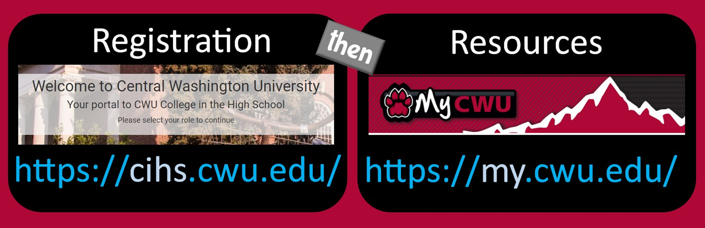
Common Point of Confusion
CWU CiHS students will have two separate accounts with two separate log in credentials
Notes:
A common point of confusion that we often must explain to students and parents is that students will have two separate account credentials. It’s important for students and their parents to know the differences and uses for both accounts.
CiHS.CWU.EDU is only used for registration and students must use this site to register each term.. Students will create this account first using their personal email address and password.
MyCWU account is created after students have signed up through CIHS. MyCWU is the student’s official CWU account will be used for everything else as it is the key for students to access resources, check grades, request their transcripts, Student evaluation of instruction (SEOI) etc.

Slide 6
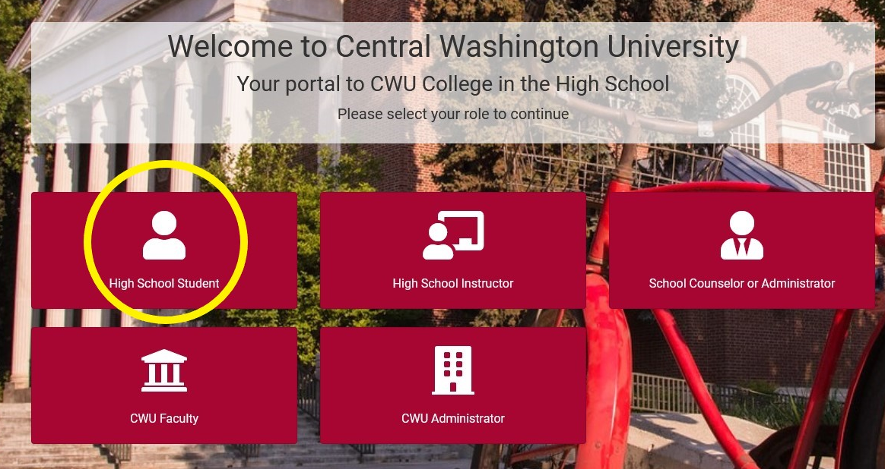
How to register for CWU CiHS Courses
Registration portal: https://cihs.cwu.edu
1.
Students will go to registration portal and click the “High School Student” tile
Notes:
Our registration period or the time students must register are very specific.
Registration period including registration deadlines are on page 13 of your packet.
The screenshot on the right-hand side is what CiHS portal home page looks like.
The first step students need to take is go to this website and click the high school student tile.

Slide 7
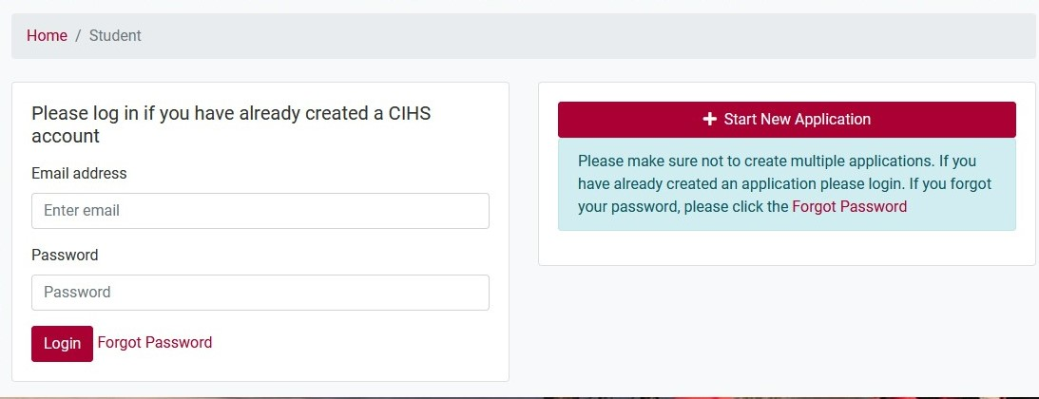
How to register for CWU CiHS Courses
2.
Students will either sign into CiHS account or create new account
Notes:
This will bring up a sign in page as seen on this slide.
New students will create a CiHS account by clicking the “Start New Application button” circled in red. This will bring up a webform that the students will need to complete to provide us with their information.
Returning students will log in to their already existing CiHS account.
Students will not be able to start a new application if the registration period is not active.
CiHS account is created by the student with their own email and password. Remind them to keep this login information secure

Slide 8
Tips for Students creating their CIHS account
Students should use their legal first and last name
Have students take their time
  Students should always review their account information before submitting
  Beware of Autofill
Mailing Address
  PO BOX – If a student has one, they should use it
  Address Verification: https://www.smarty.com/products/single-address
Email Address
  Personal Email Address > School District Email
  iCloud emails
Notes:
Students should use their legal first and last name. This is because the information they enter to create their CiHS account will be used to create their official MyCWU account. We want to ensure that this data is accurate, so students do not run into issues requesting their official transcripts. If students have a preferred name, they will be able to update their official CWU account with that information.
Students should take their time when creating their account. They should always review it to make sure their information is accurate before they submit it to create their account.
Students who use chrome or a browser with autofill need to make sure that the student’s name and email address do not get auto-filled to their parent/guardian’s name and email.
Some items we’ve seen become issues are students will enter their parents name and then autofill will update the student’s first name to their parents.
Mailing address – Students need to enter the address where they receive their mail. If a student has a PO Box, they should put that down. Sometimes students have brand new homes or issues where it won’t accept the student’s account because their address cannot be verified. Smarty.com link is where students can enter in their mailing address, and it will give them results to determine why it’s not being verified.
Email address – Students should use their personal email address over school district email. This is because students may have difficulty recovering their MyCWU account if they use school district emails which typically deactivate after high school graduation. Icloud emails sometimes return to sender due to storage issues. Students can still use icloud but they need to make sure they have enough data to receive emails.

Slide 9
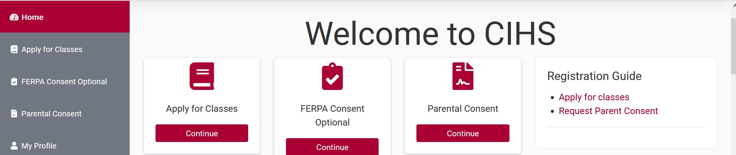
How to register for CWU CiHS Courses
3.
Click “Continue” under the Apply for Classes tile
Notes:
This image is a screenshot of the student’s homepage within their CiHS account. After a student has successfully created or logged into their account, this will be the first thing they see.
The next step they need to complete in order to register is click the “Apply for Classes” button.

Slide 10
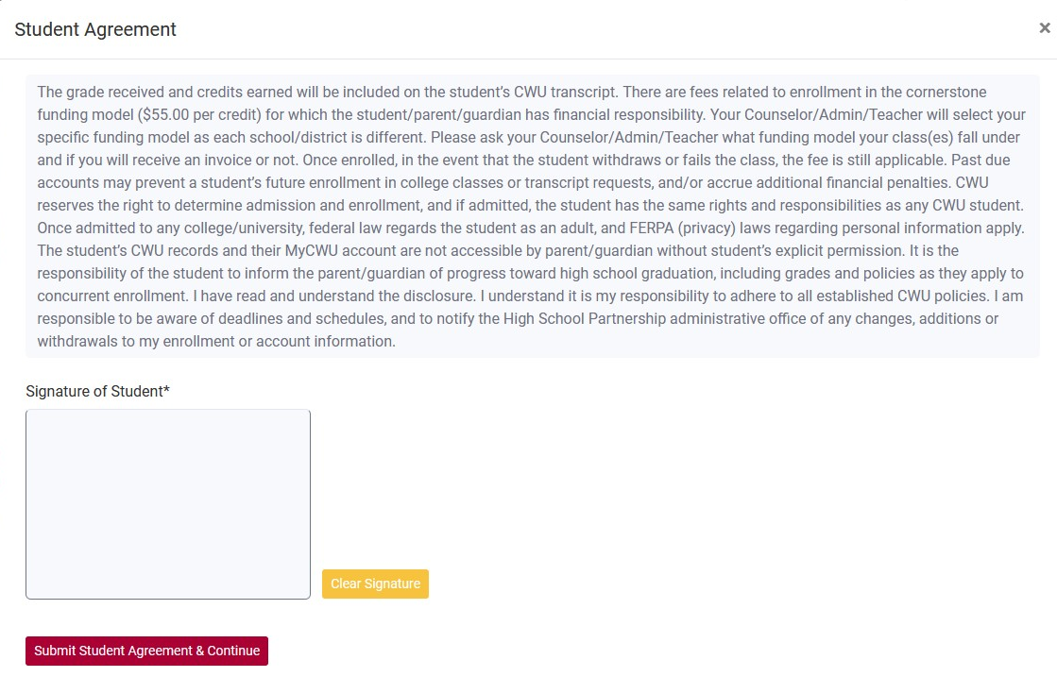
How to register for CWU CiHS Courses
4.
Student must complete and submit student agreement before applying for classes
Sample
Notes:
As soon as they click the “Apply for Classes” button, a student agreement pop up will appear. The student will need to read the agreement, provide their signature in the signature field, and click submit student agreement and continue before they can select their classes. Student’s will be asked to complete this agreement at the beginning of each registration cycle. Note that this is not the last part of the registration process.

Slide 11
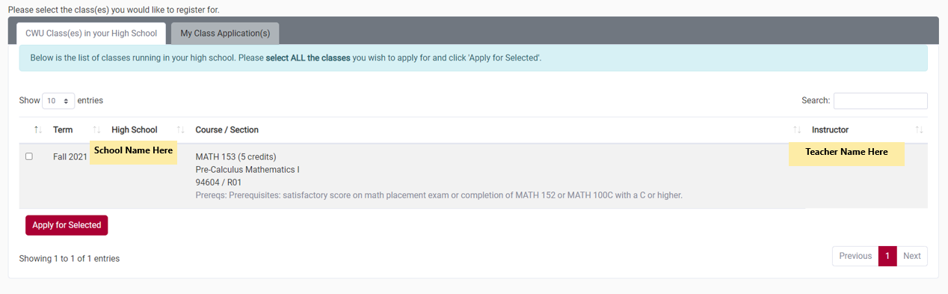
How to register for CWU CiHS Courses
5.
Student will select classes they wish to enroll and click “Apply for Selected”
☑
Click here
Notes:
After they’ve submitted their signed student agreement, a list of all the classes that are being offered at the student’s high school will appear. Students will then select the classes they wish to register and then click “Apply for Selected”.
The entire registration process is outlined on pages 16-22 in the Summer Institute packet
This step is the most common thing that students forget to do is click the Apply for Selected button.

Slide 12
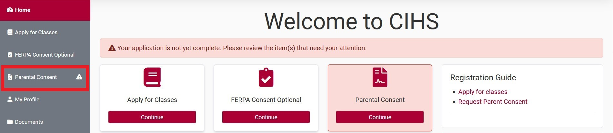
How to register for CWU CiHS Courses
6.
Student will need to receive parental consent to be enrolled in CWU CiHS Courses
Notes:
This screenshot will show from the student dashboard that the student’s application is incomplete.
There are two ways that parents can provide parental consent through our online portal. The first is that the student’s parent/guardian will receive periodic parental consent emails from our automated system which contains a link for the parent to provide their consent
The other method is the parent/guardian can sign this directly from the student’s account by clicking continue under the parental consent tile or by clicking parental consent tab from the left navigation menu.

Slide 13
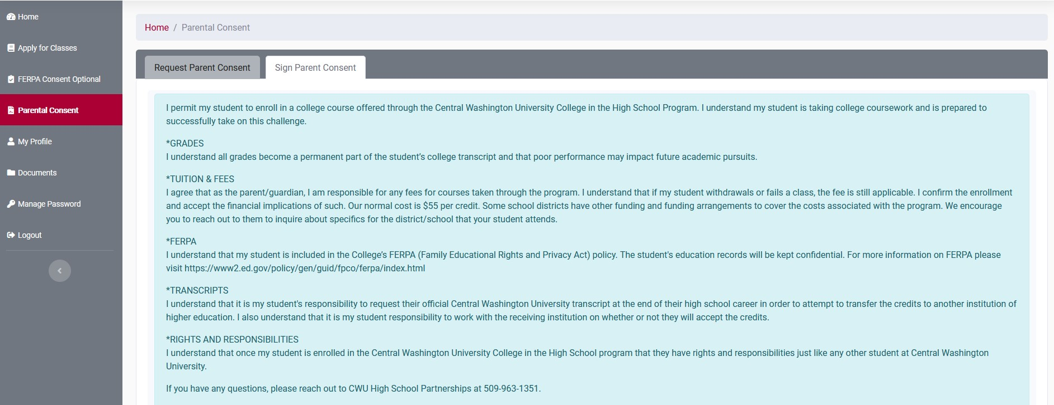
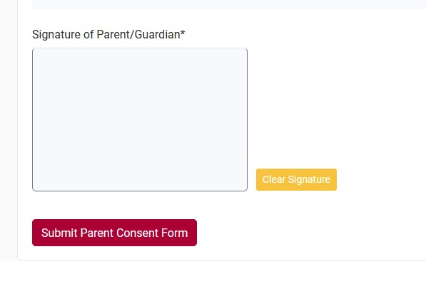
How do parents provide Parental Consent?
Sample
Notes:
This is what it will look like from their parent's end.
The Request Parent Consent tab will allow the student to re-send their parent/guardian their parental consent link.
The Sign Parent consent tab is where the parent can go from their students account where they can read the parent/guardian disclosure and sign electronically. We do pay attention to potential forgery on this as we want to ensure that the student’s parent/guardian fully understands that their student is creating a CWU transcript. Please ensure your students are not signing this.

Slide 14
How do parents provide Parental Consent? Cont.
Additional ways to parent/guardians can provide parental consent that are not through CiHS registration portal
Parents can complete one of our parental consent forms which can be found on https://www.cwu.edu/academics/specialized-programs/college-high-school/program-resources/forms.php
  & within Shared Documents tab in your CiHS portal
Parent/Guardian can call our office to give consent over the phone
  English Speakers may call: 509-963-1351
  Spanish Speakers may call: 509-963-1731
  Office hours: Monday – Friday 8 am to 5 pm.
Notes:
We do have additional methods for students to receive parental consent if technology is a barrier for the parent.
We have a parent consent form in both English and Spanish that the parent can complete. The parent/guardian consent forms must be given to your high school’s reviewer and uploaded into the student’s application on CiHS.CWU.EDU.
Parent/Guardians can call our office to provide their parental consent. English speakers may call our office at 509-963-1351 or they can call me directly at 509-963-1381. For primary Spanish speakers, they may call my colleague Alejandra Preciado

Slide 15

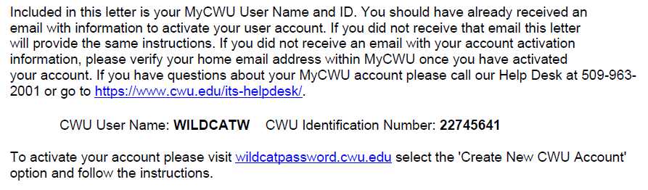
How do I sign into MyCWU?
All students receive an email and a physical letter containing their MyCWU credentials
my.cwu.edu
Notes:
Before students can sign in, they need to know their MyCWU Credentials. Students receive an email and a physical letter in the mail containing their MyCWU credentials (CWU username and CWU ID number)
Students should watch their inbox and mailboxes as these communications are only sent once
Students first need to activate their MyCWU account

Slide 16
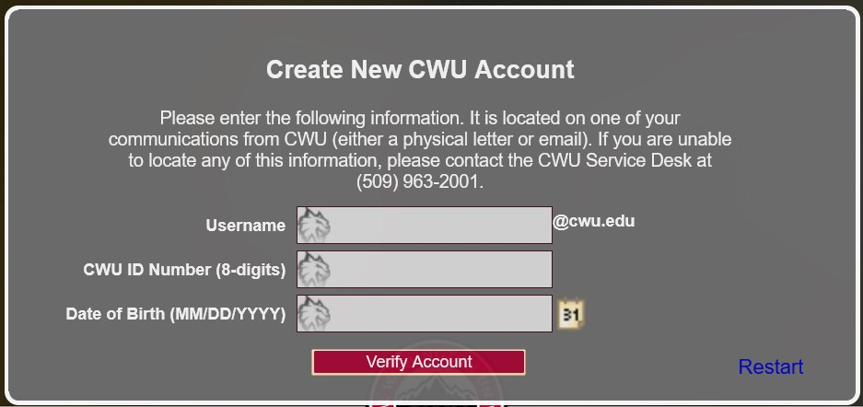
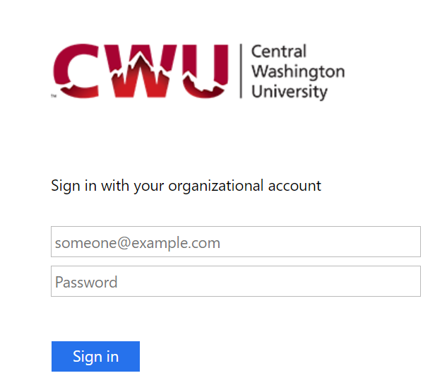
How do I sign in to MyCWU? Cont.
1.
To activate MyCWU account, students will go to: https://wildcatpassword.cwu.edu/
Student will go to MyCWU to sign in by entering their Username @cwu.edu email address and their password
2.
Notes:
Step 1: Once they go to Wildcat Password, they will select create new CWU account. From there, they will enter in their CWU username, CWU ID number, and their date of birth.
Once their account has been verified, the student will be able to set their MyCWU account password.
Please be aware that passwords expire every 180 days (6 months). Wildcatpassword site is where students will go to reset their password.
Step 2: Next the student will then need to sign into their MyCWU account by entering in their username + @cwu.edu and their newly created password.
.

Slide 17
MyCWU Notes
Multi-Factor Authentication (MFA)
  All CWU Faculty, Staff, & Students are required to use Multi-Factor Authentication (MFA)
  MFA set up guide can be found here: https://www.cwu.edu/about/offices/information-services/security-services/mfa/
  Go to https://wildcatpassword.cwu.edu/ to reset password
Student will need to contact the CWU Service Desk if they are unable to log in to their MyCWU account. They can be reached at:
  Phone: 509-963-2001
  Email: cwuservicedesk@cwu.edu
  Hours: Monday – Friday 7 am to 5 pm
Common Courtesy: Please make sure to call help desk when in a private, quiet location
Notes:
Students will be asked to set up MFA after their first-time signing into their MyCWU account. They will not be able to access their MyCWU account once their account has been enrolled in MFA.

Slide 18
How do parents access their student’s records?
Parents cannot access their students records without their student’s consent
Why? Family Educational Rights and Privacy Act (FERPA)
CWU can provide a parent/guardian with directory information
We cannot disclose information such as the students' grades, enrollment history, financial information, etc. without the student’s consent.
Solution: Student can complete a Release of Information which gives the student control over what records CWU can disclose to the student’s designated user
Notes:
This is a common question we are asked by parents. The reality is that we are very limited in the information we can share to student’s parents/guardians because of FERPA.
Once a student enrolls in a post secondary institution at any age, the rights to the student’s educational records transfer from the parents to belonging solely with the student.
We can provide parents with directory information, which is student information that would not be harmed if disclosed. However, we cannot disclose specific information such as the students' grades, enrollment history, financial information, etc. without the student’s consent.
Often, we receive phone calls from parents asking us to provide them with their students MyCWU credentials or they ask us if their student has been enrolled which we cannot answer.
Students can choose to add their parent/guardian as a designee to their MyCWU account.

Slide 19
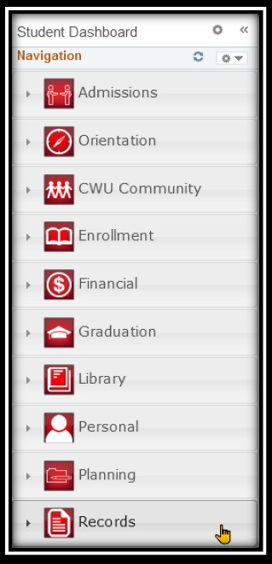
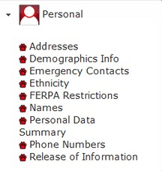


Release of Information Instructions
Students can complete Release of Information through their MyCWU account
1.
3.
4.
2.
Notes:
Step 1) Students sign into their MyCWU account.
Step 2) Once signed in, they will click the student tab pictured here which takes them to their student dashboard
Step 3) From the student dashboard, they will click the Personal tab which is located on the left-hand side of their screen.
Step 4) From the Personal tile, students will select Release of Information

Slide 20
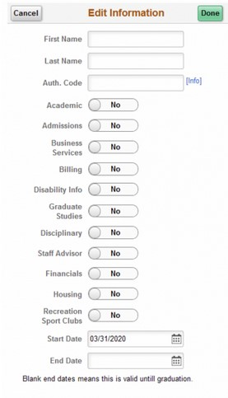
Release of Information Instructions
5.
Students will read Release of information disclosure and click “Add Designee” button at the bottom
Students will add their designee’s first and last name and enter five-digit authentication code of their choosing
Students will then select what information they wish to disclose to their parent/guardian
Lastly, they can enter a start and end date for access
Notes:
After they hit the release of information button, a disclosure will pop up informing the student about CWU’s FEPRA policy. They’ll need to read the disclosure and then click “Add Designee” button.
I have a handout that goes over these instructions that you can distribute to your students. Additionally, I can email this handout to anyone who wants it.

Slide 21
What is the cost for students to participate?
Two years ago, Senate Bill 5048 eliminated college in the high school fees for all public high school students
For students attending a private high school, courses will cost $60 per credit or $300 for a 5-credit class
CWU will not invoice the student or parent/guardian directly for CiHS course fees, we will invoice the high school/school district
CWU covers the costs of the Accuplacer Next Generation Math exam for schools who are Accuplacer testing locations. Saving of $15 per test.
Notes:
No cost for students who attend a public high school. No additional registration fees, tech fees, etc.
Private high schools, the cost is $60 per credit or $300 for a 5-credit class.
Due to the legislative changes, CWU will not longer be invoicing students who attend private high school’s, but we will be invoicing the high school/ school district directly.
CWU will be covering all Accuplacer Next Generation Math testing. CWU no longer covers the Accuplacer Next Gen Reading and Writeplacer exams due to the English Directed Self Placement exam.

Slide 22
Are CWU Credits Transferable?
CWU credits are highly transferable to both in-state and out-of-state institutions
Most institutions have transfer equivalency guides which will inform your student on how their CWU credits would be transfer to their institution of choice
https://docs.google.com/spreadsheets/d/1CmRZkfai2cw0ZmUHoquZjBywxandDV28/edit#gid=1180011737
Find that school’s Transfer Equivalency Guide
  If unsure, contact the institution of higher education your student is interested in attending
Notes:
Really important for the student to work with their receiving institution on how they will accept CWU credits as well as to do their own research.
Most common mistake is that students will forget to transfer their CWU credits

Slide 23
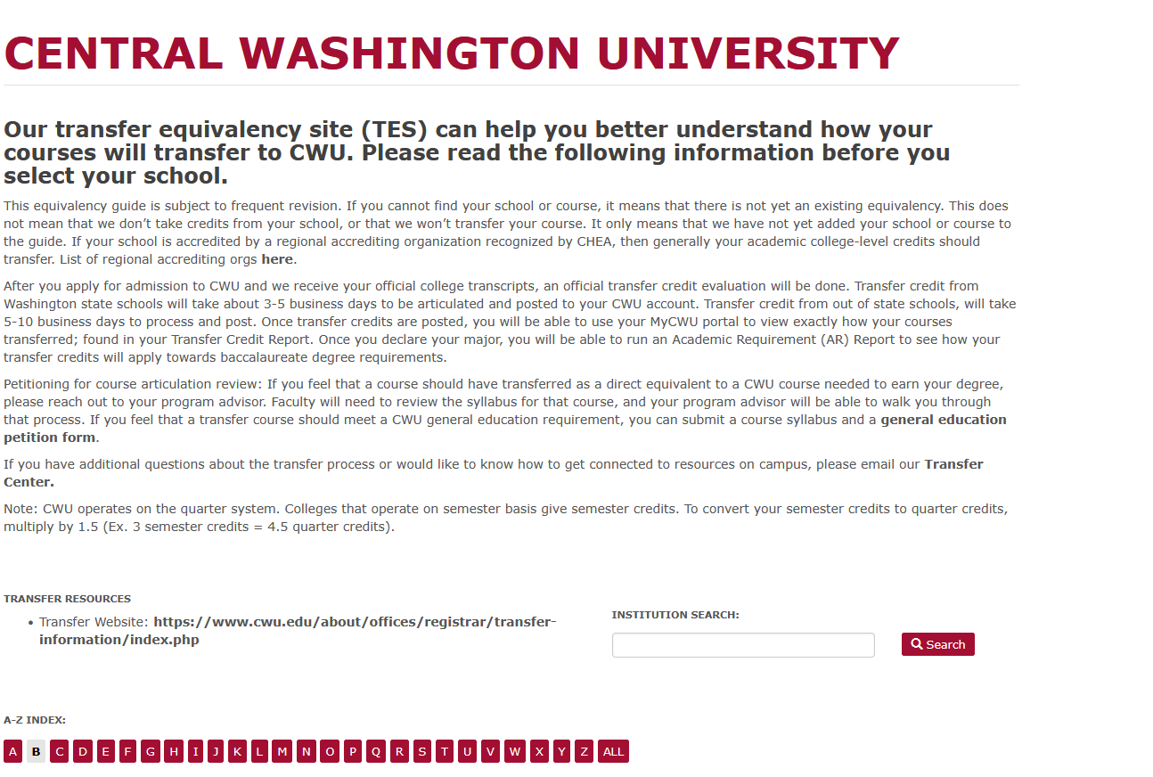
CWU’s Transfer Equivalency Page
https://tes.collegesource.com/publicview/TES_publicview01.aspx?rid=%7B747074CC-9C4D-477D-980B-529C4D6F9712%7D&aid=%7B1DE28702-DD7E-46F7-820F-7E0F873F2507%7D
Search by institution and can then search by that institutions course/class number to find how that course would transfer to CWU
Can do the same thing by looking up if courses offered at your school have been transferred to different intuitions of higher education

Slide 24
Most Common Mistake Students Make
The number one reason why student’s CiHS credits do not transfer is because the student does not request their official CWU transcript to be sent to the institution of higher education the student plans to attend post high school
Solution: We are going to inform you all how student’s can request their official CWU transcripts

Slide 25
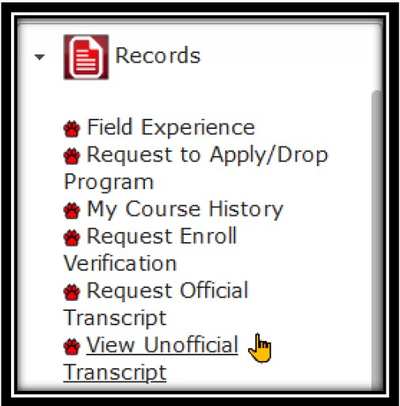
How do I request my official CWU transcript?
Students can request their official transcript through their MyCWU account
1.
3.
4.
2.
Notes:
Step 1) Students sign into their MyCWU account.
Step 2) Once signed in, they will click the student tab pictured here which takes them to their student dashboard
Step 3) From the student dashboard, they will click the records tab which is located on the left-hand side of their screen.
Step 4) From the records tile, students can select to view either their unofficial transcript, or they can request their official transcript.

Slide 26
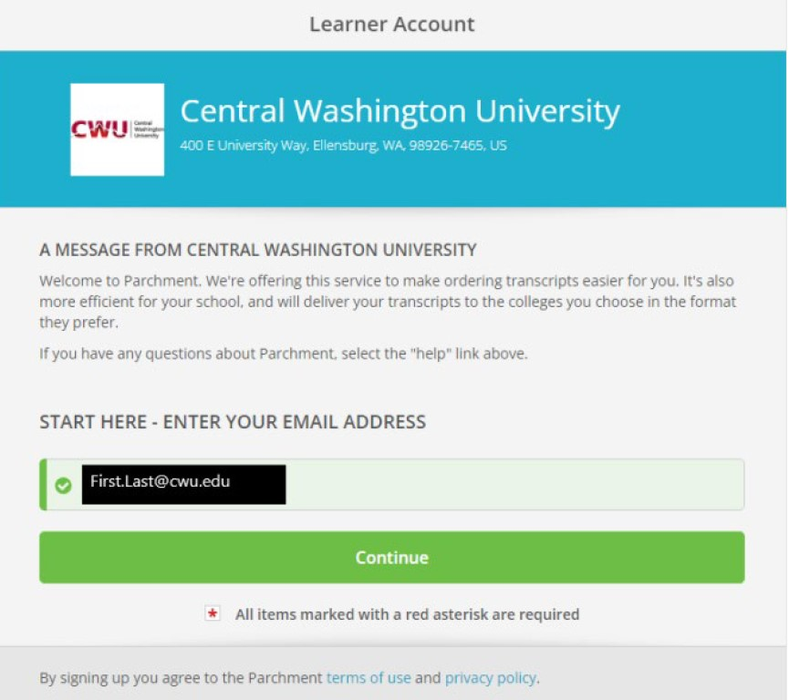
How do I request my official CWU transcript?
5.
This will take the student to Parchment.com portal
This email address will be their First.Lastname@cwu.edu version of their email and not their username version of CWU email address
More information: https://www.cwu.edu/about/offices/registrar/academic-information/request-transcripts.php
Need Help?
Contact CWU Office of the Registrar
Email: reg@cwu.edu/
Phone: 509-963-3001
Notes:
It will then prompt the student to create an account to submit their request
Requesting a transcript does cost a fee based upon the request and desired delivery date
Any issues requesting their official cwu transcript need to be directed to the Office of the Registrar.
Note: Students will want to wait until their official grades have been posted before requesting their official transcripts.

Slide 27
Who should I direct students & parents for help?
College in the High School Office
CWU Service Desk
Student having trouble registering for classes
Student doesn’t know their CiHS or MyCWU credentials
Parent/Guardian can call to provide consent
General program questions or questions relating to CWU policy
Trouble logging into MyCWU account
Trouble setting up Multi Factor Authentication (MFA)
Trouble completing Release of Information form
CWU Service Desk
Hours while classes are in session
Monday – Friday 7 am to 5 pm
Phone: 509-963-2001
Email: cwuservicedesk@cwu.edu
CWU College in the High School Office
Hours: Monday – Friday 8 am to 5 pm
Phone: 509-963-1351
Email: HSPartnerships@cwu.edu
Notes:
If students and parents have questions or need assistance, they should always reach out to our office first. We will help them troubleshoot and answer these common questions.
An important note is that the student needs to be the one to contact us. In the case of the service desk, they will not talk to the parent unless the student is present on the phone.
One key reminder we have regarding the service desk is please make sure that you are calling from a quiet, private place. Often, they’ll receive calls from students and our instructors in loud areas where it makes it more difficult for them to do their job. Additionally, they need to be able to confirm your private information and it becomes a security concern on their end if you calling in a public, noisy area.

Slide 28
Contact Us:
Email: HSPartnerships@cwu.edu
Phone: 509-963-1351
Website: https://www.cwu.edu/academics/specialized-programs/college-high-school/
Contact Me:
Email: Zane.Morrison@cwu.edu
Phone: 509-963-1381

Slide 29
Breakout Locations
10:15 am to 10:55 am. Pick one of these breakouts
Advising Breakout w/ Angelia
Who Does What When? w/ Jon

Slide 30
Room Locations
Veteran Instructors and Administrators – You will stay here for an interactive Q & A
New Partners you will have New Partner Orientation with Liaisons
Discipline | Room
Communication | 136
ETSC + SHM | 203-1
English | 202-1
ENST | 201-1
Finance | 224
History | 208-2
Math | Samuelson Hall, Room 251
PE | 209
Physics | Discovery Hall, Room 302
Psychology | 228-19
Notes:
New Partners will go to meet their liaison in one of these rooms

