Slide 1

CWU CiHS: New Partner Orientation 2025
Presented By: Jon Salazar
Notes:
Hello, Please sit in the front half and near someone. We will be starting with some collaboration time.
Hola Bienvenido Mi llamo Jon Salazar (el/ello/ellos) yo estoy coordinador de alcance para CWU’s College in the High School. If you have any questions about today’s presentation, please email jonathan.salazar@cwu.edu or HSPartnerships@cwu.edu.
A little about me:
Soy nieto de dos inmigrantes trabajados y el hijo de dos maestros de escuela publica/ I am the grandson of two hardworking immigrants and the son of two public school teachers. I can’t tell you how many Sundays I spent at school, running the copier and helping them assemble packets for the upcoming week. I’ve lived my whole life in Washington, I grew up in the Yakima Valley and earned my AA-DTA through Running Start at Yakima Valley College in June 2021. I then moved to Bellingham and graduated from Western Washington University with a B.A. in Public Relations. In October 2024, I attended the annual NACEP Conference in Orlando, FL. The National Alliance of Concurrent Enrollment Partnerships is our national accrediting organization. I have been working for CWU CiHS since February 2024.

Slide 2
Agenda for the day
Time | Subject
8:40 am – 9:25 am | New Partner Orientation
9:35 am – 10:10 am | Break Out #1
10:20 am – 10:55 am | Break Out #2
11:05 am – 12:00 pm | New Partners – Discipline Specific Orientation with Liaisons Veterans & Admins – Interactive Q & A
12:00 pm – 12:45 pm | Lunch/New Partner cont.
12:45 pm – 3:00 pm | All with liaison for Professional Development
Notes:
Quick refresher on today’s agenda. After here, you will have the option to attend two different break out sessions.

Slide 3
Agenda for the day
Time | Subject
8:40 am – 9:25 am | New Partner Orientation
9:35 am – 10:10 am | Break Out #1
10:20 am – 10:55 am | Break Out #2
11:05 am – 12:00 pm | New Partners – Discipline Specific Orientation with Liaisons Veterans & Admins – Interactive Q & A
12:00 pm – 12:45 pm | Lunch/New Partner cont.
12:45 pm – 3:00 pm | All with liaison for Professional Development
Notes:
Quick refresher on today’s agenda. After here, you will have the option to attend two different break out sessions.

Slide 4
Online Participants
If you experience any technical issues with Zoom, please reach out to Maury Webber (Maury.Webber@cwu.edu)
Please use the Chat feature to submit questions
Notes:
If you experience any technical difficulties, Maury Webber can help you with your trouble-shooting needs and get you back to where you need to be.
It may be handy to have your Zoom invite link handy in case you experience any technical difficulties and need to leave and re-join our session.
Please jot down your questions as they occur to you or add them to the chat, and we will get to them as quickly as possible.

Slide 5
Before We Start…
New Teacher Onboarding 2025 Canvas Course
  Due Friday August 15th, 2025
Notes:
This presentation is supposed to be a refresher of the New Teacher Canvas course, although I understand we have some last minute sign ups with us today. It also took us a little longer to distribute the canvas course because we’re switching from “Great Value” Canvas to regular Canvas. That is why you have until 6/27 to complete the quiz at the end of the module. You will receive another course invite you can access after the 29th. You will not have to complete the quiz a second time.

Slide 6

Here’s how you fit into the CWU Wildcat Family
Notes:
CWU is the sixth largest college in Washington by enrollment. Our program is the largest provider of dual credit in the state. We don’t have this year’s number yet, but we awarded 99,000 credits in AY 23-24.

Slide 7
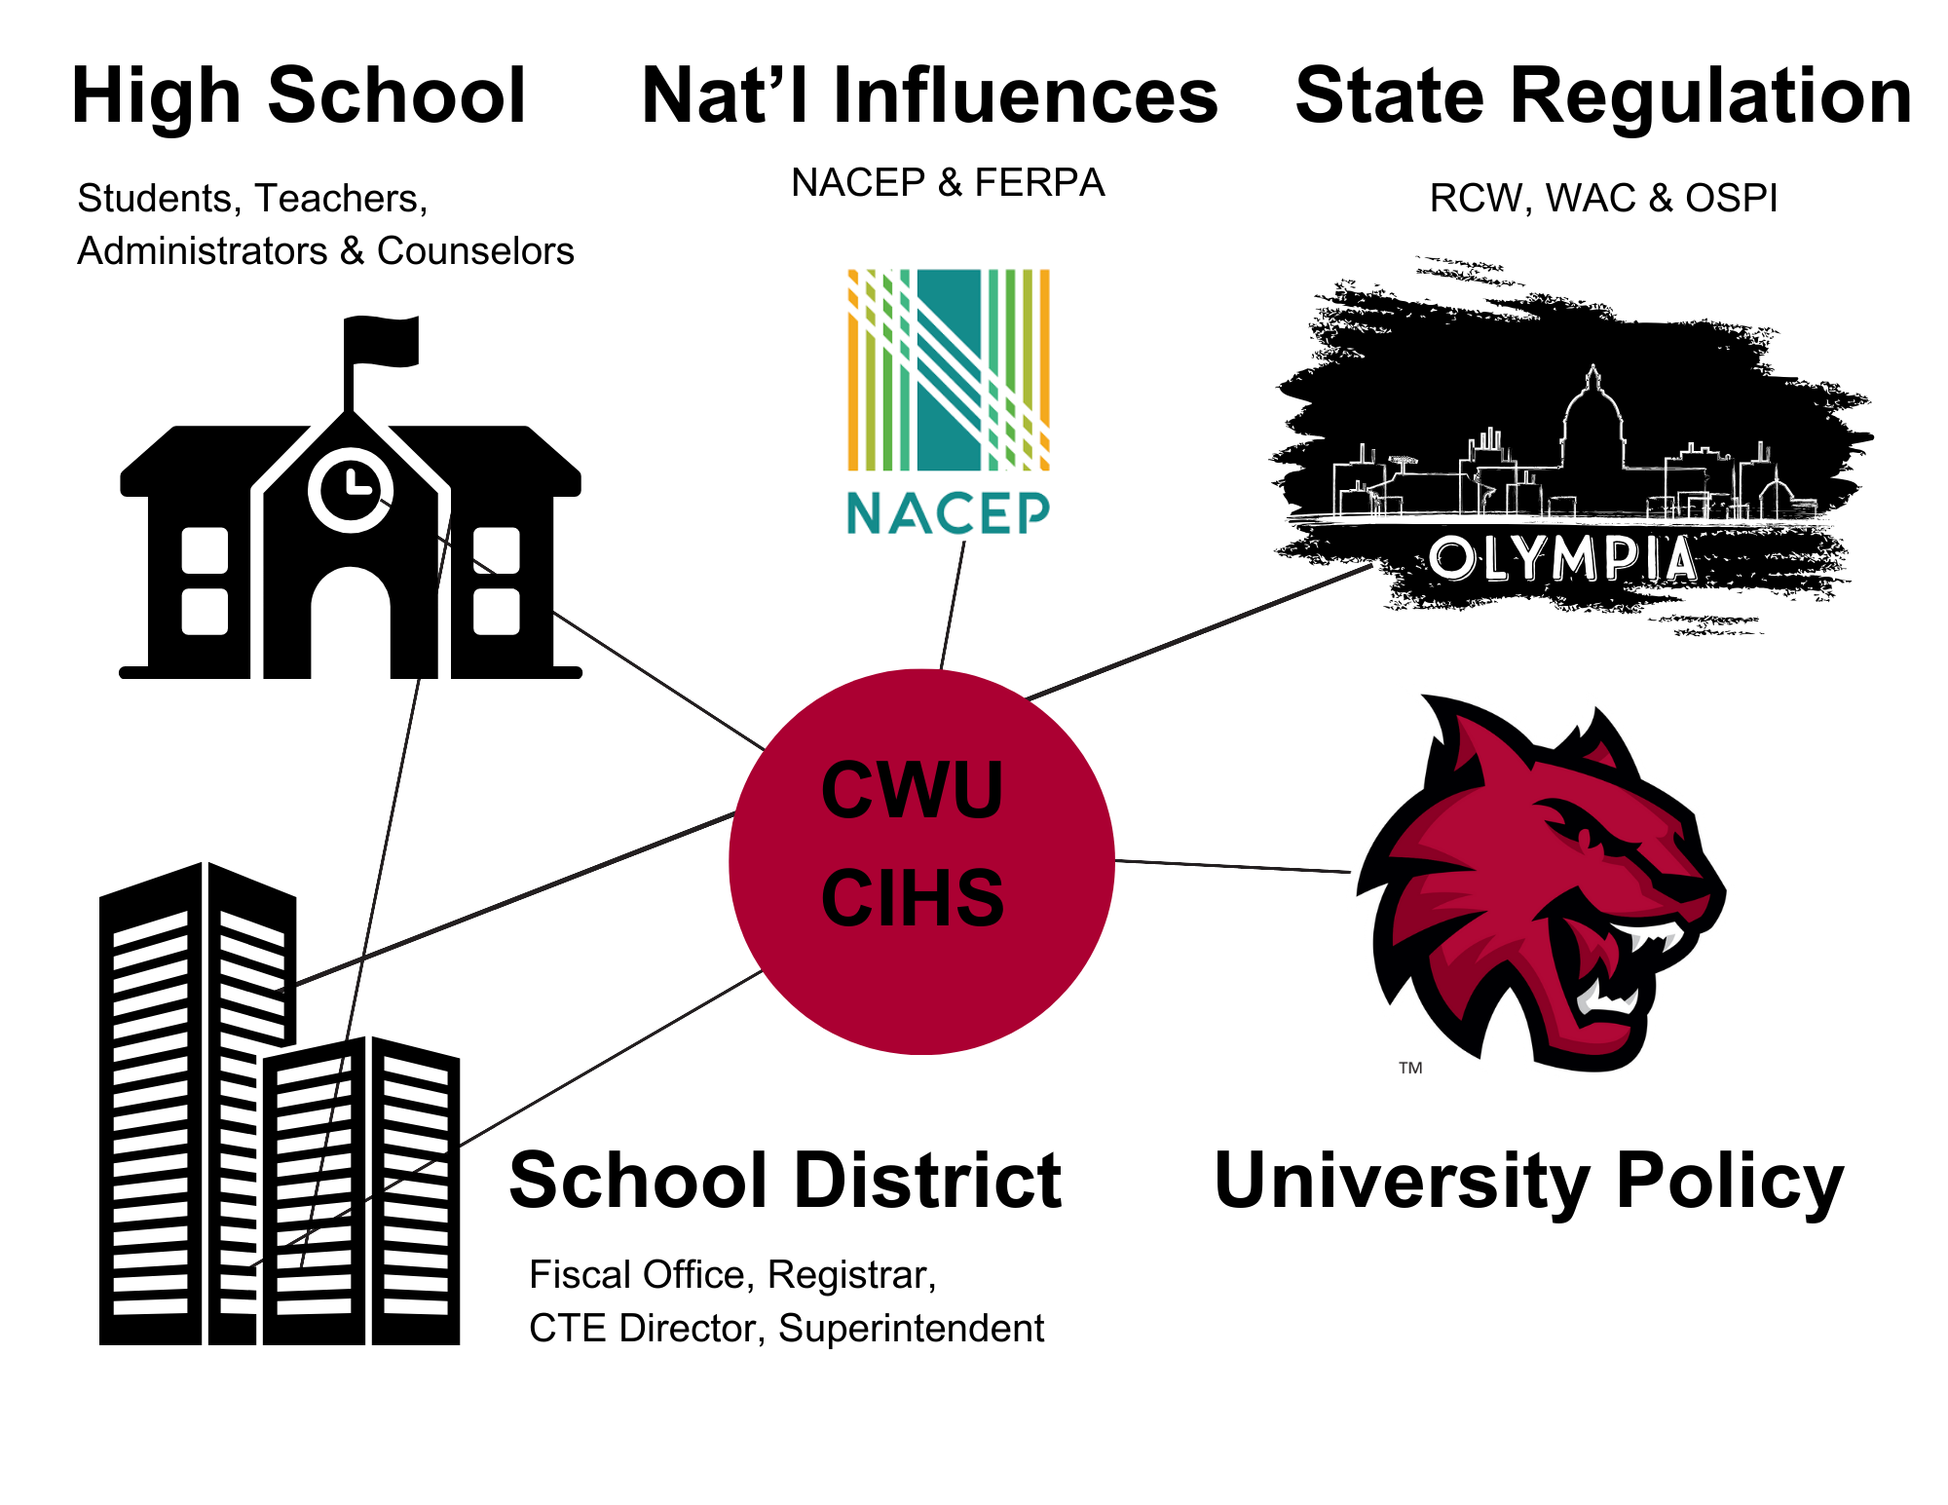

CiHS Stakeholders
Partnered Schools:
What CiHS-specific policies has your school implemented?
New Schools:
Are you new to CiHS or new to CWU?
Challenge Action Result
Notes:
There are a lot of stakeholders involved in the process.
All students and teachers must adhere to CWU policy; CiHS students have the same rights and responsibilities as any student on campus, and teachers need to adhere to the same rules as the faculty on campus.
All of us need to follow the state laws and OSPI policy as well and national policies like FERPA; we need to keep within bounds of what is required by our NACEP accreditation which is also the basis of most of the state laws concerning CiHS.
Your school and district also have their own applicable policies when it comes attendance, grading, etc. The rules and regulations of our program including info financial and reporting processes, approved teachers and classes, and reimbursement calculations can be found in the Interlocal Agreement between CWU and your school district. If you have questions about the ILA please reach out to your local school district office.
And your school provides the amazing team of instructors, counselors and other administrators that deliver this amazing opportunity to your students. You all work with us to provide program information to the students and families, manage enrollment, stay in compliance with the rules and regulations, and deliver the classes, grades, and university credit.

Slide 8
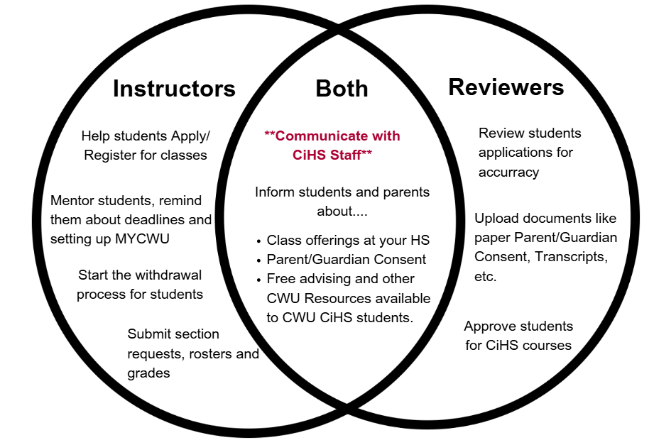
Partner Expectations
10-day Absence Policy
Attend SI every THREE years
No Fraud
Notes:
Reviewers are staff at your school who help with student registration. They have access to student info like class schedules and transcripts. Reviewers are typically academic counselors, college & career counselors, CTE staff, vice-principals. At smaller schools sometimes the teacher, principal or even superintendent is the reviewer.
It is all of our jobs to support students and create a culture of academic success. If you do these things, you will have a smooth, efficient program.
Teachers be mindful of our ten-day consecutive absence policy. If you miss 10+ days in a row we cannot offer the class unless your school has already approved sub. Redundancy is good. It’s okay to have two teachers approved to teach math if you only plan on one consistently offering math. You never know when life happens, so it might be beneficial for your school to have some backup teachers. This also gives your school more flexibility in your course scheduling.
Teachers applying for a new subject must attend SI before they can offer that course. If you are not adding any classes, you only have to attend SI every three years to receive program updates and remain in compliance.
Lastly, no fraud. Do not say you’re offering a course when you’re not, enrolling fake students. If mistakes happen, let us know sooner rather than later. We partner with around 200 schools, at some point every school has called our office.

Slide 9
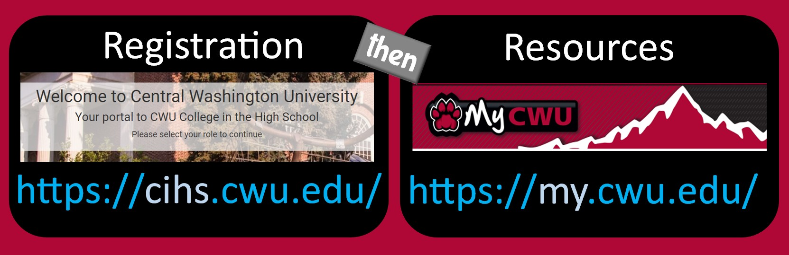
Common Confusion: A Tale of Two Accounts
CWU students have two separate accounts with two separate login credentials
CWU adjunct faculty have two separate accounts with SSO
Notes:
Before we get into the weeds, I want to address a common point of confusion. You and your students will work with two websites with two accounts. Teachers if you plan on doing your own reviews you will have a separate reviewer login for CiHS. Teachers aren’t doing their own reviews (the majority of teachers) you will have two accounts with single sign on. Students have two accounts with two separate logins.
Generally people start on our CIHS.CWU.EDU site or ‘THE REGISTRATION PORTAL” Teachers this is where you created your applications, your students will create their CiHS accounts once and sign up for CWU courses every term. Teachers check this roster during the registration window? Is anyone missing? They will not receive college credit.
Once you get sent your CWU credentials login to MY.CWU.EDU this is where teachers will enter final grades, students can access CWU resources and transcripts. Teachers your MYCWU account will be activated 7-10 days before the first day of registration. You will not have access to your CWU account when you are not actively teaching.
FERPA means the accounts belong to the students’ not the parents.

Slide 10
Faculty CiHS Account vs Faculty MyCWU
CiHS.CWU.edu
My.CWU.edu
Registration platform and where you applied to join the team
View all students who applied for your class(es).
Submit withdrawal requests
Upload course syllabi
Add class schedule and section request
Your Faculty MyCWU for official and permanent records
Only active while course is running
  Students in this roster will receive CWU credit & grade.
  Enter grades by deadline
    Graduating Seniors & transcripts
    https://wildcatpassword.cwu.edu
Two accounts with single sign-on and different purposes
Notes:
So what are the differences between your two accounts?
In your CiHS Account you can view section requests which let us know what classes you're teaching the upcoming term. Before registration opens make sure your upload your course syllabi and add your class schedule so your liaison knows when to schedule observations. You can also view all the students who signed up for you class during the registration window. When we say check your rosters during the registration window, this is what we’re talking about. Your CiHS.cwu.edu platform is where students register, and you watch your roster grow and progress in real time. This is where you did the teacher application. You will also submit withdrawal requests on behalf of students.
Your Faculty MyCWU account allow you to view your official class roster, it’s important to catch any errors while class is still in session. After registration ends and our office confirms enrollment we will ask you to check your permanent roster. You will have to enter grades for every student in your permanent roster. Be mindful of entering grades promptly, especially for graduating seniors who are requesting their official transcripts.
You’ll only have access while you have a course running..
You’ll need to have your MyCWU up and going before you can access your CiHS.cwu.edu account. And to do that you’ll need to get the multi-factor authentication connected. Please refer to the Faculty MyCWU and Multi Factor Authentication in the Instructor Participation Guide on our website.
Please note that you will not receive your MyCWU credentials until after your first course is built and uploaded into CiHS.CWU.EDU. Our office will email you your MyCWU credentials with instructions on how to activate your MYCWU account.

Slide 11
Know the Difference Between Two Rosters
CiHS.CWU.edu (Active Roster)
My.CWU.edu (Permanent Roster)
All students who applied
May not be Approved
Students in App Not Processed, Drop, Not Approved & Withdrawal will not earn CWU credit or grade
Check during registration windows.
Students are Registered
Students will receive college credit & grade.
  Exception: Withdrawal.
Enter grades by deadline
  Seniors & transcripts
Check before upcoming deadlines
Two accounts with single sign-on and different purposes
Notes:
As you’ll soon learn we talk A LOT about rosters. Teachers you have two rosters one in each account. On your CIHS account you’ll see all students who have applied. Please note not every student on this roster may receive a CWU credit or grade. Please check this roster during the registration window to make sure students sign up for college credit.
Your MYCWU roster will list all REGISTERED students. You will have to enter a final grade for these students. Check this roster after we’ve processed all student enrollments and email you “does everything look right?” Check your MYCWU roster are there students that are missing or should not be listed? It’s better to address things in a timely manner before we miss deadlines and corrections become harder. Make sure you also check this roster before withdrawal deadlines.

Slide 12

CiHS in your classroom
A Year at Glance
Notes:
Now that you have some background and context about our program, let’s dive into the logistics.

Slide 13
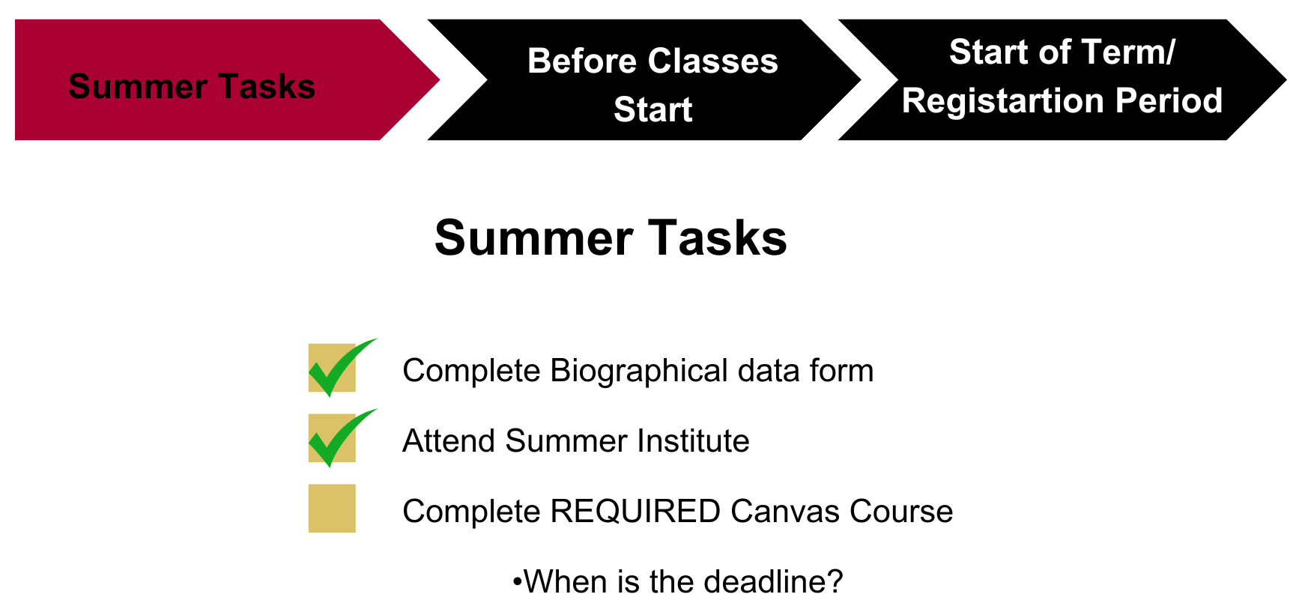
Next Steps for New Instructors (1)
Notes:
You should have all completed your Biographical data form sent to you by Dr. Kyle Carrigan, if you haven’t completed it yet, please do so when you get back home.
If you are only teaching one subject you will complete your required SI session today. If you are planning to teach multiple subjects: Math/Physics, English/Humanities, PE/Public Health you will need to attend keep attending SI until you’ve met with ALL your new academic liaisons. Clap if you are approved for more than one discipline. Mention double dip rule (one subject per SI date). Clap if you already attended 5/17. If you don’t have your second or other discipline slot scheduled, please send me an email. I will try to schedule you into your required session, but several dates have reached capacity.
Reminder you have until June 27th to complete the canvas course quiz. You will be sent another course later in the Summer so you maintain access to the Canvas course as a resource. You will not have to complete the quiz twice.

Slide 14
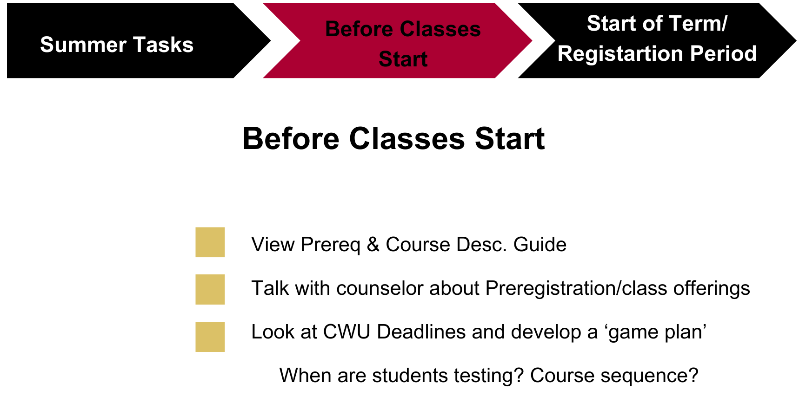
Next Steps for New Instructors (2a)
Notes:
This is the early stage of planning for CIHS at your school. I encourage you to have a quick 20-45min quarterly meeting with your admin, registrar, counselor, possibly teachers and really plan out. When are you offering courses? When will students need to test? Will they need a prior course? Make sure you are closely working with your cihs team.
If you or your counselors/ admin/ registrar/ instructional coaches would like to schedule a virtual meeting and go over the teacher application requirements, I’d be happy to meet. Our staff is also available to meet virtually and share the application process with your team, possibly at a building meeting.
This planning should be happening the quarter before minimum if not a year out. Do you need to add teachers? What courses are you missing?
This should have ideally already happened for Fall if not this upcoming school year. Your district told you what courses you would be offering and you submitted an application to teach CWU courses. As you can see we offer many courses, over a hundred to choose from and your district decides how those credits are applied. Don’t be afraid to get creative to some limit. Obviously don’t say you’re teaching calculus and teach art instead.

Slide 15
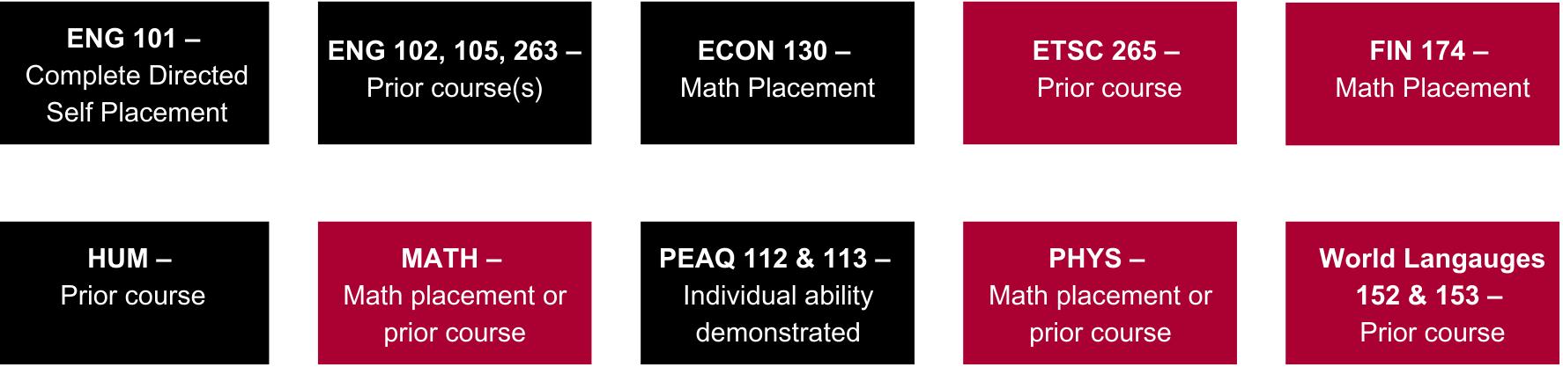
Prerequisite Requirements
Prior Course Grade
Students must maintain a 2.0 GPA (C average) in their CWU classes to be in good academic standing
Contract of Understanding (COU)
Instructors can waive some prerequisites by using a COU.
Ask liaison about specific requirements.
Notes:
Student generally need a C to enroll in the next CWU course although every department has different rules, it’s important to consult the Course Description and Prerequisite guide. Please familiar yourself with the prerequisites and how they are met and if you have any confusion, please ask.
If students don’t quite meet the prerequisite they may still be able to enroll in CWU courses. Disciplines in red offer “Contract of Understanding.” This is similar to a CWU professor writing a student in. This form found in CIHS.CWU.EDU is completed by the student and teacher before being uploaded by the counselor or the teacher if they do their own reviews. Again, every school is different.
Go over Prerequisites
Students need to meet the PRE requisites before they register, this includes taking the English self placement survey or getting testing done.
Prior coursework means college classes. Not high school classes. Being seated in the class last year, but not enrolling for the CWU credit, means that they might not meet the prerequisite.
Testing scores are only accepted for certain math-based courses.
COUs for math, physics, world language and finance essentially allow instructors to “sign in” a student to their class. Check with your liaison on COU requirements
Work with your school’s reviewers, probably a counselor or other admin who has access to student records, to make sure everyone has the information they need for the reviewer process.

Slide 16
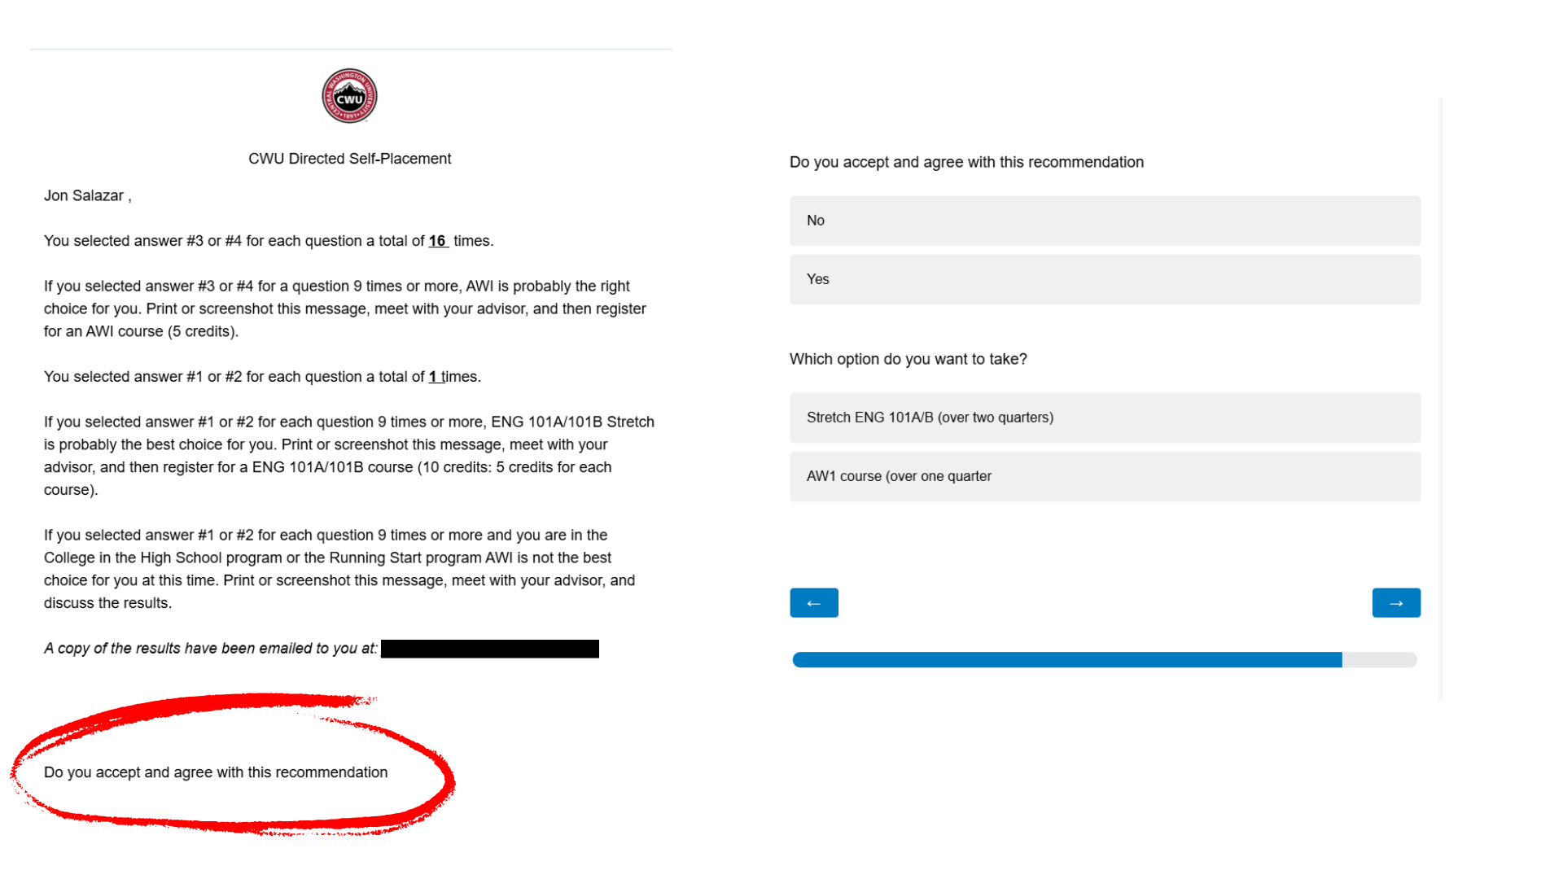
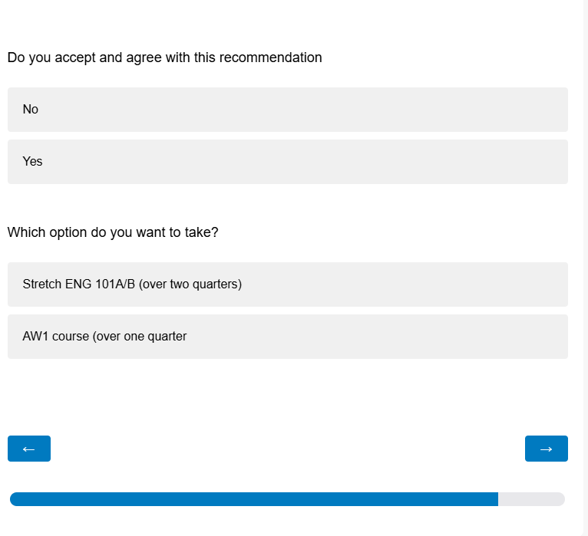
CWU English 101 eligibility
English Directed Self-Placement is the only way to get into ENG 101.
https://www.cwu.edu/general-education/directed-self-placement
Students must take survey BEFORE applying for ENG 101
Conversation with students about results to ensure readiness
Contact Josh or Austin with any questions on self-placement
Do not use Accuplacer Testing for ENG
KEEP SCROLLING
<<Students MUST Complete
Notes:
Clap if you’re teaching English.
Your students will receive an email after they complete the self-placement survey giving them a recommendation of AWI or Stretch. AWI means they’re ready to take ENG 101, whereas Stretch means that they may not be as ready for this course. Please note a student can register for ENG 101 with either recommendation but it’s important to have a conversation with your student to ensure they are ready for the rigor of ENG 101. What support and resources can they access?
When taking the English survey, many students mistakenly don’t finish. The picture on the top right is not the completion page. Notice the bottom line “Do you accept and agree with this recommendation” Students must answer yes and either select AWI or Stretch. Again if a student scores a stretch they can still enroll in ENG 101.

Slide 17
Accuplacer Math Exam NG
Benefits of using CWU Testing:
Costs covered by CWU CiHS
Two tests per year per student (Max 3 times in CWU Career)
Testing take place at your high school. Math teachers CANNOT proctor test.
    Who is your school’s testing coordinator and/or proctor?
Helpful Tips:
Each test is valid for TWO years. Tests do not auto-save
Please save a copy of your student’s test score to use next year
    Accuplacer Next Gen Math Exam will not auto save
Interested? Please contact:
William (Bill) Thelen
Phone: (509) 963-1860
E-mail: William.Thelen@cwu.edu
Notes:
Clap if you are a Math teacher.
Your High School can be set up as a CWU Accuplacer Next-Generation site. Remote Accuplacer Testing is also available. To get set up as an Accuplacer Testing location, please contact Bill Thelen.
Make sure your students take the Accuplacer NG Math exam.
See the Course Descriptions and Prerequisites Guide, in your booklet, for specific scores needed for specific Math, Finance, or Physics courses.

Slide 18
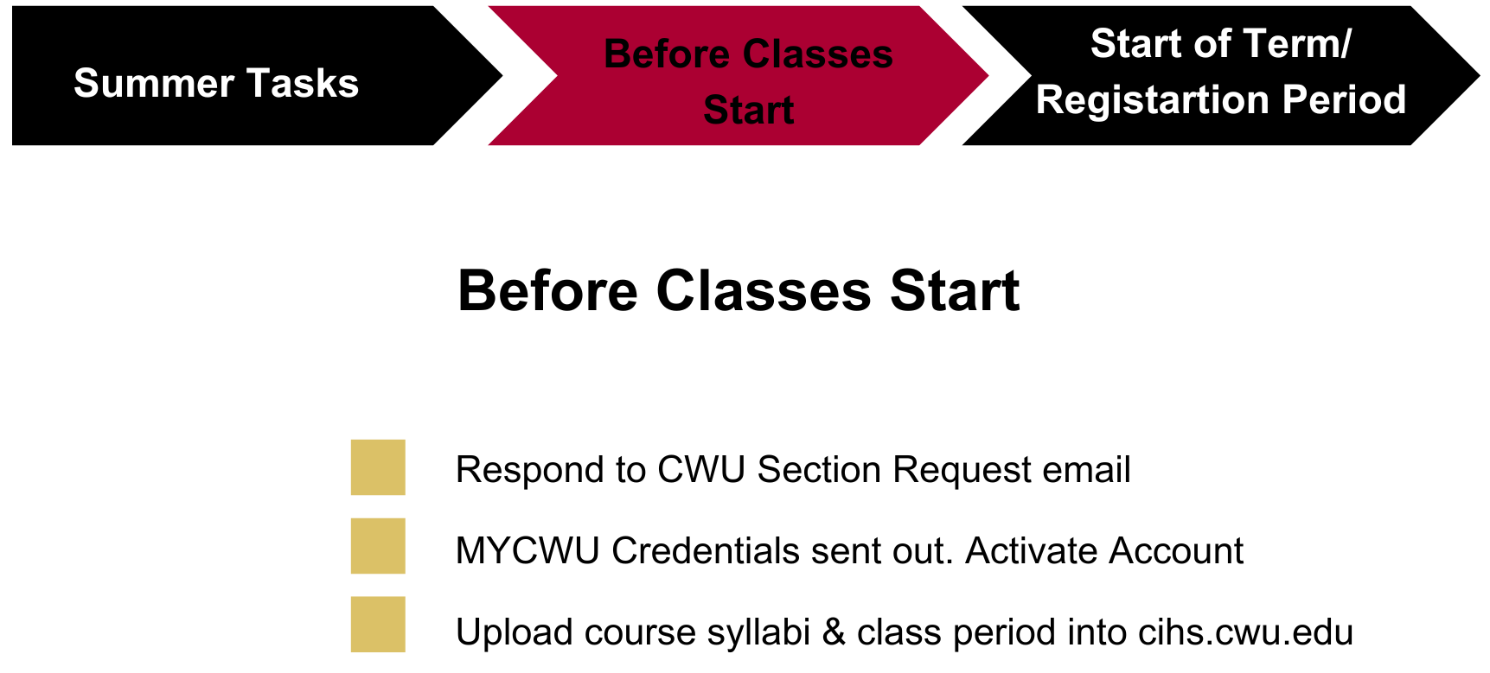
Next Steps for New Instructors (2b)
Notes:
You will receive an email containing a section request survey every term. That let’s our office know what courses you plan on teaching so we can build enough course sections. Even if you do not plan on teaching you must respond to the survey. We typically send these out the prior term. Since you were not with is in the Spring, once we confirm you’ve completed the canvas course my colleague Zane Morrison should be emailing you. Check your booklet for the section request deadline.
Clap who is offering courses in the Fall. Clap who doesn’t know yet when they’ll offer their first course? It’s okay if you don’t. This is still pretty new and you’ll have time with your liaison this afternoon to talk about curriculum.
Once we’ve received confirmation you plan to teach you will be emailed your MYCWU login credentials. Your account should be active 10 to 15 days before the registration window opens.

Slide 19
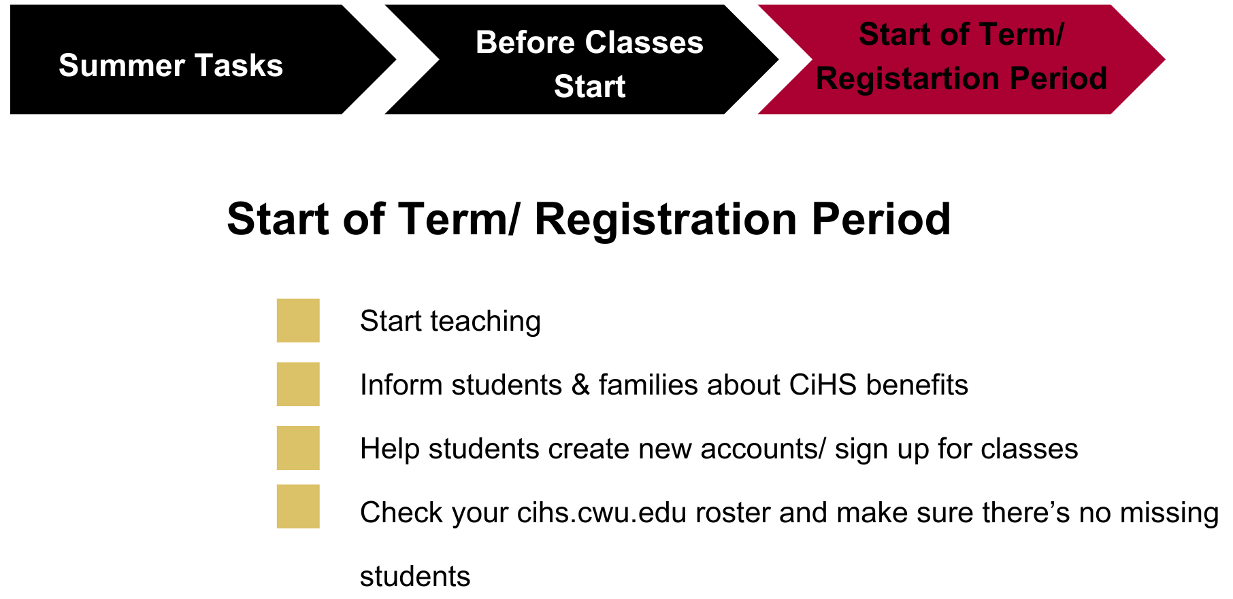
Next Steps for New Instructors (3)
Notes:
During the three to four week open registration period, check your active, real-time roster in CIHS.CWU.EDU. Make sure any student who wants to sign up for classes is on your roster in APPLIED or APPROVED status. Students MUST submit their CiHS application BEFORE the deadline. We do have a late application process but it requires a personal statement, additional forms and there is no guarantee the students is enrolled. Avoid late registartions by setting up internal deadlines at your school. Let’s turn to page 5 in your booklet and use Fall as an example.
Parent consent is a separate part of the application and has it’s own deadline. Students can submit their application without parent/guardian consent. The consent deadline is typically a few weeks after the registration deadline.
Also consider having your students sign up in each class. Maybe counselors and/or administrators can help monitor students and create culture of taking dual credit classes.

Slide 20
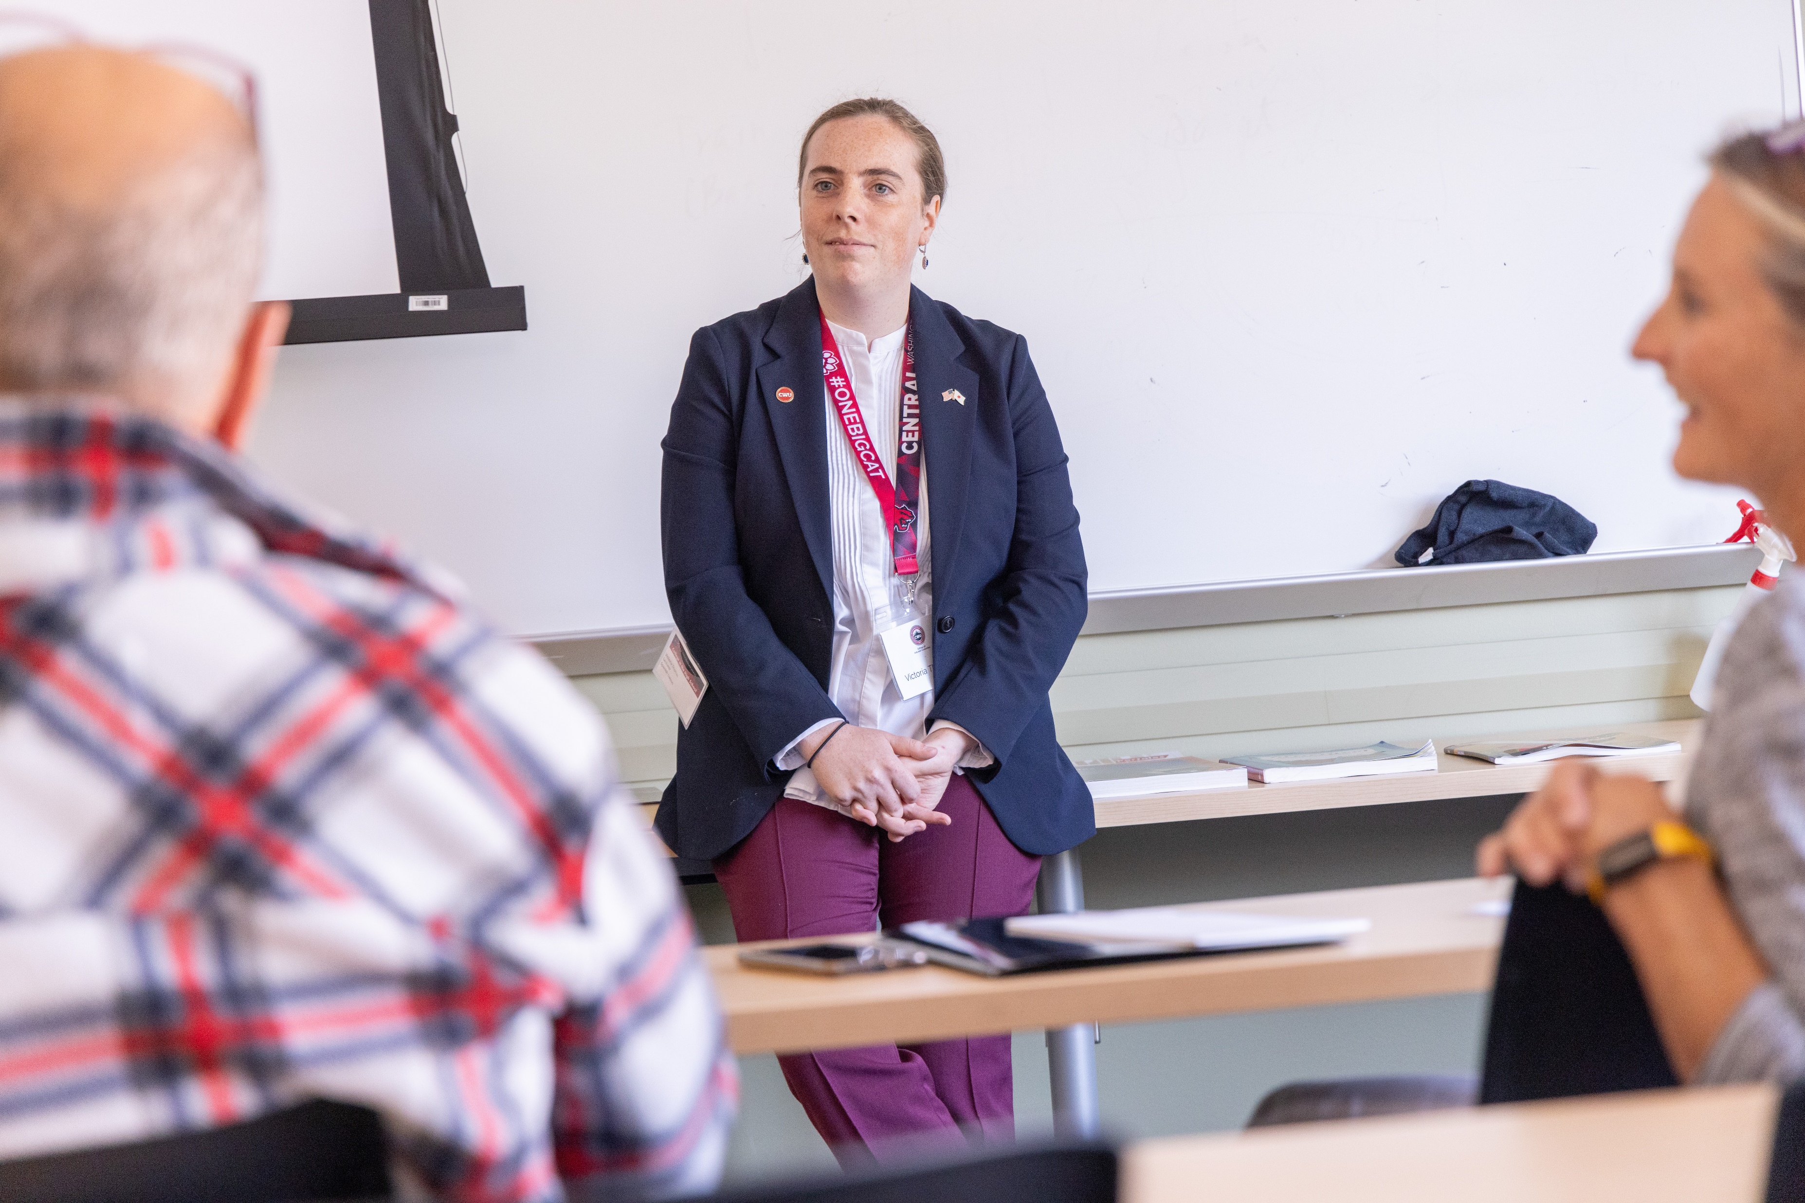
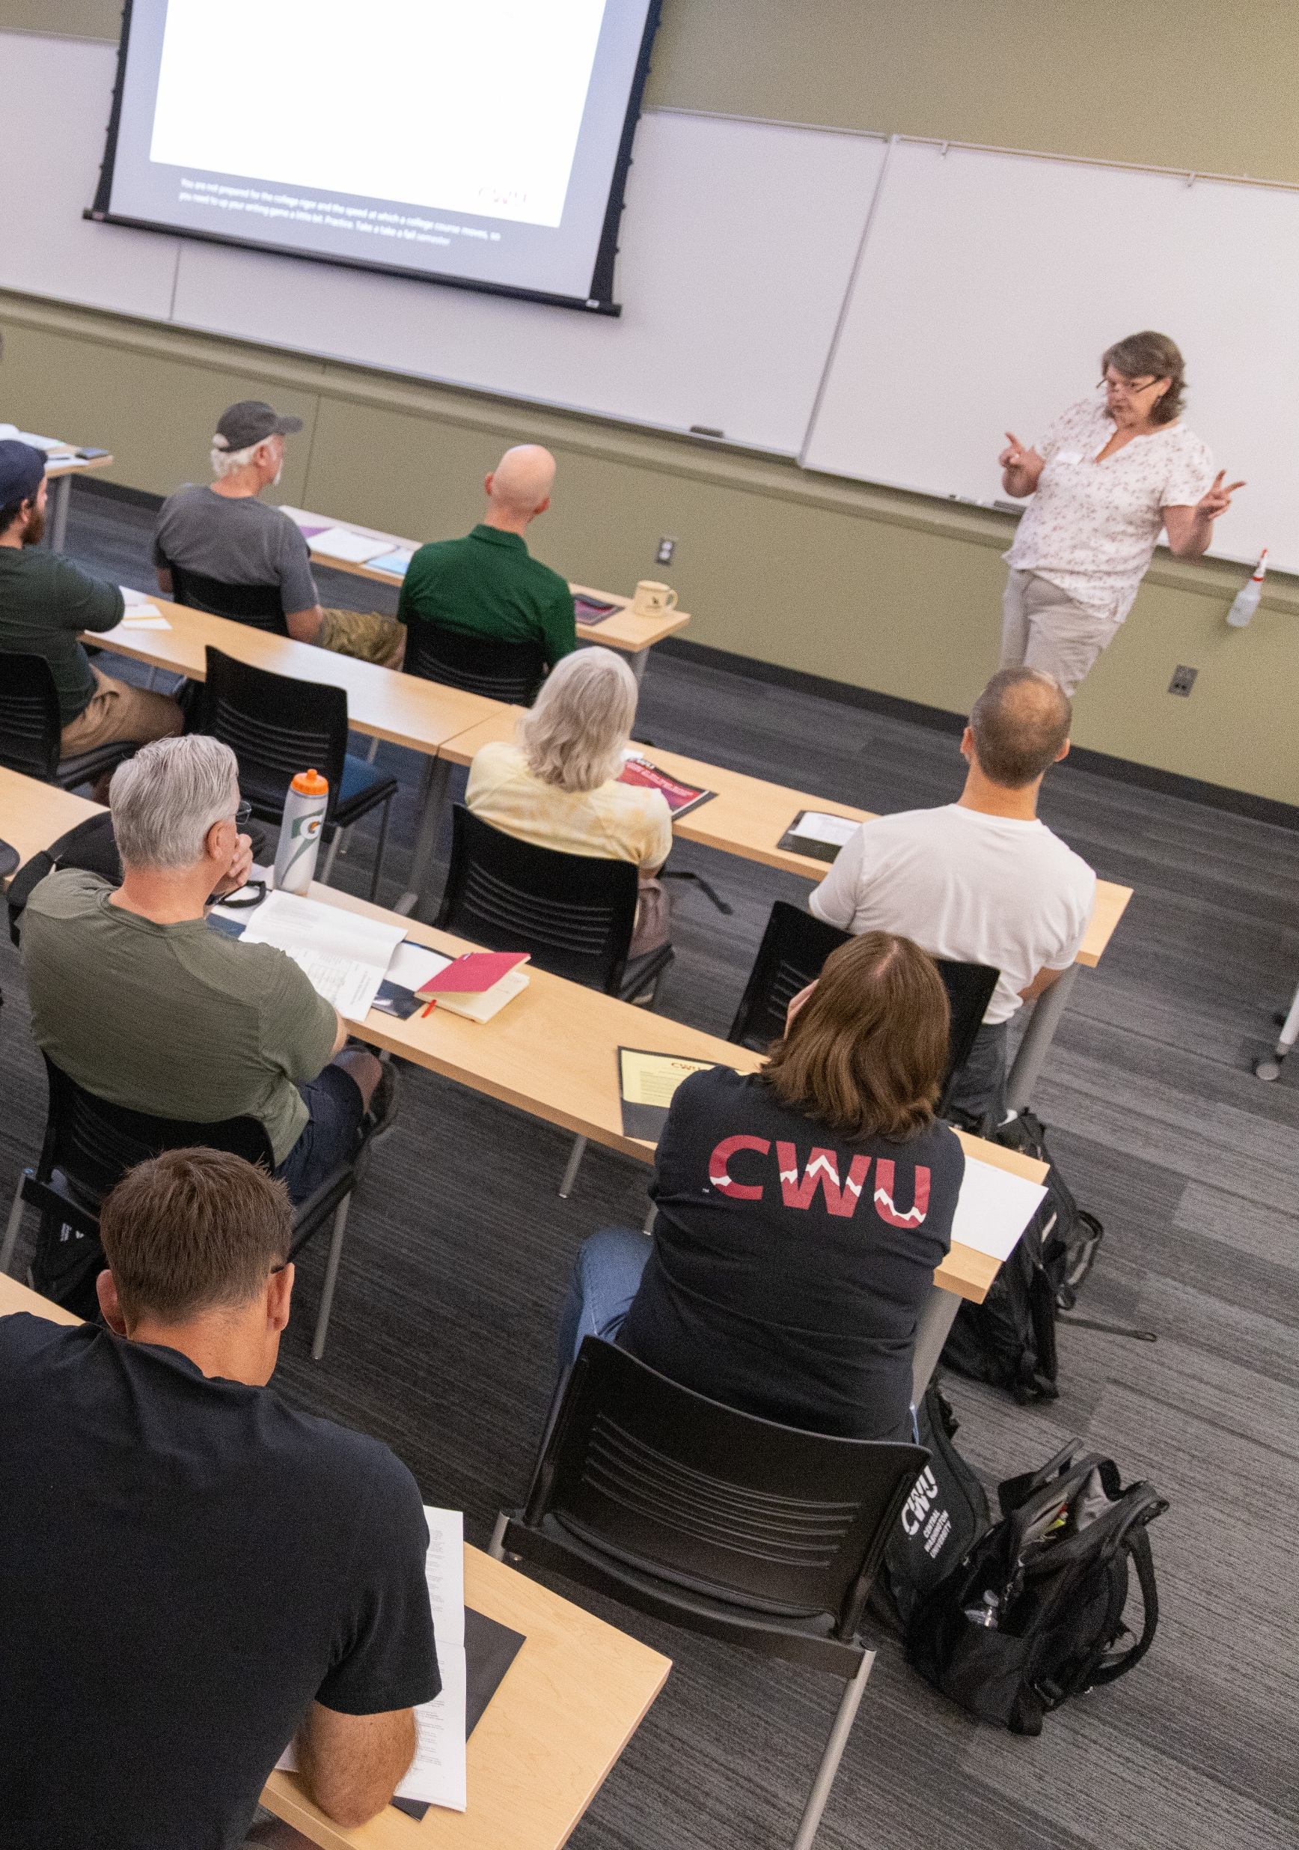

Now you teach
Students are seated in class
You’re explaining CiHS & benefits.
Students decide if they want to enroll in college class or just earn HS credit.
Liaison will schedule visit/observation
Notes:
Now you continue to teach.
You will be observed by your liaison this upcoming school year. Take this opportunity to get some feedback and support. Observations happen every two years or more often depending on academic department. Every third year you need to attend Summer Institute for professional development and meet with your liaison.
CWU strongly believes in Academic Freedom. That means that you can continue to use the textbooks, materials and delivery methods you favor best in your classroom, as long as you’ve aligned the curriculum learning outcomes with CWU and have liaison approval on your syllabus (which needs to happen every term you teach the CWU class).
And remember that any and all work a student does during a term may be incorporated into the grade for the course.
Before we get into the registration process, I’d like to go over the benefits of CiHS.

Slide 21
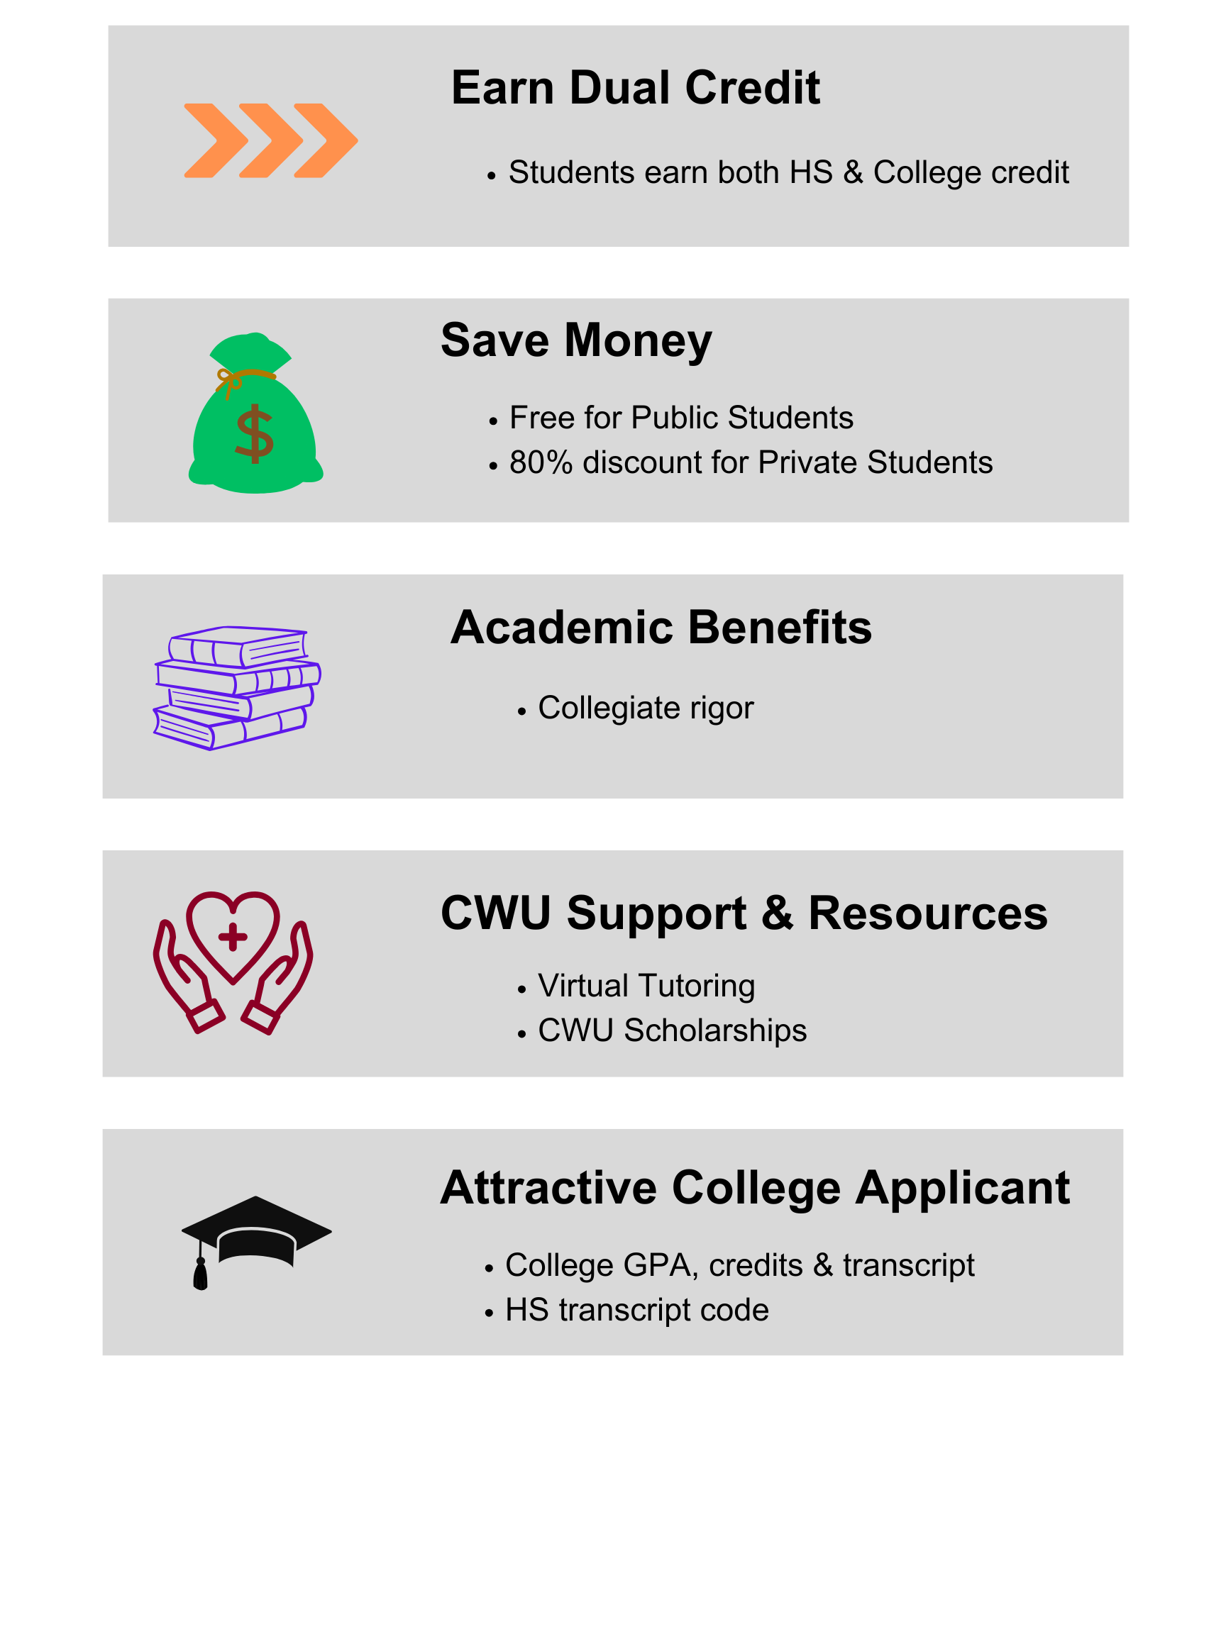
Student Benefits from CWU CiHS
Notes:
There are real benefits to enrolling in a CWU class, including financial, academic and personal.
Especially now, with public schools being able to offer CiHS courses at no cost to the student, the financial benefits are huge.
Students receive high rigor and both high school and CWU credit for the course. They get ahead on the college plan and become a more attractive college applicant.
But just because a course is no-cost to the family, it doesn’t necessarily follow that all students in every classroom are ready for the challenge and responsibility of university courses.
More information on the student benefits will take place during our advising breakout session with Angelia.

Slide 22




Academic Support from CWU for Students
Disability Services
Learning Commons
Academic Advising
CWU Brooks Library
A complete list of CWU resources and contact info can be found pg 22
Notes:
Once enrolled, the CiHS students have access to support and services through CWU. And so do you teachers.
See the CWU Resources tab in the left-hand column, and page 22 in the booklet for student support from CWU.
Learning Commons –includes the University Math Center, the University Writing Center, Peer Assisted Labs (PALS) and e-tutoring.
Advising – We have a request advising form on our website for Students to request advising from our CWU advisors.
Brooks Library – It’s an online resource where students can chat with a librarian if there are questions about resources and research.
It’s important that everyone take advantage of the access and use the resources.
This CWU Resources tab is also the fast way to find the registrar (order transcript) , help from IT (password reset), and more.
Reminder for you and your students, when requesting support, use your CWU ID, email and/or username.

Slide 23

Registration Process
During the open registration period:
  Students register at cihs.cwu.edu
  Consider having students apply in class
  Monitor your live/active cihs.cwu.edu roster
  Send reminders about firm deadlines and required parent consent
Notes:
See How Students Register on pg 9 and Instructor Guide on pg 27.

Slide 24
Registration Tips for Students (1)
Students Should…
use a personal email address, not a school email.
For best user experience, students should register for classes on a large device like laptop or PC.
Double Check their application and write down any log-in information (email and password) for later. Students are creating a government record treat it like a credit card or bank application.
Notes:
Here’s some tips for students for creating their CiHS account:
Students should use a personal email rather than a school email when creating their account. It is important because schools have fierce filters and our messages from @cwu.edu often get filtered out.
Please have them write their log in information down and tell them not to lose it.
And use a regular computer, devices especially with small screens don’t display effectively and scrolling around when you don’t quite know what you’re looking for – for a first-time user – can be frustrating.

Slide 25
Registration Tips for Students (2)
Students Need:
To know their parent/guardian’s active and accurate email address
To know what school* they go to
To know what CWU class & number to sign up for (i.e. Biology 101), and
To know what their teacher’s name* is.
*Do they really attend Washington or University High School with Mr. Teacher?
Notes:
More tips:
Students must input an accurate active email address for their parent/guardian – make sure then have that information before they start to register.
Know what school – yes, indeed – we had students from all over the state register for classes at Washington HS. (Note from Zane: If any instructors are from Delta HS, they will need to know which high school and school district they report to)
Clarify the CWU name/number of the class. They’re not looking for AP anything, or Honors whatever.
And make sure they know your name.
Encourage them to take a few minutes, slow down, and do it correctly. Don’t rush through the process.

Slide 26
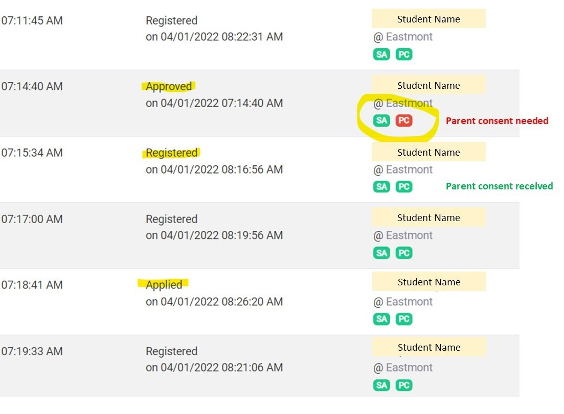
Roster Status and Consent Indicators
Applied: Student has signed up
Approved: Reviewer has checked app
Corrections Required, See Notes: Something needs the school’s attention
Pending Review: COU needs CWU faculty approval
Registered: Ready to be enrolled (or already enrolled)
Withdrawn: Class will appear on transcript with W, W+ or HW and no credit awarded.
Drop: Class won’t appear on transcript and no credit awarded.
Not Approved: Reviewer denied student.
Application Not Processed: Typically occurs when our office does not receive Parent/Guardian Consent.
Notes:
Students are on their way to fully enrolling in CWU.
If students are in App Not Processed, Drop, Not Approved or Withdrawn they will not earn college credit or grade. Will still earn full high school credit.
Corrections Required does not mean student is not approved. Our office just has a question or some paperwork is missing, Do not panic if a student is moved to Correction Required.

Slide 27

Drop & Withdrawals
Students can “Drop” before registration period ends. Class does not go on transcript.
Teachers start the withdrawal process
Three types of withdrawals
  Individual/Uncontested Withdrawal (+W)
    Student can earn CWU credit in other CWU classes.
  Complete Withdrawal (W)
    Student will not earn CWU credits or grade for ALL classes.
  Hardship Withdrawal/Petition (HW)
    Additional documentation required
More Withdrawal info can be found on pg 6 or online: https://www.cwu.edu/academics/specialized-programs/college-high-school/program-resources/drop-withdrawal-policy-and-deadlines.php
Notes:
Dropping a course has a very early deadline, it’s the same day as the close of the registration window. See page 13 for deadlines.
College students should sign up with the intention of being challenged by rigorous material and know that there is learning support available to them through CWU.
While a withdrawal won’t affect their CWU GPA, excessive withdrawals don’t look good on a transcript, and should be avoided if possible.
Students who have moved need to be withdrawn. For all drop/withdrawal requests, it is the responsibility of the student, the instructor, and/or the school district to let us know in a timely manner before our deadlines. We are unable to accept withdrawal requests from a student's parent/guardian
See page 14 for definitions for the different kinds of withdrawals.

Slide 28
Grades in MyCWU
Grading Deadlines on the website. https://www.cwu.edu/academics/specialized-programs/college-high-school/program-resources/process-deadlines/deadlines.php
CWU’s Grading Policy must be adhered to
  Difference between High School grading policy & CWU’s Policy
  Deadlines are firm: Teachers not teaching the following term will be locked out of their account after grading deadline. Will have to Call Zane Morrison for access.
Incomplete Grade Policy (I)
How to post grades guide pg. 37 of booklet
Notes:
Instructors must adhere to CWU’s grading policy and deadlines which are posted on the website, and we send reminders.
CWU’s Grading policy for your students is the same as the grading policy on campus.
It’s possible that the grade a student earns on their CWU transcript is different than the grade they earn on their HS transcript.
You may issue a grade of “I”, incomplete, if warranted. When a student completes a major portion of the course work but it isn’t finished, giving an incomplete is an option for students who can complete the work within one year or less. Please call us if you are considering this option, before you use it the first time.
If a student earns a letter grade of a D- or higher, they will have earned CWU credit for completing the course. However, that grade may not satisfy the prerequisite for the next course in a series. See prerequisites for English and math courses.
Please note it is not easy to change grades like Skyward. There is a seven day grace period where you must notify our office.

Slide 29
FERPA in high school vs FERPA at college
Parents/Guardians have access to CiHS information through the HS. This does not change.
At the college, all CWU students (of any age) are considered adults and FERPA protects the student privacy, not parent access.
Notes:
FERPA favors parent access to student information while the student is a high school student.
When a student turns 18 years old or enters a postsecondary institution at any age, students gain control over access and action within their student account.
This means we need to work directly with the student, or with their teacher on things like grades, finances, withdrawals, account access, information requests etc. However, the student can grant written permission for their parent to have access. There’s an online waiver the student can use.
This is often a new challenge for both parents and students. Students learn to communicate with us as an adult. Parents need to step back, and students need to step up.
As the teacher, you may still communicate with the parents. Your role doesn’t really change.

Slide 30
Important Websites - Bookmarks
CWU College in the High School Website: https://www.cwu.edu/academics/specialized-programs/college-high-school/
CWU College in the High School Registration Portal: https://cihs.cwu.edu
MyCWU: https://my.cwu.edu/
MyCWU Password Reset – https://wildcatpassword.cwu.edu
CWU Service Desk
  Phone: 509-963-2001
  Email: CWUServiceDesk@cwu.edu
  Hours: Monday-Thursday 7 am to 6 pm
  Friday 7 am to 5 pm
Notes:
Make sure to save on your computer.

Slide 31
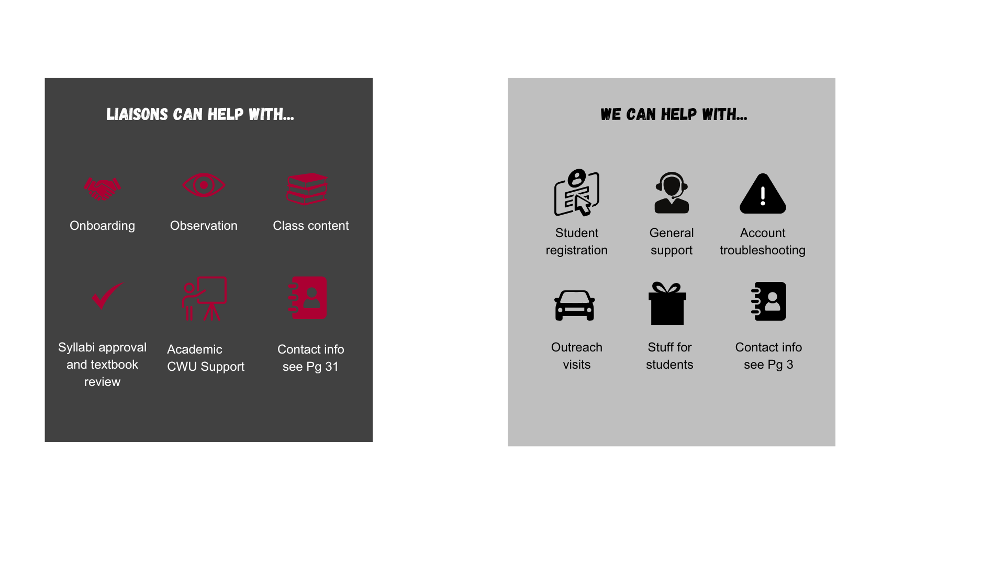
Who do I contact?
Other CWU Contacts
ServiceDesk
  MYCWU Support
  (509) 963-2001
Admissions
  CWU App & visits
  (509) 963-1211
  admissions@cwu.edu
Continuing Education
  Free PD classes
  (509) 963-1712
  ce@cwu.edu
Notes:
As part of the CWU Community you have access to a lot of resources. One of them is your Faculty Liaison who you’ll have time with later today to get some direction and be able to connect with them whenever you have questions or concerns about the academics in your classroom.
See the Liaison contacts on page 31
Please contact your liaison for support with any academic question. If you ever have trouble contacting your liaison, let us know, we will follow up.
ServiceDesk can troubleshoot any issues with your permanent records site (MYCWU) and Microsoft Authenticator. CWU CiHS staff can troubleshoot issues with the student registration platform (CIHS.CWU.EDU).
Admissions can answer questions about the CWU application and coming to campus.
As an active approved teacher, you are eligible to take a complementary professional development course for clock hours or PD credits through Continuing Education. Level up your next career or salary by unlocking your full potential.

Slide 32
What questions do you have?
Contact Us: HSPartnerships@cwu.edu or 509-963-1351
  Sarah Maes – Assistant Director – Sarah.Maes@cwu.edu
  Zane Morrison – Program Support Supervisor – Zane.Morrison@cwu.edu
  Jon Salazar – Outreach Coordinator – Jonathan.Salazar@cwu.edu
  Academic Questions?
    Contact your Academic Liaison: See page 31 in packet
Notes:
Check your hand-outs for a links that are referred to in this presentation.
The Canvas course you all worked through will continue to be available to you for a few months. If you haven’t it yet, you have until August 16th to complete the course. Will need to complete this course in order to receive stipend.
Please take some time and explore the College in the High School website.
Become familiar with both the Instructor Participation Guide and the Student Participation Guide so you are comfortable with the way the information is organized online. This will make it easier and faster to find answers to your questions.
Be sure to let us know if you have any issues, concerns, or questions. We are here to help.
But now we have time for questions about the material.

Slide 33
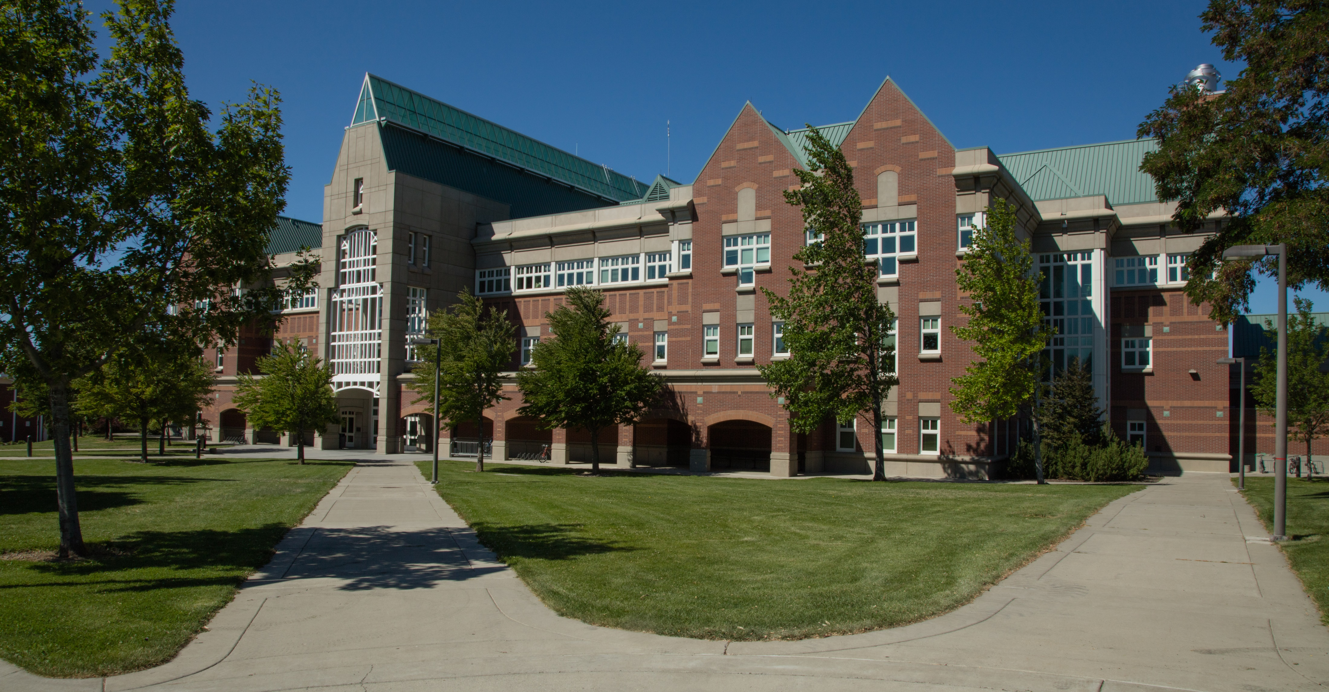



Questions? Reach Out!
CWU College in the High School
www.cwu.edu/college-hs
hspartnerships@cwu.edu
(509) 963-1351
Notes:
The CWU High School Partnerships office is here to support our students and teachers.
Let us know if your questions aren’t answered by the participation guides on the website.
Thanks for your time!

Slide 34
Agenda for the day
Time | Subject
8:40 am – 9:25 am | New Partner Orientation
9:35 am – 10:10 am | Break Out #1
10:20 am – 10:55 am | Break Out #2
11:05 am – 12:00 pm | New Partners – Discipline Specific Orientation with Liaisons Veterans & Admins – Interactive Q +A
12:00 pm – 12:45 pm | Lunch/New Partner cont.
12:45 pm – 3:00 pm | All with liaison for Professional Development
Notes:
Quick refresher on today’s agenda. After here, you will have the option to attend two different break out sessions.

Slide 35
Breakout Subjects and Locations
FAQ from Students and Parents – w/ Zane Morrison – Auditorium 150
Who does what, when? – w/ Jon Salazar – Auditorium 151
Advising/Counselor Content – w/ Angelia Riveira– Auditorium 152

