Slide 1
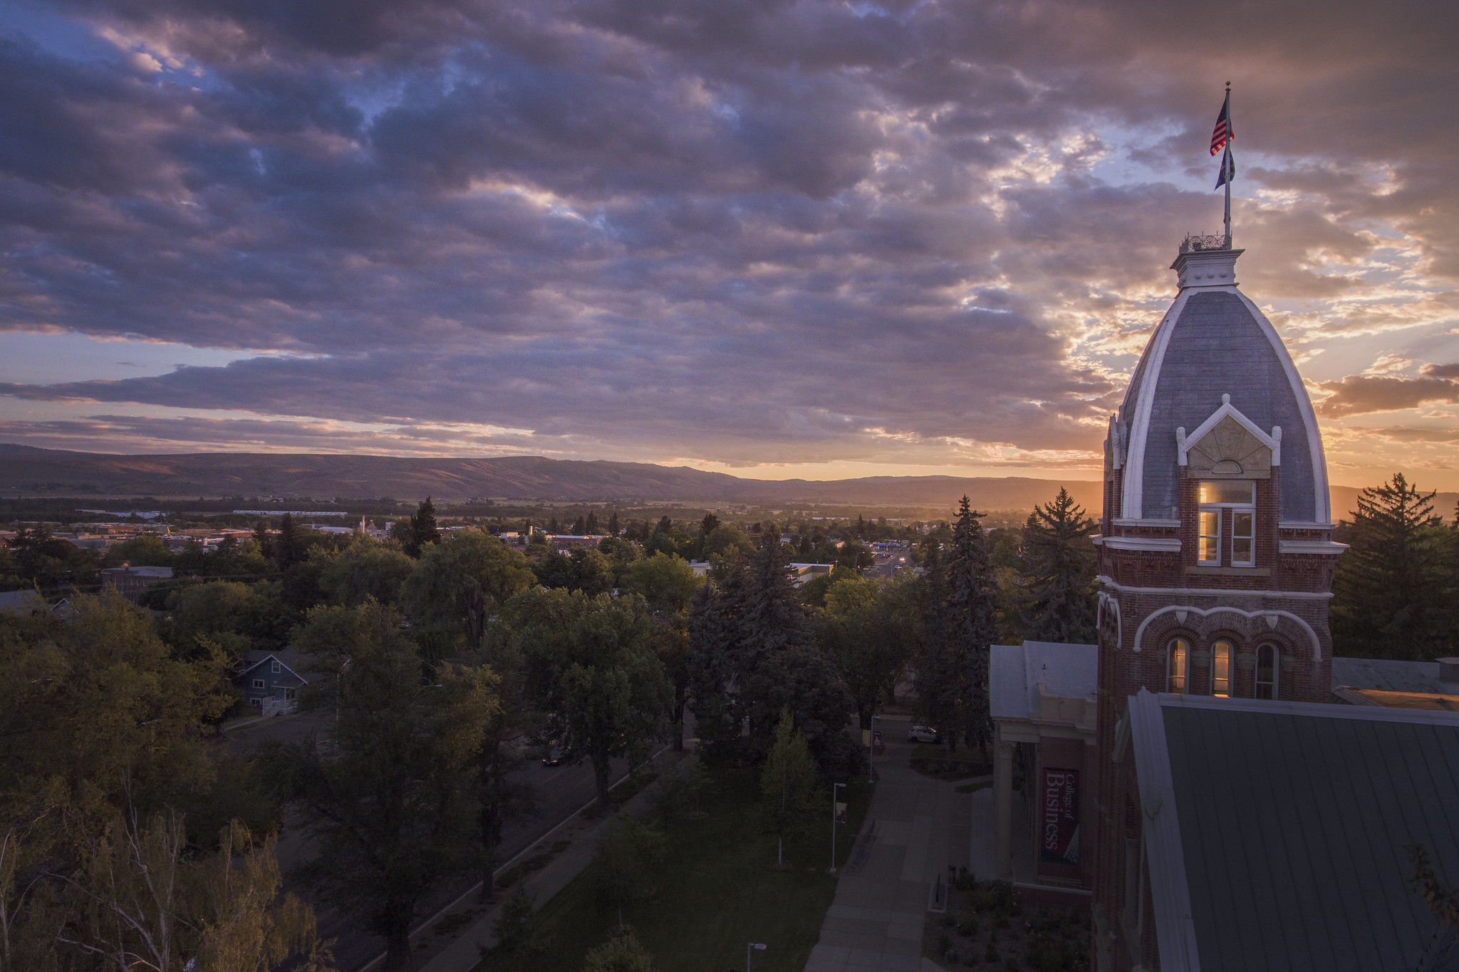
Who Does What, When? Know YOUR role in the CIHS Process
Presented by: Jon Salazar
Notes:
Hello for those of you who did not have me in the earlier session, my name is Jon Salazar (he/him/his). Today we will be going over what CIHS looks like in a typical year. As we go through this presentation, think about how CIHS is operated at your school? What processes can change?

Slide 2
Purpose
CWU Vision: Central Washington University will be a model learning community of access and opportunity.
You are often the first point of contact with your students and their parents/guardians
We want you to walk away confident that you know your roles and responsibilities including where to find resources and information
Notes:
As instructors/administrators, often you are the first point of contact your students and their parents/guardians have to information regarding CWU College in the High School. Your students are parents/guardians know you and feel more comfortable asking you questions pertaining to our program.
While we don’t expect you to have all the answers, we want to provide you with accurate information regarding our program so that you can come away from this presentation confident that you answer most questions pertaining to our program. Or at the very least, you can direct them to the right places.
We’ll walk through the most asked questions our team receives from students and parents and how to answer them.

Slide 3
Discussion Questions
Q1: How many people are involved with CWU CiHS at your school? District?
Q2: Who/what is a Reviewer?
Notes:
3-5min discussion.

Slide 4

Discussion Answers
A1: Everyone! Or at least more than you think.
A2: Reviewers are school staff who check student apps & upload documents
Today we’ll focus on Teachers & Reviewers
Notes:
Yes I mean everyone, while we love our teachers, we recognize everyone contributes to creating a comfortable and inclusive learning environment. Students wouldn’t be able to learn without teachers, but also if the trash was piled high, or if there was no breakfast or even subs because our teachers deserve breaks too.

Slide 5
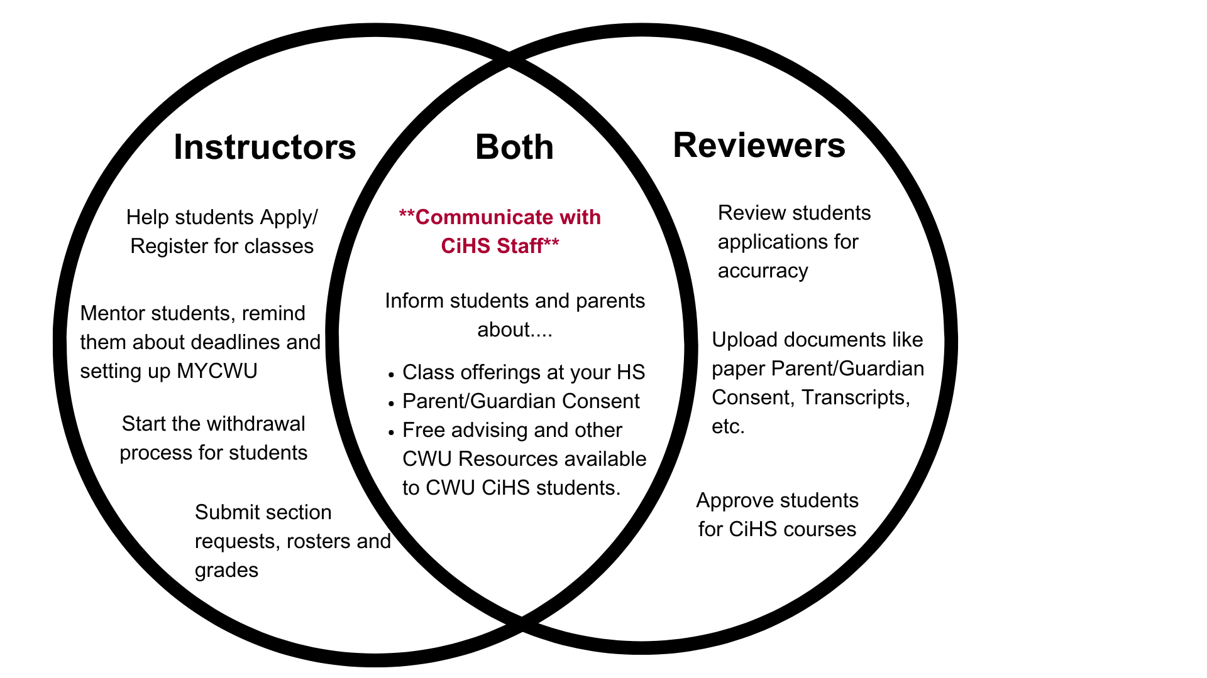
General Overview
Notes:
There are a lot of people involved in the College in the High School process. Teachers and Reviewers however do a majority of the work and typically have access to our online registration site (cihs.cwu.edu). Communications between students, teachers, reviewers, families and the CiHS Office is critical. Let’s look over the responsibilities of teachers and reviewers at their school. Notice some similarities – things we should all be doing. We will go into more detail through this presentation and provide you with an overview of just how quickly things can happen in College in the High School.

Slide 6

CIHS in a Year
Oh the places you will go.
Let’s take a look at a typical year of offering CIHS.

Slide 7

July & August
  Teachers: Attending SI, submitted section requests
  District: Completing Interlocal Agreement with CWU
Notes:
Summer Tasks:
We know you work very hard during the year, so we try not to take too much of your time over the Summer. Returning teachers will receive section request emails in May or June for Fall. If you are a new teacher or new to your discipline you will receive a section request email once we confirm you completed your required training today.
Teachers are required to attend Summer Institute every three years to remain in compliance.

Slide 8

Quick Check 1
  What is an Interlocal Agreement?
  An (ILA) is the annual contract between your school district and Central Washington University. It outline the rules and regulations all parties agree to follow.
  i.e- Student teacher, subs, reimbursement rate
  A copy can be found at your School District office.
Notes:
The interlocal agreement (ILA) contains a list of approved schools and teachers authorized to offer specific CWU courses. If a teacher is not listed in the ILA they cannot offer CWU courses.

Slide 9

September
Students: Fall Registration Window Opens
Teachers: Informing students & helping them sign up for classes. Don’t forget to check your real-time CIHS.CWU.EDU roster!
Reviewers: Think about hosting a Parent Night or use your school’s communication system to let parents know about CWU CiHS.
Notes:
School is back in session. Our Fall 2025 registration period for ALL schools opens September 8th, 2025 and closes October 3rd, 2025. It’s okay if students are seated in your class before they can sign up on cihs.cwu.edu, this is their time to get a feel for the class and determine if they want to sign up for college credit. Teachers should be informing their students about CiHS options available to them. Counselors should also be informing students and families about dual credit. Consider hosting an dual credit night at your high school.

Slide 10

October
Students: Seated in the correct class. Explore campus and meet with Admissions during Wildcat Preview Day (Saturday October 11th).
ALL Teachers: Check your live rosters!! Is anyone missing? Late Registration & Parent Consent
Trimester Teachers – Uncontested Withdrawals
Reviewers: Reviewing student applications, adding supporting docs.
Consider adopting building procedures for when a student wants to withdraw? Do the counselor AND teacher both know?
Notes:
Students should be seated in the correct class before the registration window closes. Make sure you are all checking your rosters! If a student signed up for the wrong class, they can correct it themselves before the enrollment window closes by logging into their cihs account and viewing their class applications. Students also have their first opportunity of the year to visit CWU for Wildcat Preview Day.
Trimester counselors and administrators should know October is busy month with many pumpkins to juggle. Late registration, parent consent and uncontested withdrawals are due in October all while you’re reviewing student applications and uploading supporting docs like transcripts, contracts of understanding, paper parent consent, etc.

Slide 11
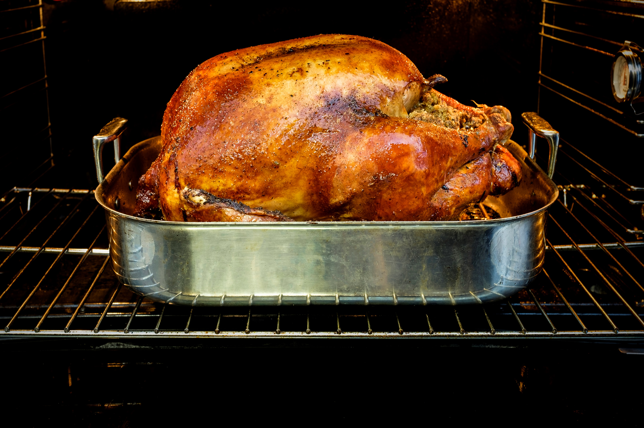
November
Student: Students access CWU resources
Semester Teachers: Check-in with students about Withdrawals for Fall Semester
- Trimester Teachers: Students sign up for Winter classes, FALL Complete Withdrawals & Hardship Petition due
Reviewers: Finish reviewing last few student apps in ‘Corrections Required- See Notes” status. Start thinking about the courses you want to offer next year. Encourage teachers to start an application.
Notes:
Teachers you and your students have access to CWU resources, feel free to use them! Think about the different ways you can use the library, tutoring and other services into your classroom assignments. Semester staff engage with your students about uncontested withdrawals.
If your school team would like to meet with me and go over teacher minimum qualifications and the application process. I’m also happy to speak for a few minutes at an AM staff meeting or maybe Fall PD day.

Slide 12

Quick Check 2
  1. What are the three types of withdrawals CWU CiHS students can use?
  2. Do you know what supporting docs a Reviewer might upload?
Notes:
CWU CiHS offers three types of withdrawals for students, can you name all three? Hint the answer may be right in front of you. This is an open book question!
This one might be a little more tricky… what type of documents do you think a Reviewer uploads?

Slide 13

Quick Check 2 Cont.
  Complete, Hardship Petition & Individual/ Uncontested
  Contracts of Understandings, Accuplacer score reports, transcripts, AP Scores, Paper parent consent and class schedules.
Notes:
Uncontested or Individual Withdrawals are used when a student wants to leave some of their CWU classes while remaining in others. Watch out, this is always the first withdrawal deadline.
Complete withdrawals are used when a student wants to leave all of their CWU classes. If the student only signed up of rone class and wants to leave, it is a complete withdrawal.
Hardship Petitions require additional documentation and a legit hardship. This type of withdrawal is for students wishing to leave some of their CWU courses for extenuating circumstances while they remain in other CWU courses. At the end of the quarter it may be better to enter an incomplete and a grade change form after the student completes coursework.

Slide 14

December
Student: Winter Break
Teachers: Trimester Fall Grade Due
Reviewer: Processing Trimester Winter applications.
Everyone: Make sure everything is okay and accurate before leaving for break.
Notes:
You and your students may be on break, but our office will be open throughout the month of December. There’s not much going on for Semesters aside from planning for the future – next semester and next year. Trimesters on the hand have to repeat the registration process. By now students should be signed up but staff should still remind them about upcoming parent consent before leaving for winter break.
Counselors should also work on approving students and processing winter applications.
Teachers remember to submit your grades before leaving for break.

Slide 15

January
Student: Practicing good study habits and 2026 goals.
Teachers: All: Check rosters and ask about Withdrawals
Semester Fall Grades Due
Reviewer: More in-depth planning about what classes to offer next year. Give teachers time to complete an application.
Notes:
CiHS is the perfect opportunity for students to practice their goal setting.
Teachers should check in with their students about withdrawals. Specifically Trimester uncontested withdrawals for Winter Quarter and Fall complete and hardship withdrawals for semester students.. Fall semester grades are also due at the end of the month.
Semester counselors your students register for classes next month. Has the computer lab or devices been reserved for testing? Do students meet prereqs?
Closely monitor deadlines if your school has a week off in January.

Slide 16

February
Students: Semester students sign up for Spring classes. All students can visit CWU & Ellensburg at Wildcat Preview Day
Sem. Teachers: Spring Registration window
Tri. Teachers: Ask students about Winter Withdrawal requests.
Reviewers: Making sure your school is meeting deadlines and staying on track. Semester staff make sure you’re informing students & home about dual credit.
Notes:
Love is in the air and students have another opportunity to fall in love with campus at Wildcat Preview Day. While semester students are signing up for Spring classes, trimester students must submit any Winter withdrawals.

Slide 17

March
Student: Feeling lucky its almost Spring Break
Tri. Teachers: Winter grades due
Sem. Teachers: Spring Late Reg & Consent deadlines
Reviewer: Start thinking about Accuplacer testing. When can students test? Who can proctor?
Everyone: Finish your business before leaving for break.
Notes:
Teachers and Reviewers, keep each other accountable and pay attention to deadlines. Make sure students and staff have completed all their tasks before going off to Spring Break.
Reviewers and admin: have all your students wanting to take a central class signed up? Have teachers completed COUs before break. The teacher application for adding classes next year closes in two months. Will your staff meet the deadline?

Slide 18
Quick Check 3
1: When are section request emails sent out and do you have to respond?
2: When will teachers have access to their accounts if they are not teaching the term before.
Notes:
This is our last Quick Check and the questions are a little more tricky.

Slide 19
Quick Check 3
1: Section Request emails are sent before the term. You must respond to the email even if you are not teaching. There is a “no” option. Use it.
2: Teachers gain access to their account 10-15 days before the start of the term they are teaching. You will lose access the day after grades are due if you are not teaching the following term.
Spring Qtr- everyone loses access after grade deadline
Notes:
We use section request emails to build your CWU courses in a timely manner. New this year, we have added a section request deadline at the request of our Registrar’s office who was getting a little overhwlemed by the number of last minute class builds.
Look at the people around you in this room, please be a good neighbor and plan ahead.

Slide 20
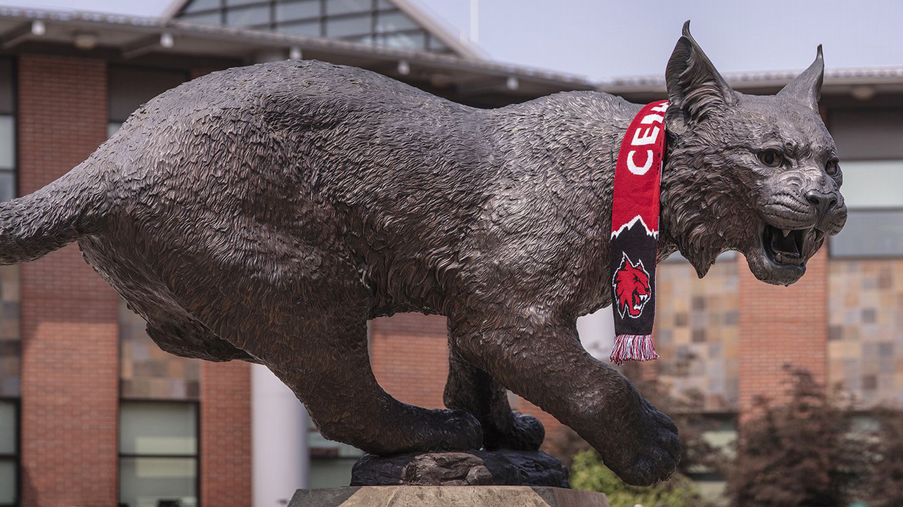
April
Student: Meet with Admissions, Financial Aid, Housing, Student Employment & other CWU depts. during Spring Wildcat Preview Day.
Tri Teachers: Spring Registration closes, Late registration & consent due.
Sem Teachers: Spring Uncontested withdrawals due.
Reviewer: Start Accuplacer Testing
Notes:
You all should be back from Spring Break now. Students have one final chance to connect with Admissions and Financial Aid on campus.

Slide 21

May
Student: Seniors are checking their unofficial transcripts
Teachers: Watch for Withdrawals. Teacher Application closes.
Reviewers: Look at SI dates, encourage new coworkers to attend.
Notes:
Make sure students are aware they should not purchase an official transcript before spring grades are finalized if they’re taking a Spring class. Students can use unofficial transcripts for academic advising and scholarships.
Teachers make sure to give your students another withdrawal reminder.
Are there any Spanish or ASL teachers here today? The World Languages Department also holds a festival in May and in the past schools have brough CiHS students to campus.

Slide 22
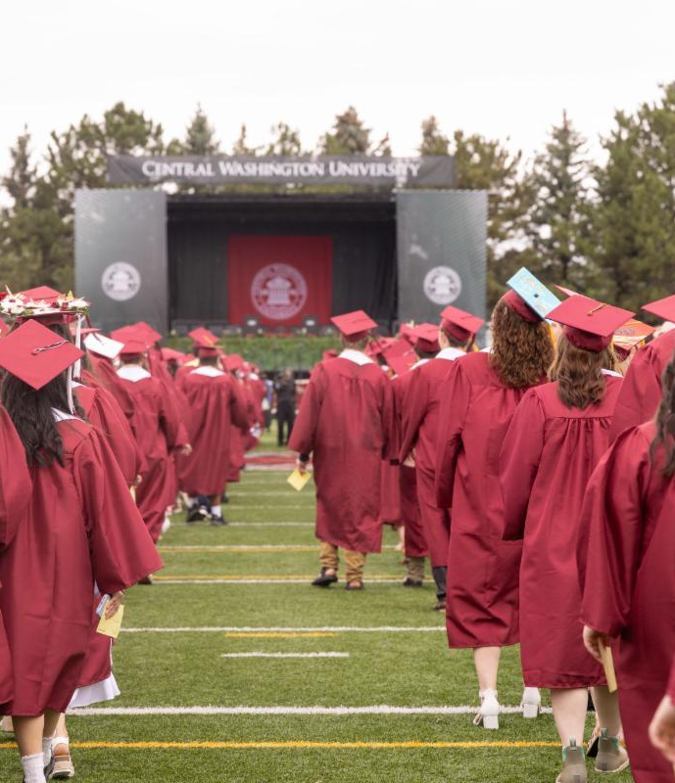
June
Student: Seniors request official transcripts after Grades due.
Teachers: Submit grades before their due.
Reviewer: Graduation prep work
Notes:
You’re almost there!!! Make sure you submit final grades before leaving for vacation. You will not have access to your account and the grade portal over the Summer.

Slide 23
Withdrawal Game
  1. Lisa is enrolled in one class and wants to leave.
  2. Seth moves to Akron, Ohio mid-semester and can’t finish all 3 of his CWU classes.
  3. Mary is enrolled in TH 107, SOC 109 and MATH 154. Mary only wants to leave MATH 154.
  4. Jenn is involved the court system and is unable to complete all 2 of her classes.
    Nearly 4 in 10 students are indirectly exposed to the legal system before they turn 18 (U. MI, 2022)
  5. Heather shows up to school wearing a boot around her foot. They want to leave PEAQ 111 while remaining in ENG 263 and GEOG 208.
  6. Bonus: Bronwyn is too excited to sign up for CiHS classes on the first day. She accidentally signs up for PHYS 181 instead of PSY 101.
Based on the following prompts determine what type of withdrawal each student needs.
Don’t worry about deadlines for this exercise just focus on the withdrawal type.
Feel free to use Pg 6 Additional Deadline Info in your booklet.
Notes:
If we have adequate time….
I will read the questions aloud for everyone. As I’m reading think about each type of withdrawal the students need. Feel free to use Pg 5 Deadlines and Definitions. This is an open notebook exercise. Then I will give you a few moments to think and share with your groups. Then we will discuss this as a larger group and answer any questions.

Slide 24

Withdrawal Game
  1. Lisa is enrolled in one class and wants to leave.
  2. Seth moves to Akron, Ohio mid-semester and can’t finish all 3 of his CWU classes.
  3. Mary is enrolled in TH 107, SOC 109 and MATH 154. Mary only wants to leave MATH 154.
  4. Jenn is involved the court system and is unable to complete all 2 of her classes.
    Nearly 4 in 10 students are indirectly exposed to the legal system before they turn 18 (U. MI, 2022)
  5. Heather shows up to school wearing a boot around her foot. They want to leave PEAQ 111 while remaining in ENG 263 and GEOG 208.
  6. Bonus: Bronwyn is too excited to sign up for CiHS classes on the first day. She accidentally signs up for PHYS 181 instead of PSY 101.
  Answer Key
  1. Complete Withdrawal
  2. Complete Withdrawal
  3. Uncontested Withdrawal
  4. Complete Withdrawal
  5. Hardship or uncontested Withdrawal
  6. Drop
  How many did you get right?
Notes:
If we have adequate time….
I will read the questions aloud for everyone. As I’m reading think about each type of withdrawal the students need. Feel free to use Pg 5 Deadlines and Definitions. This is an open notebook exercise. Then I will give you a few moments to think and share with your groups. Then we will discuss this as a larger group and answer any questions.

Slide 25
Contact Us:
Email: HSPartnerships@cwu.edu
Phone: 509-963-1351
Website: https://www.cwu.edu/academics/specialized-programs/college-high-school/
Contact Me:
Email: jonathan.Salazar@cwu.edu
Phone: 509-963-1731
Notes:
If you think of questions later, please don’t hesitate to reach out.

Slide 26
Agenda for the day
Time | Subject
8:40 am – 9:25 am | New Partner Orientation
9:35 am – 10:10 am | Break Out #1
10:20 am – 10:55 am | Break Out #2
11:05 am – 12:00 pm | New Partners – Discipline Specific Orientation with Liaisons Veterans & Admins – Interactive Q & A
12:00 pm – 12:45 pm | Lunch/New Partner cont.
12:45 pm – 3:00 pm | All with liaison for Professional Development
Notes:
Quick refresher on today’s agenda. After here, you will have the option to attend two different break out sessions. Feel free to look at Today’s agenda for a description of each break out session.

Slide 27
Room Locations
First Floor Rooms
Breakout Rooms
  FAQs w/ Zane – Room 150
  Advising w/ Angelia – Room 152
Communication – Room 136
Math – Meet in Lobby.
Physics – Meet in Lobby.
Returning Teachers & Admin – Room 150
Second Floor Rooms
Engineering & Safety – Room 203
English- Room 202
Environmental Studies – Room 201
Finance – Room 224
History – Room 208-2
Physical Education – Room 209
Psychology – Room 228-19
Notes:
After attending two break out sessions, new teachers will meet with their Faculty Liaison while returning teachers and administrators/reviewers will participate in a program Q & A with our Assistant Director Sarah Maes.

