Slide 1

Summer Institute 2025
Veteran Refresher
Zane Morrison
Program Support Supervisor
Notes:
Introductions

Slide 2
Agenda for the day
Time | Subject
8:40am – 9:25am | Veteran Instructor Briefing
9:35am – 10:10am | Breakout Sessions (Choose one of three)
10:20am – 10:55am | Breakout Sessions (Choose one of three)
11:05am – 12:00pm | New Partners: Orientation with Liaisons Veterans & Admins: Interactive Q & A
12:00pm – 12:45pm | Lunch / New Partners Orientation cont.
12:45pm – 3:30pm | All with liaison for PD

Slide 3
High School Partnerships Staff
Kyle Carrigan – Director of Concurrent Enrollment – kyle.carrigan@cwu.edu
Sarah Maes – Assistant Director of CiHS– sarah.maes@cwu.edu
Zane Morrison – Program Support Supervisor–zane.morrison@cwu.edu
Jonathan Salazar – Program Coordinator – Jonathan.Salazar@cwu.edu
Angelia Riviera – Associate Director of Running Start – angelia.riveira@cwu.edu
Chuck Dickson – Program Coordinator – Charles.Dickson@cwu.edu
Chelsea Braun – Sammamish Advisor – chelsea.braun@cwu.edu
Arviso Alvord – Fiscal Specialist – arviso.alvord@cwu.edu
Scott Landwehr - Fiscal Specialist - Brendan.Landwehr@cwu.edu
Notes:
We had an advisor but currently that position is vacant with the hopes of being filled soon.

Slide 4
College in the High School Numbers
Since 20-21, we’ve experienced steady growth
Notes:
Since 2020-21 AY, our number of total students has nearly quadrupled from a little over 4,700 students to more than 16,338 students earning CWU credit
We’ve also seen our total number of registrations grow tremendously, especially in the last two years. We went from having close to 14,000 registrations to now a little over 29,000 registrations.
Most of these numbers are in direct correlation with the state funding changes that passed two years ago to make CiHS free for public high school students.

Slide 5
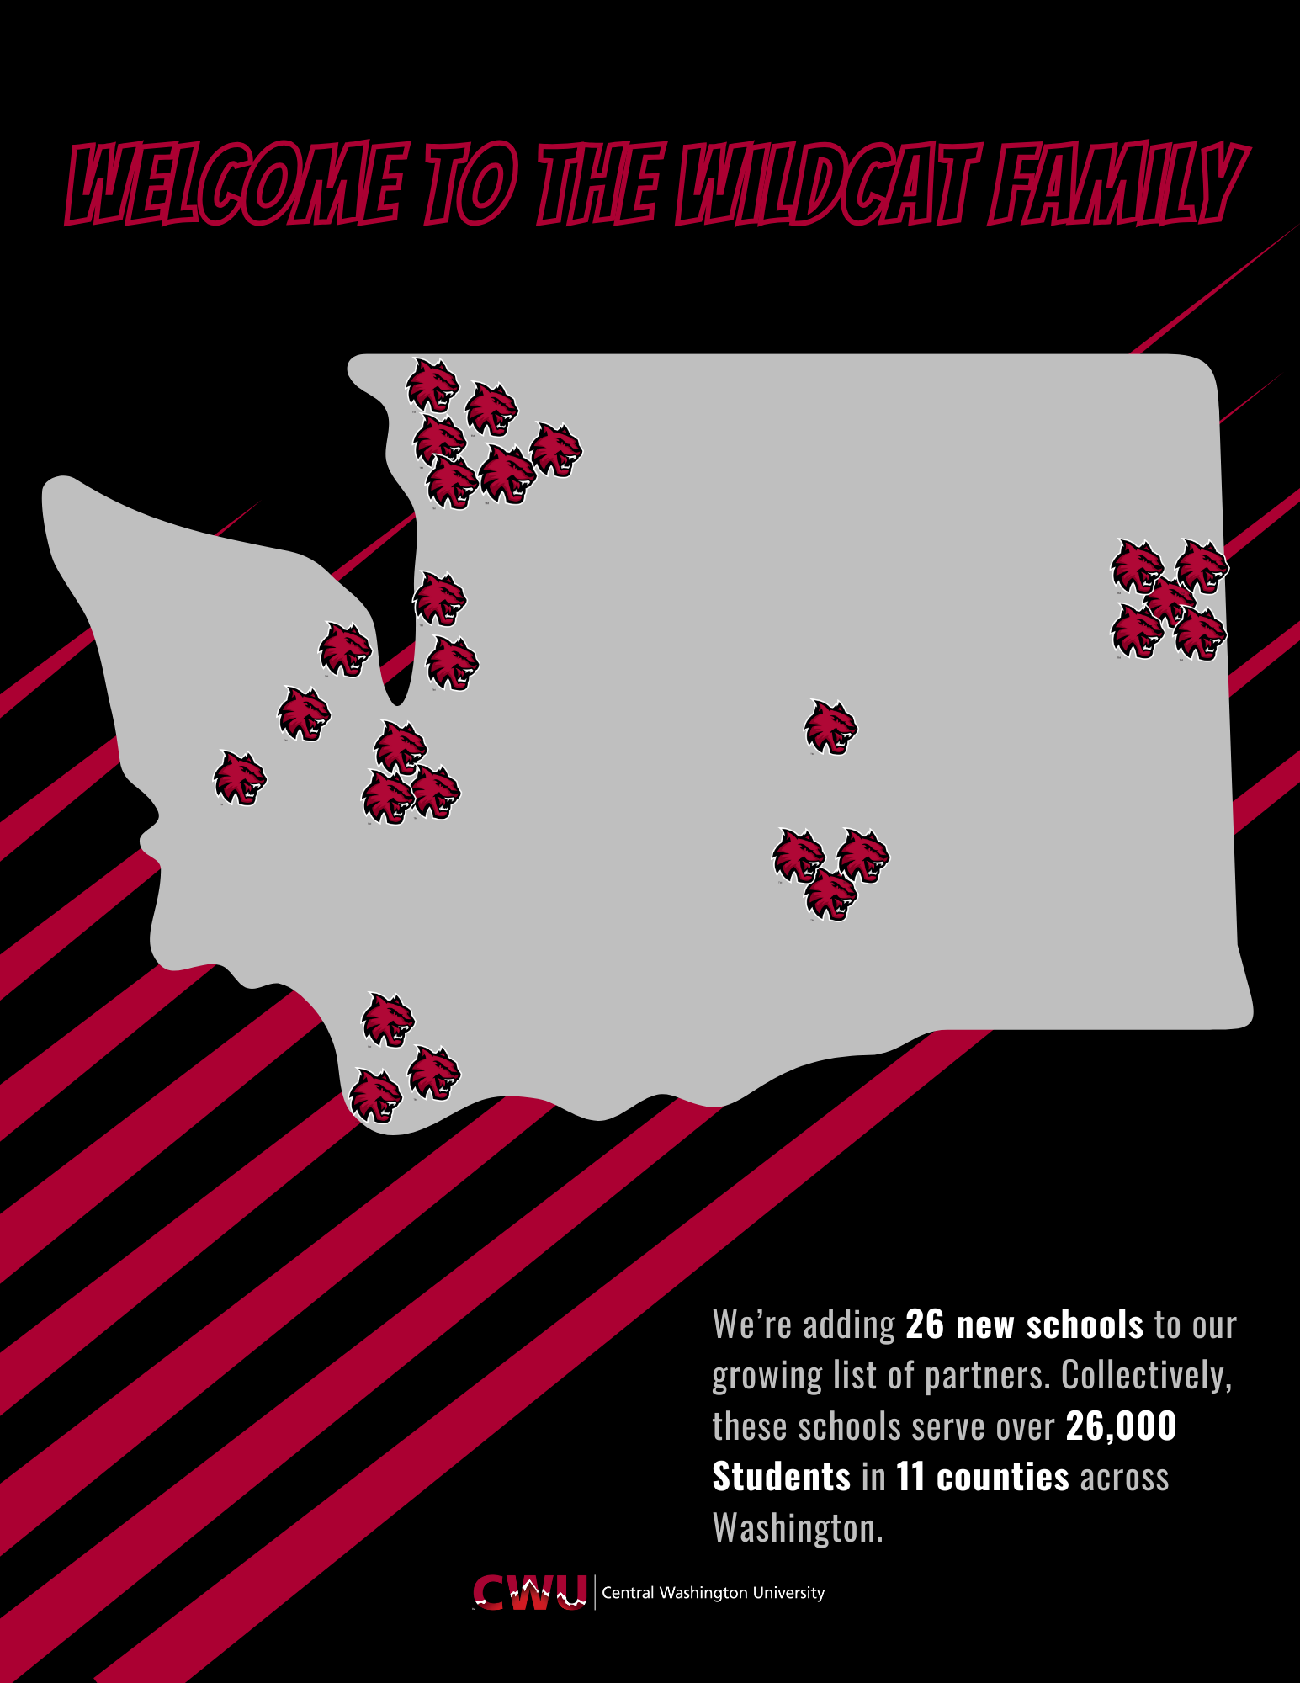
New state funding effects:
Increase in teachers
  2024-25: 212 new teachers approved.
  2025-26: 243 new teachers approved in 17 disciplines so far as of 6/16/25
New Schools
  Welcome our 26 new schools*
Increase in registrations and enrollments
Students
Credits earned
Notes:
With this increase we are doing more outreach, we will be contacting the teams at our new schools with some additional information and support.
UPDATE graphic for 2025

Slide 6
Things to keep in mind:
Nothing has changed for those eligible: 9th, 10th, 11th and 12th.
Registration still requires parent and student signature to sign up. This is required every time a student registers
There is not automatic enrollment, students still have to register.
Just because the cost is free does not mean that it makes sense for a student’s future goals.
Notes:
We’ve seen an uptick in withdrawals and low grades. Remember this is on a student’s permanent transcript.
Tracking students that attend more than one school is a data accuracy puzzle, we’re working with the schools and the skills centers and our platform vendor to make it as clear and efficient as possible.

Slide 7
CiHS Course Updates
New Courses:
  ATM 280 – Basic Sewing Techniques
  ATM 301 – Intro to the Fashion Industry
  CMGT 101 – Construction and the Built Environment
  ENG 263 – Intro to Creative Writing
  MUS 105 – Intro to World Music
  PSY 205 – Psychology of Adjustment
  SHM 102 – Occupational Health
If you or your colleagues are interested in applying for these courses, you may do so when our application window opens this Fall.
Notes:
We’ve added some new courses that we will be accepting applications for during our next teacher application window
Apparel, Textiles and Merchandising 280 – Basic Sewing Techniques
ATM 301 – Introduction to the Fashion Industry
Construction Management (CMGT) 101 – Construction and the Built Environment
ENG 263 – Intro to Creative Writing
MUS 105 – Introduction to World Music
PSY 205 – Psychology of Adjustment
Safety and Heath Management (SHM) 102 – Occupational Health
These are the changes to some courses

Slide 8
CWU English 101 eligibility
English Directed Self-Placement is the only way to get into ENG 101.
https://www.cwu.edu/general-education/directed-self-placement
Students must take survey
Conversation with students about results to ensure readiness
Talk with Josh or Austin about details
Do not use Accuplacer Testing for ENG
Notes:
Just make sure they take the survey BEFORE they register.
If you have questions about the Stretch or the AW1 Recommendation, please check with Josh and/or Austin.

Slide 9
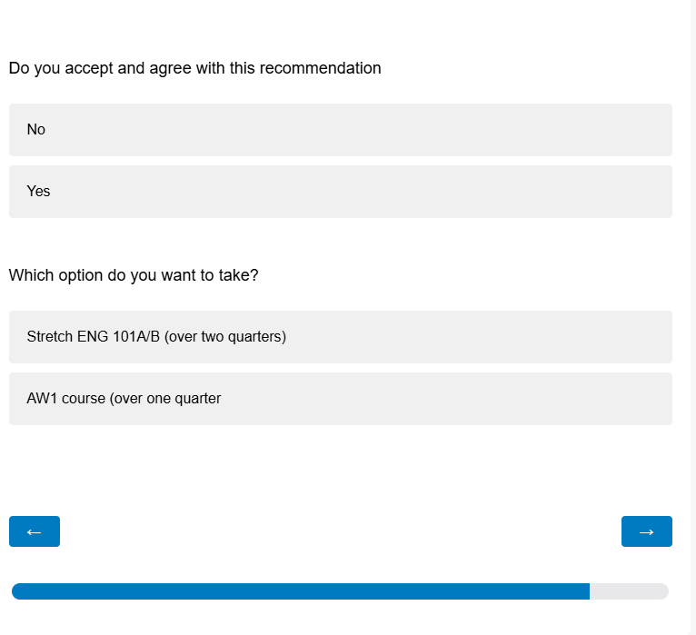
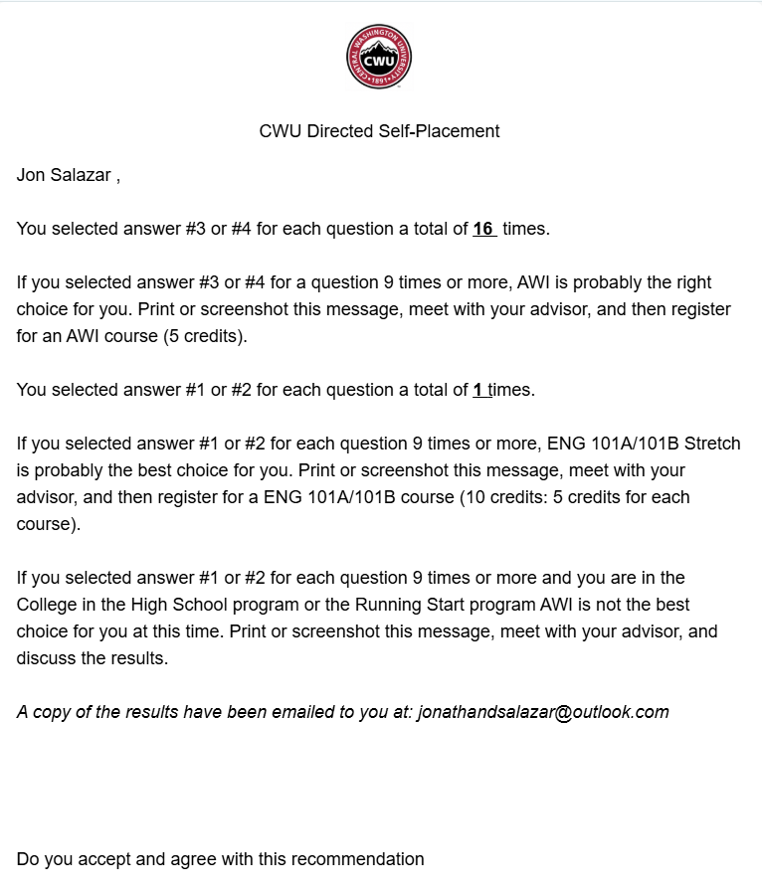
ENG 101 Self-Placement Cont.
Notes:
Self-Placement pain point, is that students will receive this results page on the left-hand side and believe they’ve completed the self-placement.
There’s two more questions the students must complete within the survey which are Do you accept and agree with this recommendation and which option do you want to take.
After they answer those questions, they will get the same page again on the left-hand side, but their results will be recorded this time.

Slide 10
CWU Testing - Math
Your High School can be set up as a CWU Accuplacer Next-Generation site
Remote Accuplacer Testing is also available
Benefits of using CWU Testing:
Costs covered by CWU CiHS again this year
Testing takes place at your high school
CWU has records of their test scores
Please contact:
William (Bill) Thelen
Bouillon Hall 125
400 East University Way
Ellensburg, WA 98926-7427
Phone: (509) 963-1860
E-mail: William.Thelen@cwu.edu
Notes:
Make sure your students take the Accuplacer NG Math exam.
They’ll need a Quantitative Reasoning, Algebra and Statistics score or an Advanced Algebra & Functions score to meet the prerequisite.
See the Course Descriptions and Prerequisites Guide, in your booklet, for specific scores needed for specific Math, Finance, or Physics courses.
CiHS will be covering the costs for math Accuplacer testing again this year. So no cost to the student or the school.

Slide 11
CWU Testing – MATH Cont.
The ONLY Accuplacer test that your proctor(s) will administer for placement will be:
*CWU Math Exam_NG
  This exam consists of two Math tests
  All students will start with the Next-Generation Quantitative Reasoning, Algebra and Statistics
    After completing the first test students will complete either:
      Next Generation Arithmetic (Placement score not accepted for placement)
      Next Generation Advanced Algebra and Functions
    Students must complete BOTH tests every time they take the test
    Students can take this exam three times
* If you administer any other exams, they may not be valid for placement

Slide 12
Prerequisite Requirements
ENG 101 – Directed Self Placement
ENG 102, 105, 263 – Prior course(s)
ECON 130 – Math placement
ETSC 265 – Prior course
*FIN 174 – Math placement
HUM – Prior course
*MATH – Math placement or prior course
PEAQ 112 & 113 – individual ability demonstrated
*PHYS – Math placement or prior course
*World Languages (152 & 153) – Prior course
*This is where COUs might come into play. Please be sure to fill them in completely if you need to submit one for a student.
Get them back to your Reviewer for upload.
SEE Course Descriptions and Prerequisites handout
Notes:
These are the disciplines or courses that have prerequisites.
Please be familiar with the prerequisites and how they are met.
Different disciplines or levels have different requirements and if you have any confusion, please ask.
“Prior coursework” means previous COLLEGE course.
Being seated in the class last year, but not enrolling for the CWU credit, means that they might not meet the prerequisite.
Please make sure the students have met the prerequisite BEFORE they register. Check with your Reviewer, do they need a COU or other documents?

Slide 13
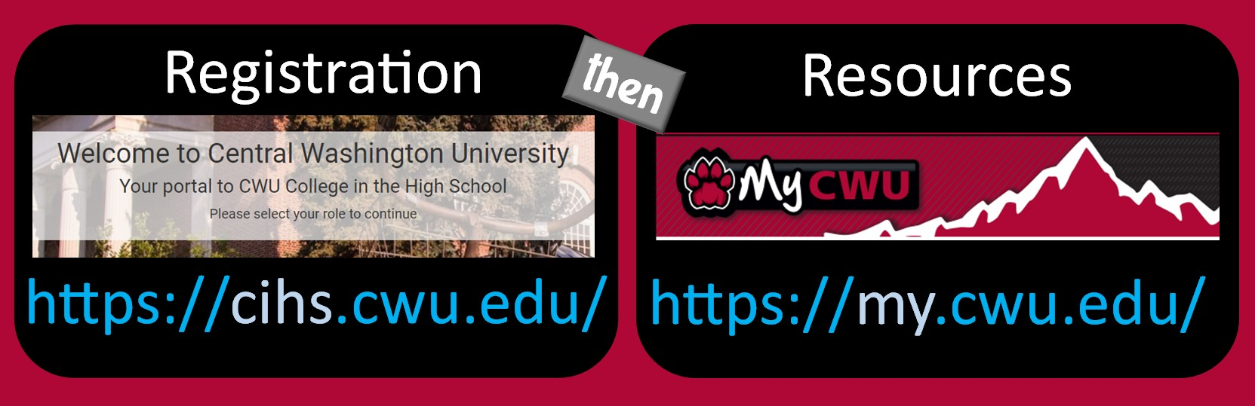
Two accounts for teachers – same sign in
Add class periods, class schedule, upload syllabi, access forms, track student registrations, verify class rosters.
Official permanent roster, grading roster
Notes:
Teachers have single sign on, while students need to track two different log-ins.

Slide 14
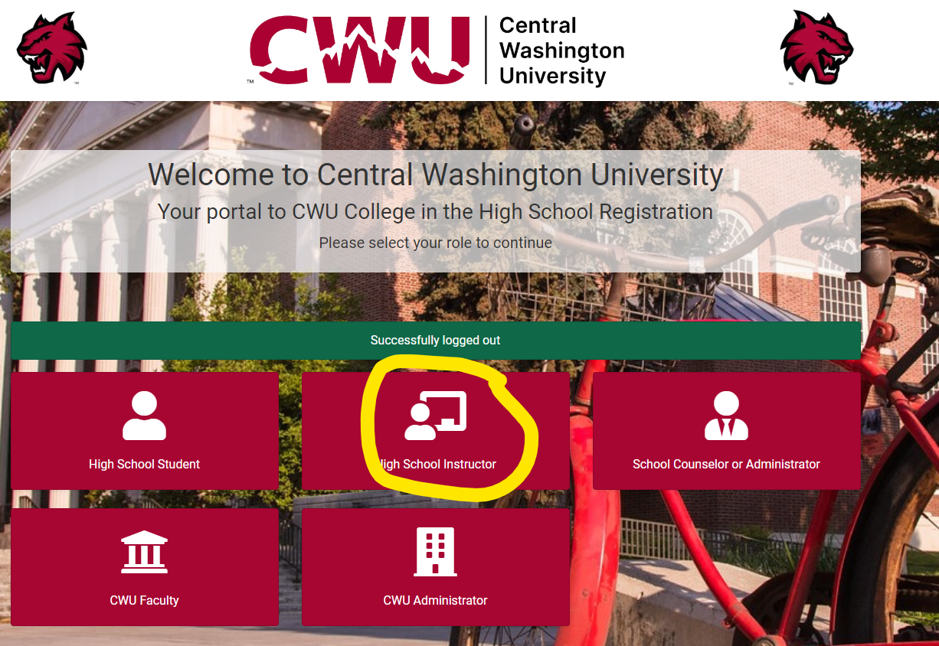
In your CiHS.cwu.edu account
Monitor the intake
Notes:
Please watch your roster in CiHS! Watch for parent consent and to make sure that everyone signed up before deadline.
If the student doesn’t show on your roster, they didn’t make it all the way through the process, haven’t actually applied, and won’t be enrolled.
Remind about parent/guardian consent.
Students that do not sign up during the registration window cannot go back and do a retroactive enrollment.
Registration is on line, cloud based, and they can do it anywhere on the planet. Being away from home or whatever is not a real good excuse. It takes only a few minutes.

Slide 15
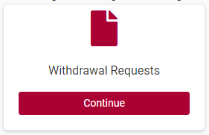
Within your CIHS.cwu.edu Instructor Account
My Classes:
See your classes
Check your “working roster” in real time.
Withdrawal Requests:
Submit a withdrawal request
My Files:
Your application (if done online), any material you add
CIHS Adjunct Application:
Apply for a new discipline or additional courses
Shared Docs:
COUs, parent consent forms in English and Spanish
Syllabus template, upload instructions and more
Announcements:
Reminders and Deadlines, etc.
Notes:
There’s a lot of capability within the platform, but just because it’s online, cloud-based, and in real time…check around and see how it can support you.
Page 29 shows an example of what the instructor homepage in CiHS looks like and that you all should be familiar with.
Teachers can submit withdrawal requests. Any time a student leaves your classroom, they must be withdrawn.

Slide 16
To get set up for Registration:
Get your class listed in CiHS platform
  Respond to the section request emails
    New for 2025 – Section Request Deadline (see page 5 in booklet)
  Check the platform before registration opens
Get prerequisites and/or testing lined up well in advance
  Accuplacer Next Generation for math
    Need an AAF or a QRAS score
  English Self-Placement for ENG 101
  Transcripts for “prior coursework”
Have your syllabus ready to upload
Notes:
Please do as much as you can before the very last minute.
It requires a lot of work on our Registrar’s end to build these courses. We only have one person who builds these courses so if we receive inaccurate course builds, it creates a lot of unnecessary and additional work for her.
Check with your admins and if you’re teaching the class, respond to the course build request. (as a rule, you’re getting much better at this)
Do your testing and prerequisite stuff in advance and so forth.

Slide 17
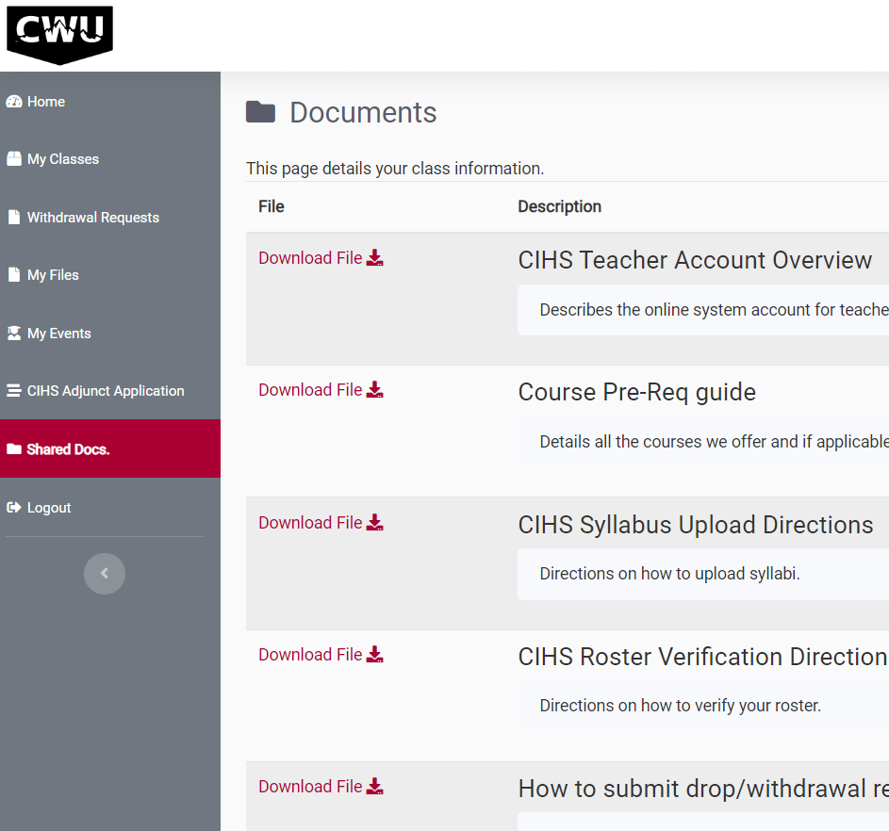
Look in Shared Docs
Most of our forms and guides are located in CiHS.cwu.edu under Shared Docs
  Consent Forms
  Process Guides
  COUs
  How-to’s for students, instructors, and reviewers
Notes:
Helpful hint for you – most of our forms and guides are located in the cihs.cwu.edu system.
These are available to both the school reviewers and the instructors.
Pages 28-31 in our booklet is a teacher guide that walks through all the uses of the instructor platform within CiHS.CWU.EDU

Slide 18
CIHS registration info for students
Share information about the registration process and the online platform with your students and families before the window opens.
  Refer to materials in your handbook, share links and hand-outs.
Deadlines are firm.
  Use our deadlines to create internal deadlines
    Do not wait until the very last minute
  The grace period when we accept Late Registration Requests also has firm deadlines.
Notes:
There’s information included in your booklet starting on page 8-23 that we hope you will share with your students.
Get the word out to your families before registration starts.
Print the hand outs, attach the PDFs to emails to families, send out the link to the student participation guide.
Watch your deadlines. They are in your booklet, on the website, within CiHS registration platform, and we send reminders via email and newsletter.

Slide 19
Remind your students:
New-to CWU students start an account in cihs.cwu.edu
Returning students log in.
  Do not start a new account in CiHS, call our office for assistance if needed.
  Use a personal email address
Just because the class is free, does it make sense to register?
  Are they prepared for the rigor and have clear expectations
  Will they be successful? Consider grades and permanent transcripts
  Academic advising is available
Notes:
On this second point, just be mindful that attention should be given to what classes students sign up for and why. There could potentially be a financial aid impact later. And it also makes no sense for the student to take excessive courses in one subject. Please head over to the Academic Advising session with Angelia if you want more in-depth information about that.

Slide 20
How to get the required parent consent
Through the email sent to the parents
  Students need to have an accurate email address for their parent/guardian.
By having their student login to their account
Paper Consent form (in Shared Docs)
  Get the paper signed and then deliver it to your Reviewer who needs to upload it.
  Let us know it’s been done so we can check it off as received
Call our office
  English speakers: 509-963-1351
  Spanish speakers: 509-963-1731
Other situations
Notes:
It’s a big NO-NO for students to add the parent signature.
Paper consent forms are available in English and Spanish.
You can track consent in your working roster in CiHS.
If you have students who are 18+, homeless, emancipated, or “other” reason why parent consent isn’t available, call us. We won’t register them unless PC is received or input by us.
Additional concerns: Smiley faces, stars, flowers are not student signatures, and we’ll delete them and send a note through the system.
If we see a student has signed for the parent, we’ll delete that and send a note through the system.
If either or both signatures are not authentic, and in the system before deadline, the student won’t be enrolled.

Slide 21

Stumbling block! Email bounces
Students must have an email address for their parent/guardian that is
  Accurate
  Inbox that is frequently checked
Students should use a personal email address rather than an @school.org.edu address. Icloud inboxes are also problems.
Notes:
Email bounces delay registrations and our staff uses a ton of time following each one of them up to make a correction.
Please stress to your students the importance of having an active, accurate email address for their folks.
And to double check what they typed in their account.

Slide 22
More tips for students
Students should write down their log-in information (email and password) someplace safe so they can find it later.
To know what school* they go to
To know what CWU class & number to sign up for (i.e. Biology 101), and
To know what their teacher’s name* is
              *Seriously
Notes:
A big tip is for your students to just slow down.
Read, comprehend, and add information.
Make sure the information is accurate
Be aware of auto fill.
Provide them with the Student registration guide, in your booklet on page ________ and information found at the link: _________________________

Slide 23
During registration period…
Teachers need to:
  Watch your working/live roster, see the status change.
    Is anyone missing? Who still needs parent consent?
    Students must register and get consent before deadline.
    Did anyone register for your class by mistake?
If a student doesn’t show on your working/live roster, they’re not signed up!
High school reviewers go through registrations and provide information
  Class period, test scores, supporting docs like transcripts or COUs, etc.
Notes:
Please watch your roster in CiHS! Watch for parent consent and to make sure that everyone signed up before deadline.
If the student doesn’t show on your roster, they didn’t make it all the way through the process, haven’t actually applied, and won’t be enrolled.
Remind about parent/guardian consent.
Students that do not sign up during the registration window cannot go back and do a retroactive enrollment.
Registration is online, cloud based, and they can do it anywhere on the planet. Being away from home or whatever is not a real good excuse. It takes only a few minutes.

Slide 24
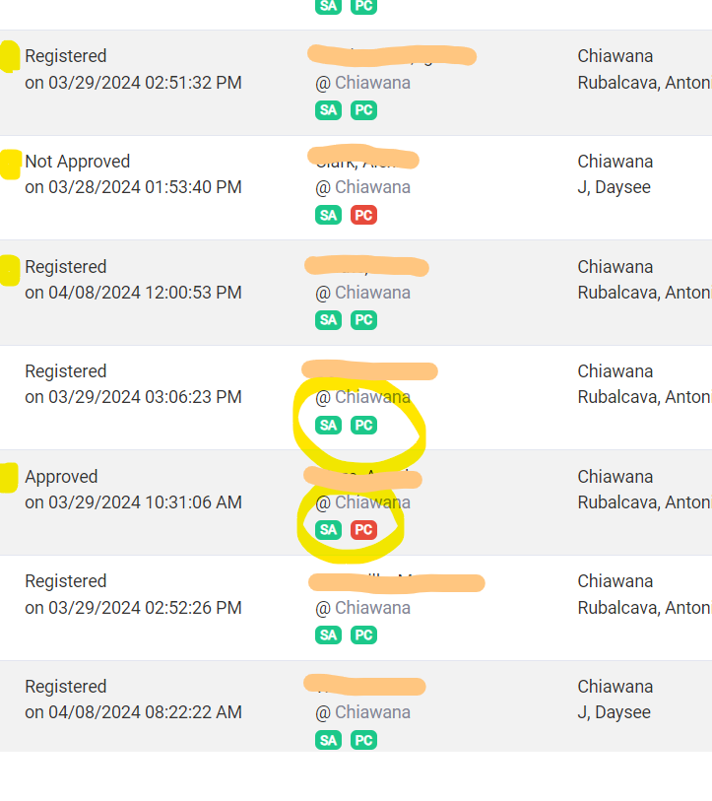
Roster Status
Applied: Student has signed up
Approved: Reviewer has done their part
Not Approved: Reviewer determined student is not approved to take course
Pending Review: COU needs faculty approval
Registered: Ready to be enrolled (or already enrolled)
Withdrawn
Dropped
Application Not Processed – See Notes: Can’t move student’s app forward
Corrections Required, See Notes: Something needs the school’s attention
Notes:
One thing you can see on your roster is whether a student who has left your class has been properly withdrawn.
Withdraws are started by the teacher in the cihs platform.

Slide 25
Late Registration Request
If students have a legitimate reason beyond their control for not meeting the deadline, they may submit a Late Registration Request.
Late Registration Requests only accepted for one week after registration period has closed.
Please do not approve or submit if it is past the deadline
All forms must be complete, signed and submitted all together from the school
They are processed after all the registrations which came in on time
We do deny requests so please remind students to take it seriously
Avoid this hurdle by watching your working roster in CiHS.cwu.edu
More information to come this Fall regarding finalized late registration policy
Notes:
A request packet consists of a student form, a reviewer form, proof of any prerequisites, and the student’s response to a writing prompt.
This the one week when you MUST catch any errors or missing students.
We have to know at the beginning of the term when something has gone sideways.
At the end of the term when you go to put in grades and you see someone is missing, it is too late. Nothing can be done.
Double check your roster at the registration deadline, or even before, and make sure everyone is on your list that should be.

Slide 26
After student registration period…
When we are done processing all the student registrations, you will receive a roster verification email.
  Pay attention to the status of each student
  Only students with “Registered” status will be enrolled
  Check your official MyCWU roster
  Confirm names, class period etc.
  Students who are missing at this time cannot be added
    Should have been looking at working/live class roster during registration period
Notes:
After the Late Registration period, students can not be added.

Slide 27
NACEP Syllabus Alignment
National Alliance of Concurrent Enrollment Partnerships (NACEP) Standards for Accreditation
CWU Course Title
CWU Course Descriptions
CWU Outcomes and Objectives
Instructor Name and Contact Information
Course term and dates (change each time)
The Syllabus Template is found in CiHS.cwu.edu, under “Shared Docs”
Notes:
See the syllabus template in your SI Guide Booklet, you’ll have time with your liaison to check on some details and get it ready to go.

Slide 28
Syllabi
Upload a copy of your CWU syllabus (pdf preferred)
  System sends reminders until it’s submitted
  Syllabi should be reviewed at Summer Institute
Submit one for each class, every term
Look for feedback from liaison
Follow the CWU Syllabus requirements; see the template in Shared Docs
Provide a copy of the CWU syllabus to your students at the beginning of the term
Notes:
In your book, the syllabus template is found on page 33-37.
It’s also located within the cihs.cwu.edu “Shared Docs” tab.
Don’t forget to distribute your complete/approved syllabus to your students.

Slide 29

Has single sign-on with your cihs.cwu.edu registration platform.
Is where to find your official class roster and your grading roster.
You have access while you have a course built and while you are teaching (until the grading deadline).
If you didn’t get grades in on time and your account is locked, please reach out to Zane at zane.morrison@cwu.edu or (509) 963-1381 instead of calling the IT Servicedesk
Check the term button to make sure you’re looking in the right term.
Gives you access to CWU Library and other resources.
Notes:
The password thing is tricky. If your password will expire while you do not have a class in session, then you don’t have access to update your password. We suggest changing your password at the end of your teaching term before your account shuts down for the summer. This will help you avoid complications later.
Please get your grades in before the deadline, or your account will lock you out.
Grading Guide is on page 38

Slide 30
Multifactor Authentication & Password Reset
All MyCWU accounts are required to use Multifactor Authentication (MFA) prior to signing into their accounts.
Most common MFA method is the Microsoft Authenticator App
https://www.cwu.edu/about/offices/information-services/security-services/mfa/index.php
If you have a new phone of if MFA is not working for you, please contact our Service Desk
  Phone: 509-963-2001
  Email: CWUServiceDesk@cwu.edu
  Their hours are Monday-Friday 7 am to 5 pm.
https://wildcatpassword.cwu.edu/ - Where you’ll go if you need to reset password
FYI, Passwords no longer expire after 6 months

Slide 31
Student’s Rights & Responsibilities
Prohibited Conduct:
Academic Dishonesty - CWU
Cheating
Plagiarism
Forgery
Personal Offenses - Bullying
Academic Rights:
Request hardship withdrawal prior to finals.
Receive appropriate advising resources.
Not take a test that is more than 20% of the course grade the week before finals.
Know the grading policy used by an instructor at the outset of a course and have it applied consistently
Notes:
These haven’t changed.
And there’s no hard policy at CWU regarding AI. It depends on the department. Please check with your liaison if you have issues or concerns about that.

Slide 32
Student’s Rights & Responsibilities Continued
They need to manage their information in their MyCWU:
Check Grades
Order Transcripts
Enable Authorized User
FERPA Waiver
Brooks Library and other resources
Notes:
Students need to step up and parents need to let them.

Slide 33
Family Educational Rights and Privacy Act (FERPA)
While a student is in high school:
Parents have access and control over records such as report cards, transcripts, disciplinary records, etc.
While a student is in college:
When a student turns 18 years old or enters a postsecondary institution at any age, the student gets control over their records.
Notes:
FERPA hasn’t changed.
Just remind your students that in our university eyes, they are adults and control their records, not their parents.
We need to work with the students. Have them call or email us with questions.
Parents can find general program information on the website, but if they have questions about the grades or other student information, they should talk to their student, or maybe you can help them with the high school side of things.

Slide 34
FERPA (continued)
Your FERPA relationship with your students/parents does not change.
The student needs to manage their CWU account and records.
Students may waive their FERPA rights, give permission to authorized users.
Our ability to disclose records with a FERPA waiver is dependent on what the student indicates on the waiver form.

Slide 35
Known Issues
Username Letters – students need to watch for them and keep them in a secure place. They need their credentials.
Advanced Placement – please clarify for your families the differences and the CWU is not College Board AP
Extended Absences – Teachers out for ten consecutive instructional days
Notes:
Username letters contain your students ID number and is their key to resources through CWU. They get this letter one time. Tell them not to lose it. They need this information later to request their transcript and have their credits transferred. Page 19 in booklet has example of what this letter looks like.
Distinguish between CiHS and AP courses for the students and especially their parents/families. We are not AP.
If you need to be out for an extended absence, we must know in advance. CWU must approve the instructor and plan that will be in place while you’re out, if you’re gone for ten days or longer. If no approved instructor can take over, the class must be cancelled.

Slide 36
Questions?
Informational Website/Home:
www.cwu.edu/academics/specialized-programs/college-high-school/index.php
Registration platform:
cihs.cwu.edu
Permanent records, entering grades:
My.cwu.edu

Slide 37
Remainder of the day
Time | Subject
9:30am – 10:10am | Advising w/ Angelia Who Does What When? w/ Jon FAQs for Students/Parents w/ Zane
10:15am – 10:55am | Advising w/ Angelia Who Does What When? w/ Jon FAQs for Students/Parents w/ Zane
11:00am – 12:00pm | New Partners: Orientation with Liaisons Veterans & Admins: Interactive
12:00pm – 12:45pm | Lunch / New Partners Orientation cont.
12:45pm – 3:00pm | All with liaison for PD
Notes:
Please see the agenda in your folder for additional information about the break out sessions.
(Check sheet, where are which sessions, where do they go next?)
If you want to hear more details about the CiHS.cwu.edu Reviewer process, I’ll be doing that right here in a few minutes. See Zane for the FAQ session, and see Angelia and Melisa for the Academic Success and Advising information.

Slide 38
New Partner with Liaisons locations
At 11:00 a.m.
Discipline | Room
Communication | 136
ETSC + SHM | 203-1
English | 202-1
ENST | 201-1
Finance | 224
History | 208-2
Math | Samuelson Hall, Room 251
PE | 209
Physics | Discovery Hall, Room 302
Psychology | 228-19
Notes:
Update for 2025

Slide 39

College in the High School

