Slide 1
Maximizing CiHS Course Enrollment
Presented by:
Angelia Riveira, Associate Director of Running Start

Slide 2
Agenda
CWU Academic Standing & CHS Students
Choosing the Right Dual Credit Courses
Understanding General Education Requirements at CWU
Transfer Planning
  General education at other institutions
  Associate degrees
Additional Resources & Tips
Notes:
This presentation will guide you through how to advise students enrolled in College in the High School (CiHS) programs. We’ll explore academic policies, course planning, transferability, and support tools. Whether students stay at CWU or go elsewhere, intentional advising is key.

Slide 3
CWU Academic Standing & CHS Students
Status | Definition
Good Standing | Quarterly GPA and cumulative GPA are 2.0 or higher
Academic Warning | One term with quarterly or cumulative GPA below 2.0
Probation | Two consecutive quarters with quarterly and cumulative GPA below 2.0
Warning 2 | Previously on warning; quarterly GPA 2.0+, cumulative GPA below 2.0
Academic Suspension | On probation and quarterly and cumulative GPA remain below 2.0
CHS students are held to the CWU Academic Standing Policy.
Students and schools will be notified of the student’s status each term by CHS staff.
Notes:
CWU holds CiHS students to the same academic standing policies as matriculated students. It’s important students know that their performance in these courses impacts their college record and future financial aid eligibility.

Slide 4
Fall Quarter CHS Outcomes
Fall Quarter CHS Academic Standing & GPA Outcomes
Total Students = 9220 | Grade Earning Students = 9065 | Average GPA = 3.26
Academic Standing | # of Students* | %*
Good Academic Standing | 8325 | 92% of grade earning students
Warning | 672 | 7% of grade earning students
Warning 2 | 36 | <0% of grade earning students
Probation | 31 | <0% 0f grade earning students
No Standing/Complete Withdraw | 155 | 2% of total students
Notes:
While the average GPA is strong, the 739 students not meeting standards reflect a need for proactive advising. These students may face academic standing warnings or holds in the future.

Slide 5
Dual Credit Opportunities & Challenges
OPPORTUNITIES
Earn college credit in high school
Reduce time to degree
Save money
Explore majors/careers
Competitive advantage for scholarships/admissions
CHALLENGES
Course options can be confusing
Risk of redundant or unnecessary credits
Transfer credit can be unpredictable
Course rigor may impact GPA
Students may be pushed to make decisions about majors/future before they are ready
Notes:
Dual credit is powerful when used strategically. Advisors, teachers, and counselors should help students choose courses that fit both their current level and future goals. Mistakes can have long-term academic and financial consequences.

Slide 6
Financial Aid Considerations
Dual credit is low-cost, but...
Financial aid eligibility may be affected by excessive credits
  Over 225 attempted credits can reduce eligibility for federal or out of state aid.
Encourage thoughtful course planning to avoid wasted credits
Notes:
Financial aid formulas include all attempted college credits—including withdrawals and failed courses. This is especially relevant for students who will rely on federal financial aid.

Slide 7
How Teachers and Counselors Can Help
🌟 Help students define short- and long-term goals
📖 Clarify why specific courses matter
✏️ Encourage intentional course selection
📈 Align coursework with future degrees/careers
🤝Encourage use of university advising and academic support services
Notes:
Students may not understand the implications of their course choices. Help them view their schedules through the lens of their college or career goals. Encourage quality over quantity.

Slide 8
Planning for Academic Success
(at CWU or Beyond)
Follow CWU's General Education requirements
  This is generally a safe bet for students
5-credit courses usually transfer cleanly
For other universities, check:
  Gen Ed policies
  Transfer equivalency guides
  Degree maps
Notes:
Whether students stay at CWU or transfer, Gen Ed courses are typically a reliable choice. Use CWU’s Gen Ed map or an AA-DTA template to keep students on track while preserving flexibility.

Slide 9
Overview of the CWU Gen Ed Program
Three parts:
Engage: First-Year Experience (13-14 credits)
Explore and Connect (32-40 credits)
Connect, Create, and Empathize: Culminating Experience (1-12 credits)
Total credits for CWU’s General Education Program: 46-66
Depending on what courses are offered at your high school, many of these requirements can be completed through CWU’s College in the High School Program
Notes:
The Gen Ed Program at CWU allows students to fulfill many requirements through CiHS. This slide offers a big-picture view for students considering enrolling at CWU full-time after high school.

Slide 10
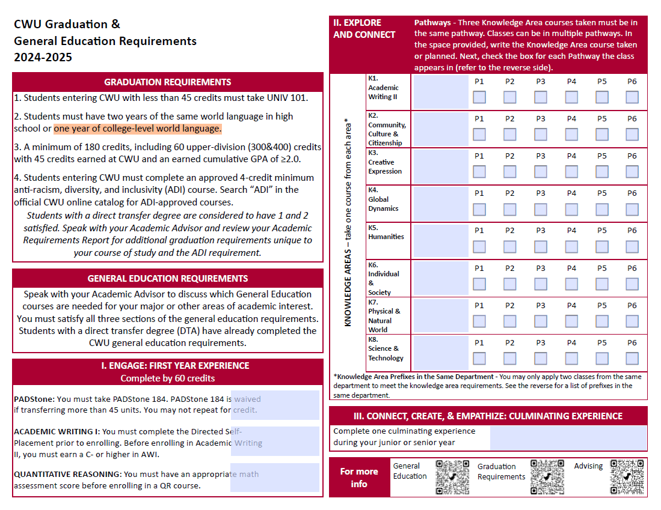

Slide 11
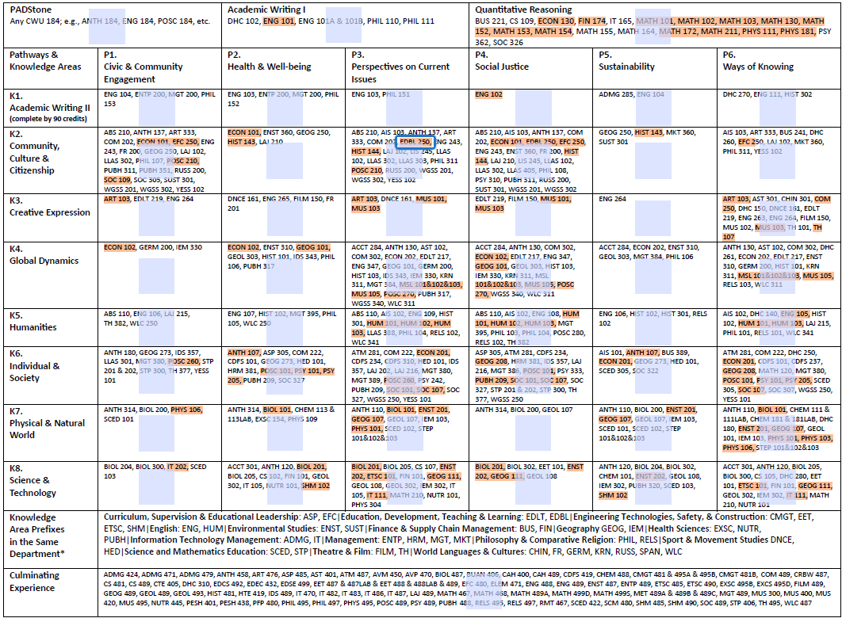

Slide 12
CHS Student Example 1
Term | Class | Credits | Grade | General Education
Fall 2021 | MATH 153 | 5 | A | QR – Quantitative Reasoning
Fall 2021 | PHYS 111 | 5 | A | QR – Quantitative Reasoning
Spring 2022 | MATH 154 | 5 | A | QR – Quantitative Reasoning
Spring 2022 | PHYS 112 | 5 | A | N/A
Fall 2022 | ENG 101 | 5 | A | AWI – Academic Writing I
Fall 2022 | MATH 101 | 5 | A | QR – Quantitative Reasoning
Spring 2023 | ENG 102 | 5 | A | K1 – Academic Writing II
Spring 2023 | MATH 102 | 5 | A | QR – Quantitative Reasoning
Spring 2024 | ENG 105 | 5 | In progress | K5 – Humanities
Total Credits: |  | 45 credits
Total Credits for Gen Ed |  | 20 credits

Slide 13
CHS Student Example 2
Term | Class | Credits | Grade | General Education
Fall 2022 | MATH 153 | 5 | A | QR – Quantitative Reasoning
Spring 2023 | HIST 144 | 5 | A | K2 – Community, Culture, & Citizenship
Spring 2023 | MATH 154 | 5 | A | QR – Quantitative Reasoning
Fall 2023 | MATH 172 | 5 | A- | QR – Quantitative Reasoning
Fall 2023 | SPAN 151 | 5 | A | N/A –
Fall 2024 | ENG 101 | 5 | In progress | AWI – Academic Writing 1
Spring 2024 | SOC 101 | 5 | In progress | K6 – Individual & Society
Spring 2024 | SPAN 152 | 5 | In progress | N/A
Spring 2024 | MATH 173 | 5 | In progress | N/A
Total Credits: |  | 45 credits
Total Credits for Gen Ed |  | 20 credits

Slide 14
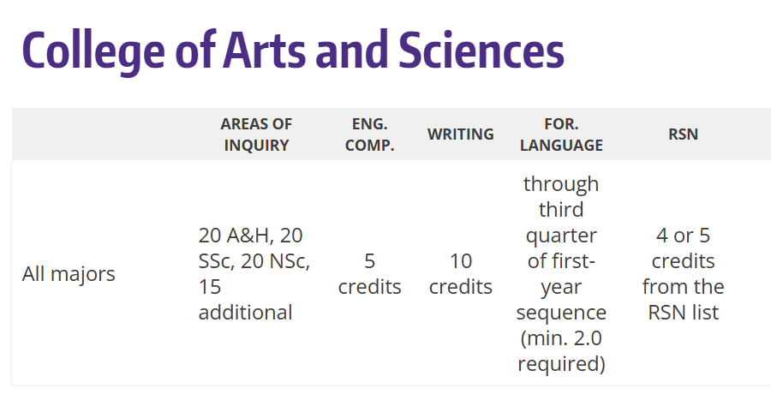
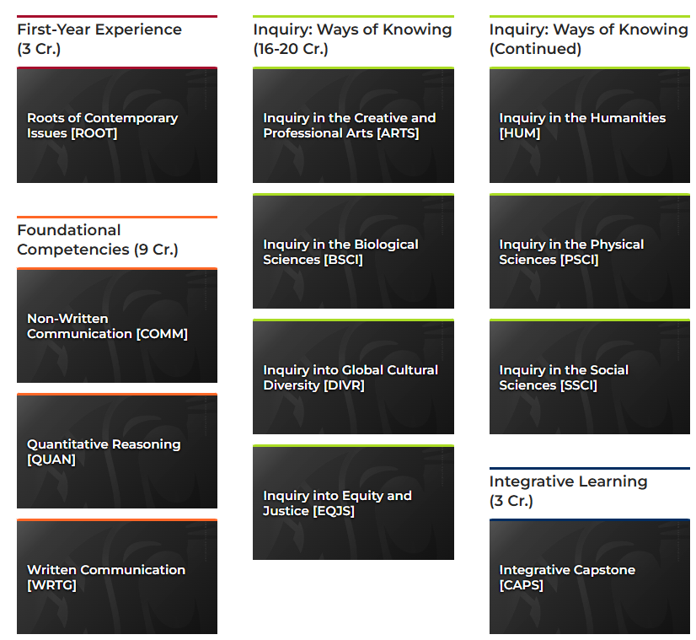

Other General Education Examples
University of Washington WSU
Western Washington University

Slide 15
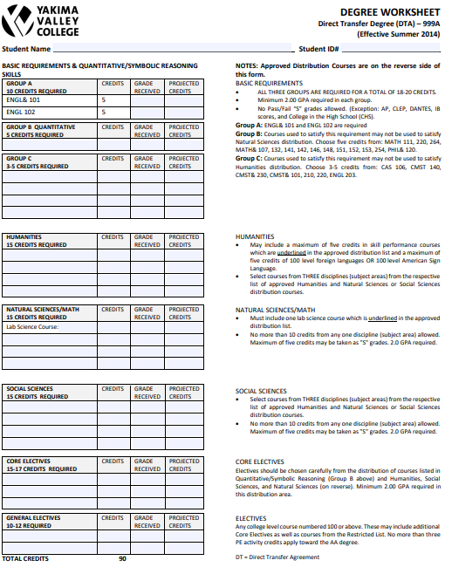
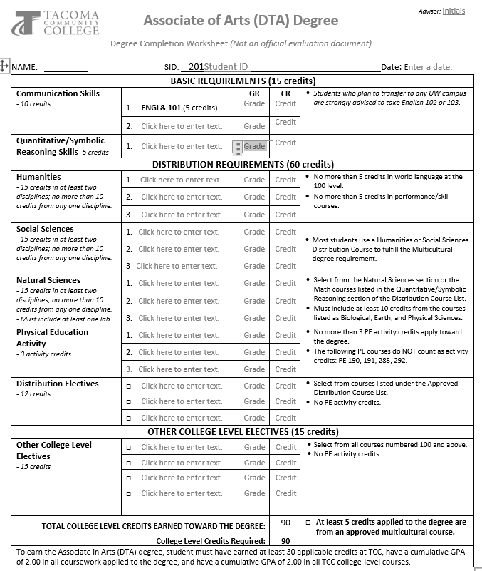

Slide 16
Top Planning Tips
Take general education classes
Avoid redundancy (e.g., AP + CiHS ENG 101 or taking more classes in a general education category than is necessary)
Earn C grades or better
Complete sequences when applicable (esp. STEM)
Check with new college about transfer policies and equivalencies
Keep track of earned credits and send official transcripts to new institutions
Notes:
These six tips can dramatically reduce frustration and credit loss. Emphasize the importance of transcript requests, watching for course duplication, and understanding major-specific pathways.
General education classes are more likely to transfer to other institutions toward their general education than non-general education courses.
Five credit classes generally transfer better other classes because some institutions, such as UW, require a certain amount of credit in a general education category for a student to complete the requirement. Five credit classes also transfer better to semester schools like WSU.
Students want to avoid taking too many classes in the same general education category or enrolling in courses they already have credit for. Some students think that if they take AP Language & Comp and English 101, they can earn 10 credits of English. This doesn’t work because pretty much all colleges consider them to be the same course.
If students do not earn at least a C or higher in their CHS courses, they are unlikely to transfer to other institutions.
Many STEM degrees require that students take a full sequence, such as PHYS 111, 112, and 113 to meet the degree requirement. Because the content in these courses can be taught in different orders at different institutions, it is safer to take the entire sequence for transfer. Otherwise, the new institution may make them repeat the class(es).
All institutions will have transfer policies on their websites and many also post equivalency guides so students can see exactly how their coursework will transfer. Students should use these to help guide their decisions for enrolling in dual credit classes.
Note – sometimes students won’t find all classes listed in an equivalency guide, especially if the new institution is out of state. That doesn’t mean the institution won’t take the transfer credit the student has earned, but they should follow up with the new institution for guidance. If not many students from CWU have transferred to that school, it’s possible that the only classes listed in the equivalency guide are what students have previously transferred.
The number one reason students don’t receive transfer credit for their dual credit coursework is because they don’t request official transcripts. Please remind your students and encourage them to use a dual credit tracking sheet to document what they’ve earned and from what institution.

Slide 17
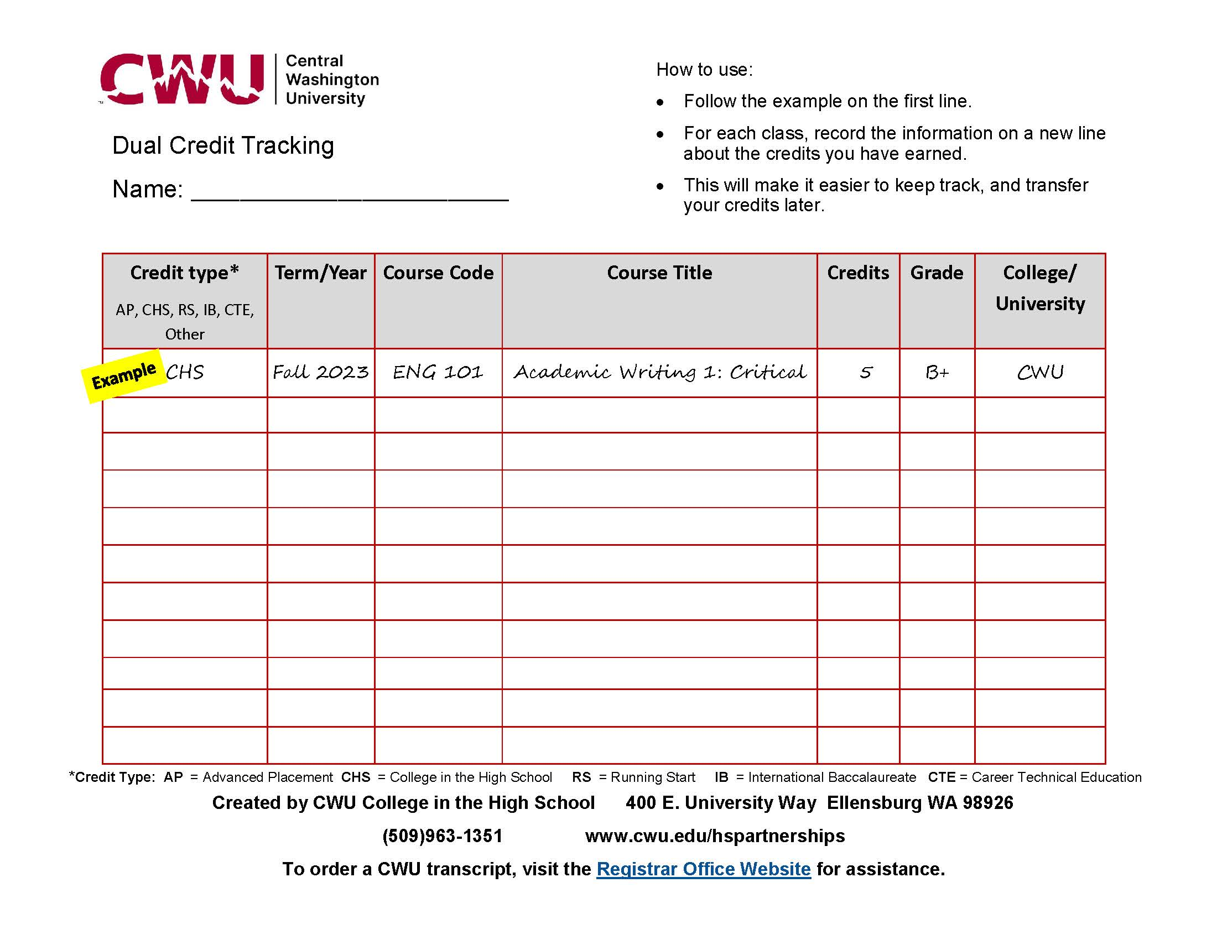

Slide 18
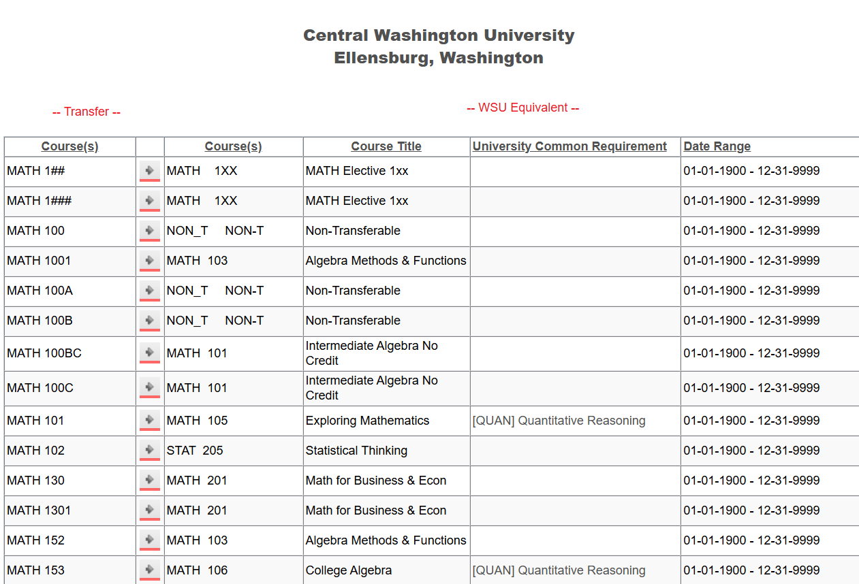
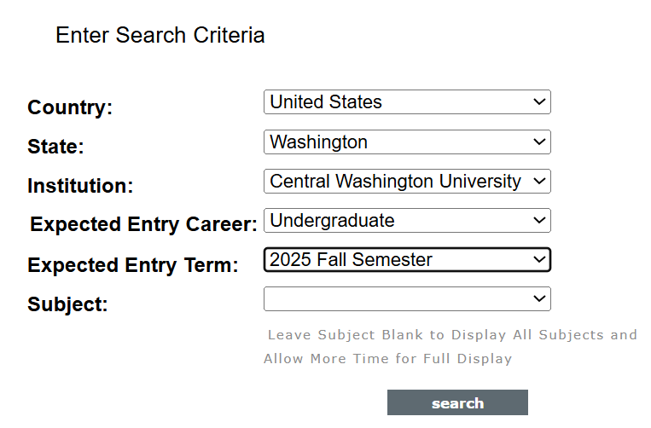
Equivalency Guides

Slide 19
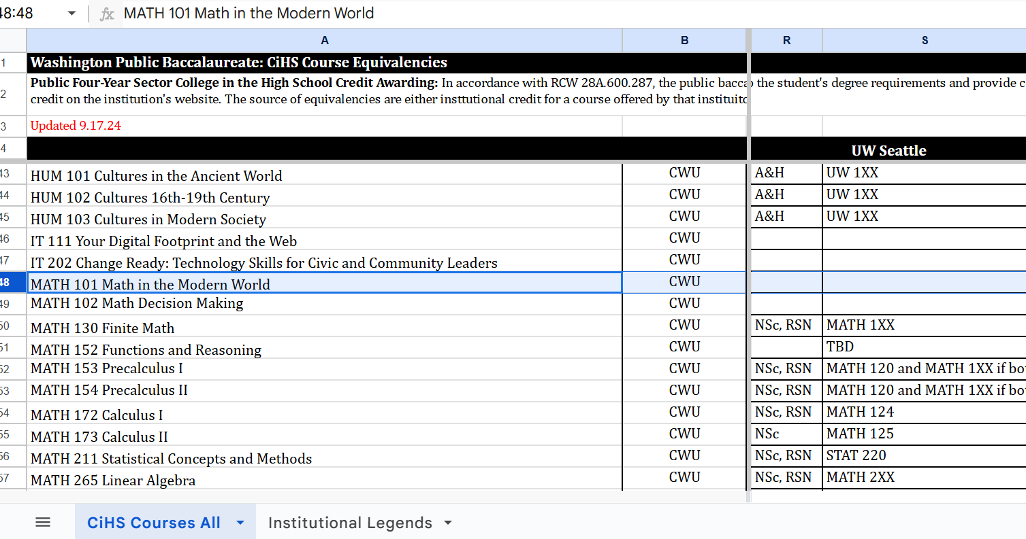
CHS Public-Four Years Equivalencies

Slide 20
Additional Resources
CWU Academic Standing Policy: https://catalog.acalog.cwu.edu/content.php?catoid=76&navoid=5571#acad_stand
CWU General Education: https://www.cwu.edu/academics/general-education/
Washington Student Achievement Council Transfer Resources: https://wsac.wa.gov/transfers
CiHS Equivalency Tool: https://docs.google.com/spreadsheets/d/1CmRZkfai2cw0ZmUHoquZjBywxandDV28/edit#gid=1180011737
UCONN Early College Programs Credit Transfer Database: https://eceapps.uconn.edu/credit_transfer_database/
State Guidelines for an AA-DTA: https://wsac.wa.gov/sites/default/files/DTA.Associate.Degree.Guidelines.pdf
CWU Dual Credit Tracking Sheet: https://www.cwu.edu/academics/specialized-programs/college-high-school/_documents/dual-cred-tracking.pdf

Slide 21
Advising Assistance
High School Partnerships Office
  509-963-1351
  RunningStart3@cwu.edu
College in the High School staff can assist with registration issues and requesting transcripts.
Running Start advisors will be available to assist CiHS students who need advising.

Slide 22
High School Visits
We are available to visit your high school:
  Parent nights
  Student presentations
  Career fairs and other events you are hosting
  Meetings with your teachers and administrators to discuss building your program and advising your students

Slide 23
CWU Resource Contacts
CWU Registrar Office
  Reg@cwu.edu
  (509)963-3001
CWU Service Desk
  cwuservicedesk@cwu.edu
  (509)963-2001
CWU Learning Commons
  learningcommons@cwu.edu
  (509)963-1270
CWU Admissions Office
  admissions@cwu.edu
  (509)963-1211
CWU Financial Aid Office
  FinancialAid@cwu.edu
  (509)963-1611
CWU Libraries
  libraries@cwu.edu
  (509)963-3682

Slide 24
Questions?

