Slide 1

CWU Club Baseball Budget Presentation 2025-2026

Slide 2
About Us
This team is, yes, a baseball team—but if you take a closer look, it's also a true brotherhood. From day one, every player has had each other's back, both on and off the field. We play the game we all love, together, as a team. Sure, we’re here to compete, but more importantly, we're here to have fun. And that’s what this game is really all about.

Slide 3
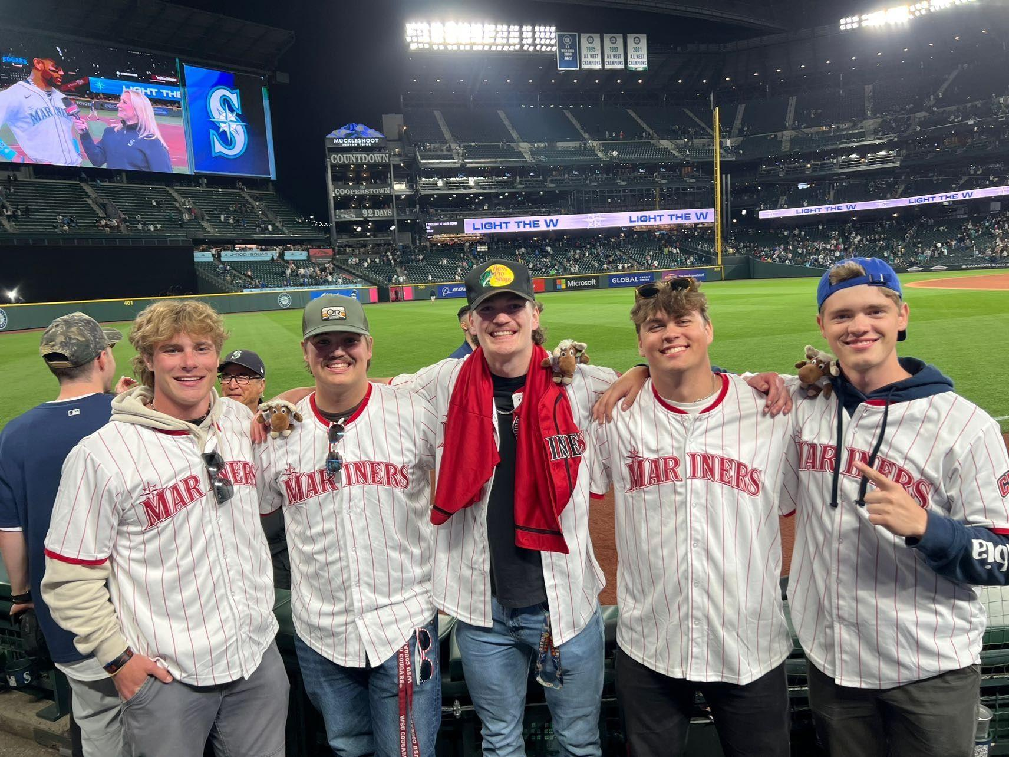
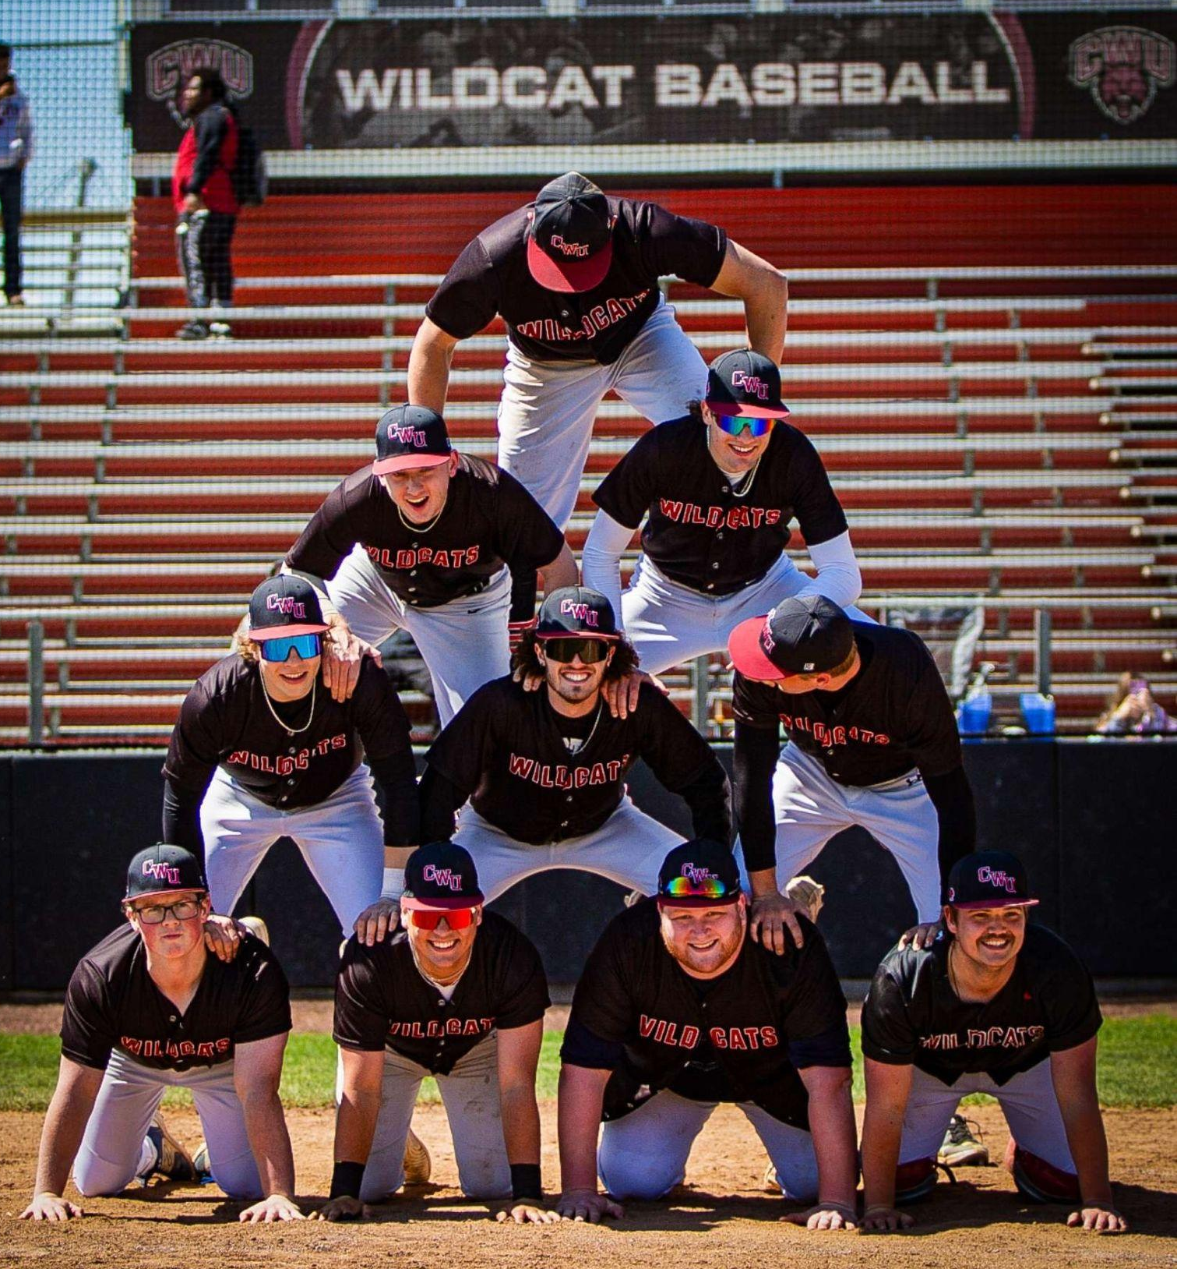
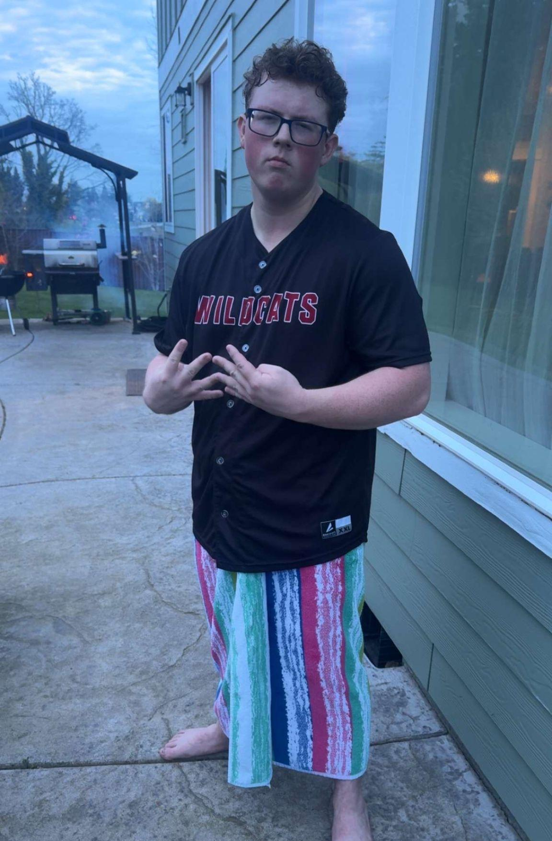
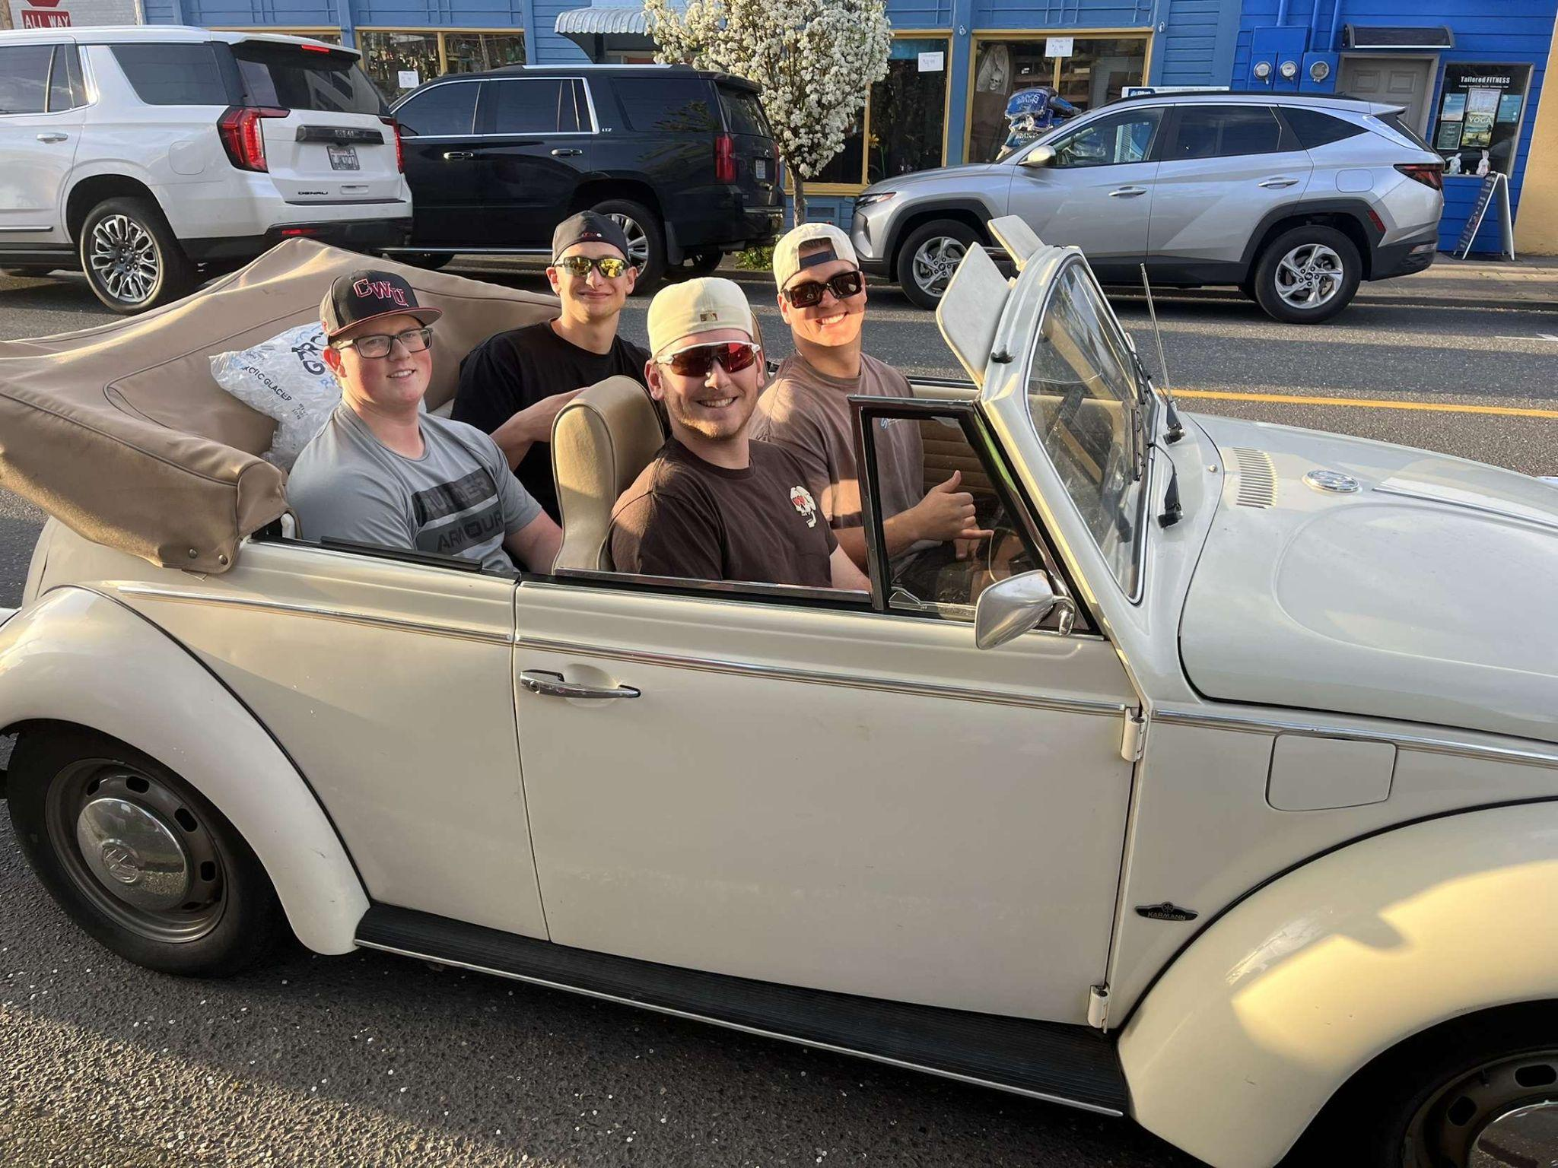
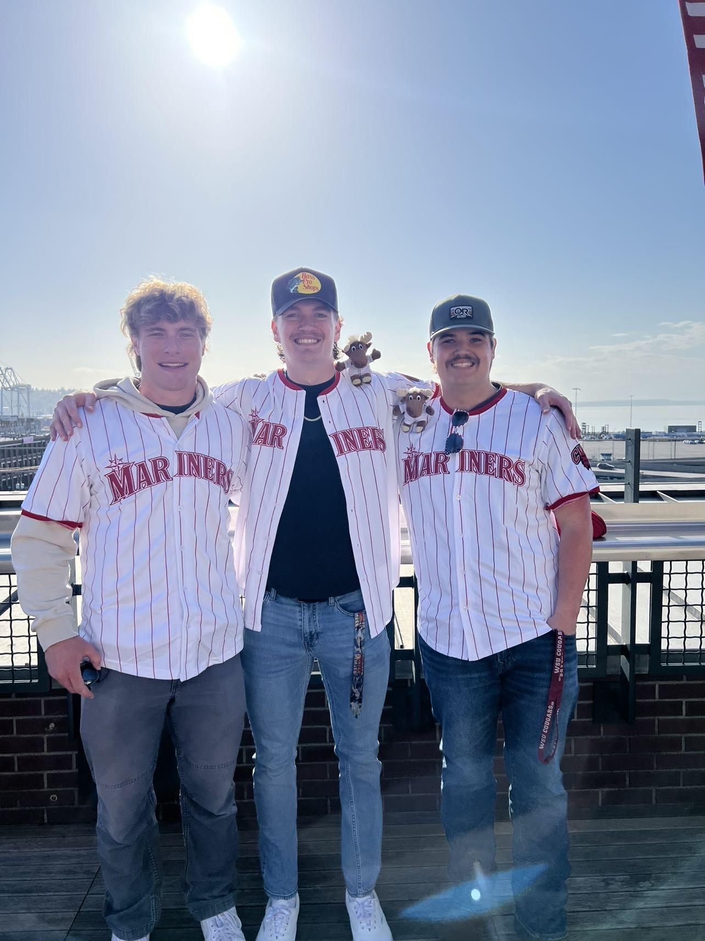
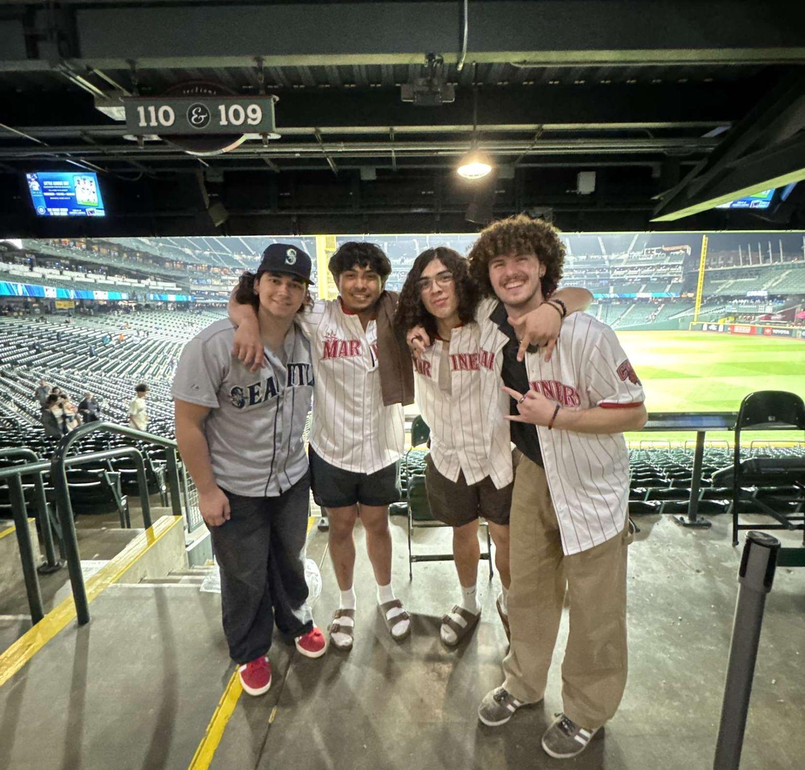
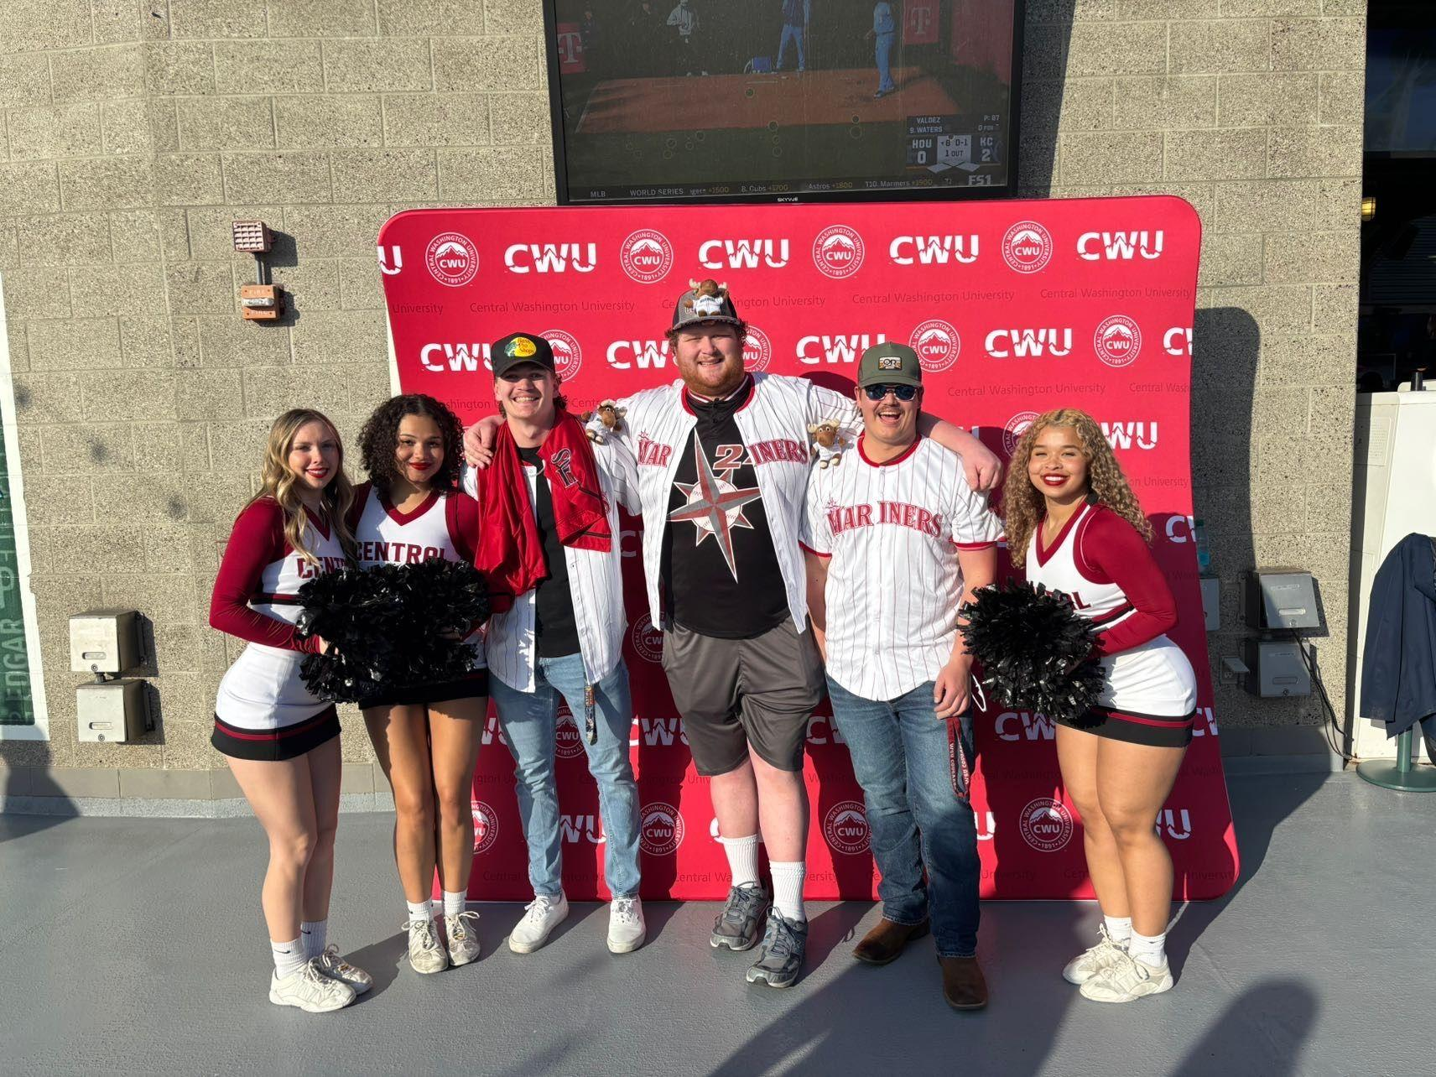

Slide 4
Introduction and Goals
Our Mission:
To be more competitive in our league
Continue to fostering a positive team environment on and off the field
Positively represent CWU and recreation
Goals:
Establish a relationship with local youth baseball organizations of Ellensburg
Acquire a permanent home field
Increase player tryout participation.
Pursue sponsorship opportunities
Notes:
This year we want to have a more supportive, and competitive team environment. We should continue representing. We are going to pursue sponsorship opportunities, to support the projected program growth, equipment needs, and community outreach

Slide 5
What is the NCBA?
National Club Baseball Association
Founded in 2000
About Competing:
Creates a competitive environment for college club baseball teams nationwide
CWU Club Baseball competes in Division 2 Rocky Mountain North
Top 2 teams in each conference advance to play in regionals for a chance to advance to the NCBA World Series

Slide 6
This Year’s Events
2 home series and 5 away series, 20 game season.
Oct 18/19 CWU @ Montana
Oct 26/27 EWU @ CWU
Mar 1/2 CWU @ WSU
Mar 5/6 CWU @ UW
Apr 4/5 CWU @ PSU
Apr 13/14 CWU @ Idaho
May 17/18 EWU @ CWU
Notes:
This year we played only 2 home series but 5 away series. Next year we hope to play more games hoping we hit the 30 game mark.

Slide 7
Team Accomplishments
NCBA Player Accolades
First Year in the NCBA
Team Bonding
WSU weekend - Alex Cox
Player of the Week
UW weekend - Torrey Bannan
Player of the Week
UW weekend - Rowan Hobson
Pitcher of the Week
Idaho weekend - Torrey Bannan
Player of the Week
NCBA All Regional Player - Alex Cox
Finished with a conference record of 6-9. Including wins against:
Defending division champs University of Montana.
2025 division champs University of Idaho
Team dinners
Team movies
Players hosting dinners
End of season banquet
Notes:
We have had a number of different NCBA accolades. These are given out very sparselfy and represent a high honor in clubbaseball. WE finished with a final record of 6 and 9 with a win against montana whom finished in the NCBA world series.

Slide 8
Revenue Summary
Revenue | 2024/2025 Actual | 2025/2026 Estimate | Increase / (Decrease)
Allotted funds | $4,000 | $8,000 | $4,000
Club dues | $3,400 | $3,200 | ($200)
Fundraising | $125 | $1,600 | $1,475
Donations/sponsorships | - | $1,500 | $1,500
Other | $778 | - | ($778)
Total | $8,303 | $14,300 | $5,997
Notes:
00

Slide 9
Fundraising: CWU Club Camps
CWU Club Camps:
Camp Dates:
We will be holding 4 camps in the fall
2 camps will be dedicated to T-ball - Coach Pitch
2 camps will be dedicated to Minors-Majors
The separation of ages ensures that we give the correct coaching experience to the kids
October 18th &19th
November 1st & 2nd
November 22nd & 23rd
December 6th & 7th

Slide 10
Fundraising Pt. 2
We are estimating a minimum of 20 kids per session, if not more
With that being said we are going to be charging $40 per player for the whole weekend and $20 per player for just one day
Yes the goal of these camps is to make money, but we also are doing this to try and bring fun back into the game of baseball and engage with the community in Ellensburg

Slide 11
Potential Sponsorships
IGN Manufacturing
Twisted Tee Clothing Manufacturing
A new team banner with both sponsor logos
A donation to the team (still working on dollar amount)
20 practice shirts, branded with CWU logo

Slide 12
Expense Summary
Expense | 2024/2025 Actual | 2025/2026 Estimate | Increase / (Decrease)
Equipment | - | $574 | $574
Uniforms (jerseys) | $446 | $1,408 | $962
Officials (umpires) | $1,300 | $2,300 | $1,000
Travel | $5,590 | $5,900 | $310
Fees | $2,210 | $2,210 | -
Facility rentals | - | - | -
Other | $304 | - | ($304)
Expressed | $9,850 | $12,392 | $2,542
Uniforms (hats) | $611 | $594 | ($17)
Non-expressed | $611 | $594 | ($17)
Total | $10,461 | $12,986 | $2,525

Slide 13
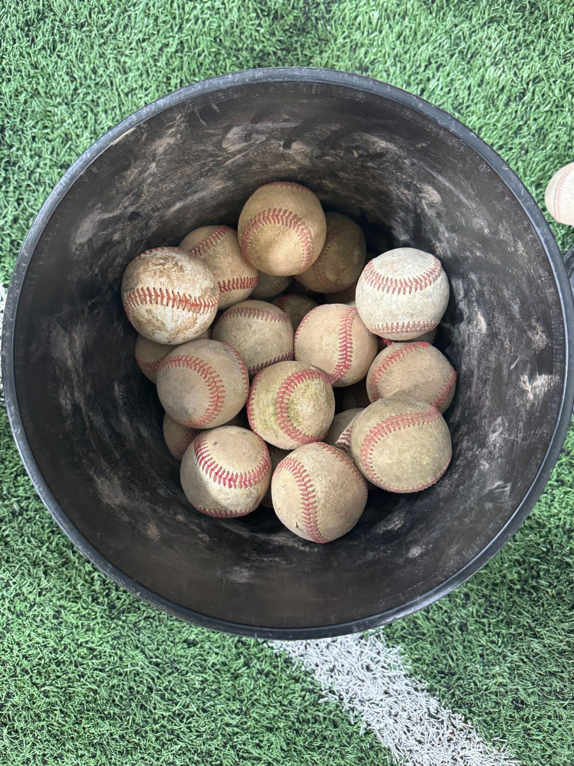
Equipment (Expressed)
Pre-Game Equipment
Pre-game hitting balls
J-Bands
Plyometric Balls
2 Collapsible Hitting nets
Everyday Practice Equipment
Practice balls
Functional L-Screen
Pitching Machine
(Current condition of our practice balls)

Slide 14
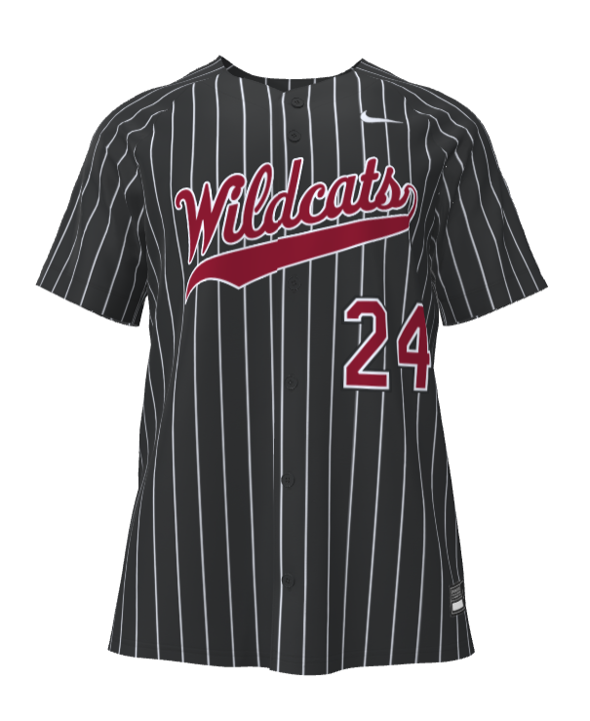
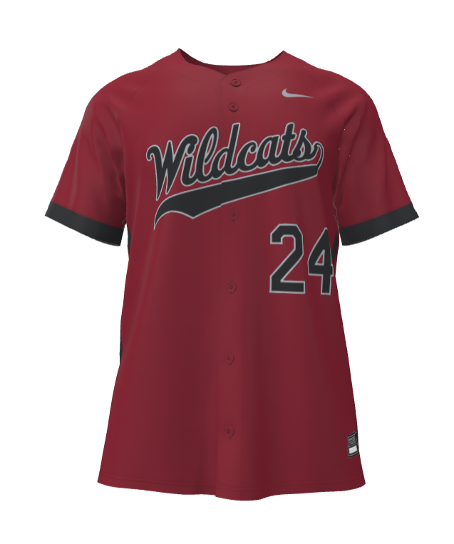
Uniforms (Expressed)
Potential Jersey Designs
Jerseys ($1407.84)
Current jerseys do not follow NCBA regulations
“All players and coaches on teams holding membership in the NCBA will be required to wear the officially designated brand of baseball hat (The Game) and jersey featuring the official NCBA logo (see 9.05.1.1) during all NCBA Sanctioned Baseball Games”
Black Pinstripes Jerseys (Home)
Crimson Jerseys (Away)

Slide 15
Travel (Expressed)
Plan to travel 5 times again next year
We will continue to limit travel costs by using family/friends homes to keep costs low
Hotels 2024/2025 ($4,093)
4 people per room (only 4 rooms booked)
Fuel 2024/2025($1,497)
We save gas by carpooling to games
Travel Budget 2025/2026 increased by 5% due to inflation

Slide 16
Other Expressed Needs
NCBA League Fees ($2,210)
Mandatory fee to stay in the league
Facility Rentals
We need scheduled practice time in the Pavillion during the winter quarter
Officials ($2,300)
Increase of $1,000 to play two to three more series

Slide 17
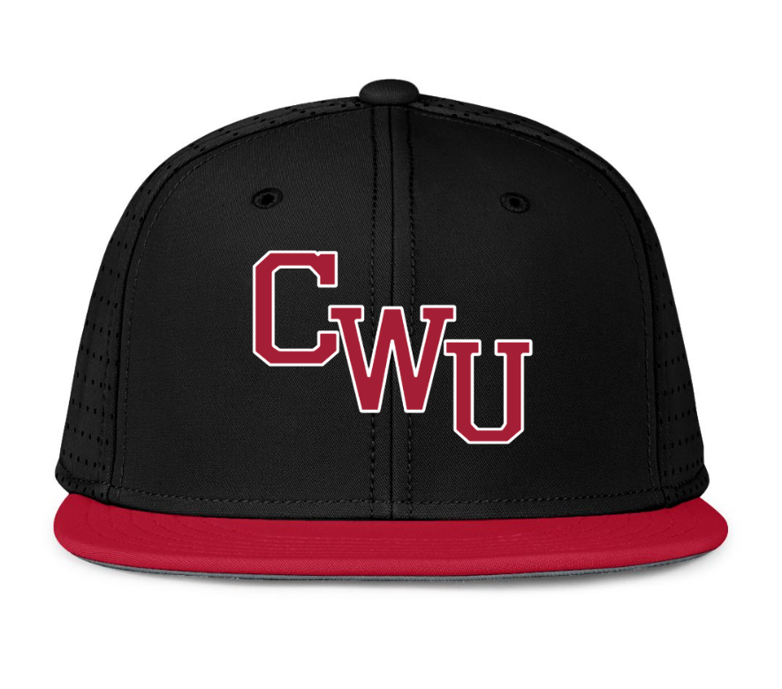
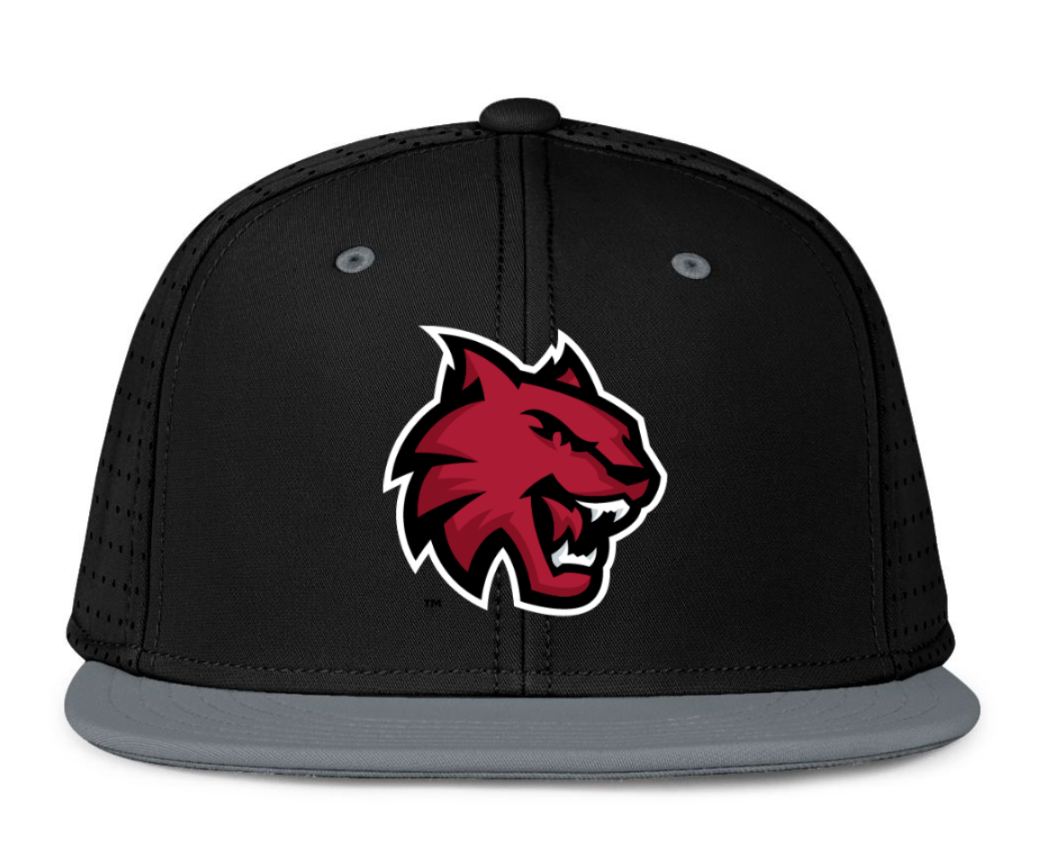
Hats (Non-expressed)
New Hats ($593.85)

Slide 18
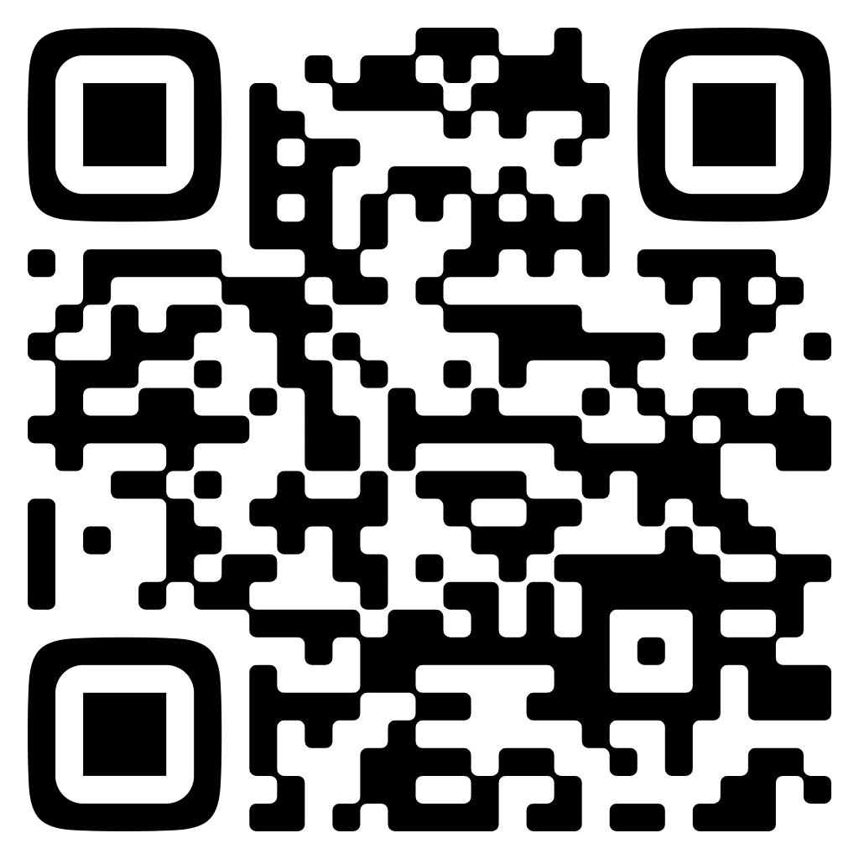
Our Website

Slide 19
Thanks For your Time!
Any questions?

