Slide 1
How to Sign Up for IM Leagues

Slide 2
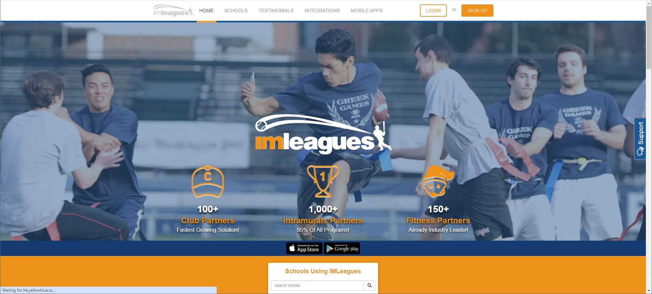
Go to imleagues.com

Slide 3
Click Sign Up!

Slide 4
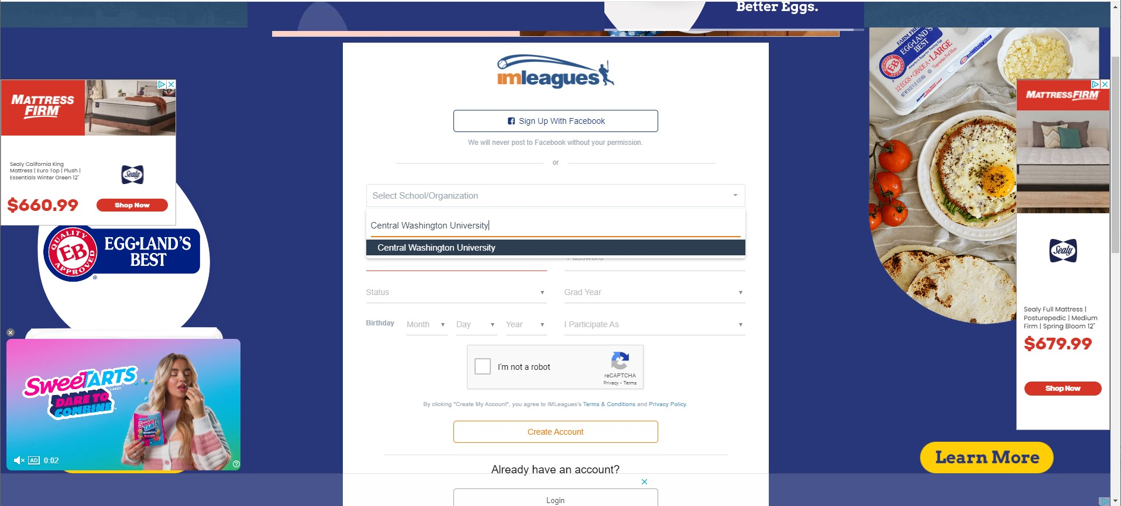
Type in Central Washington University

Slide 5
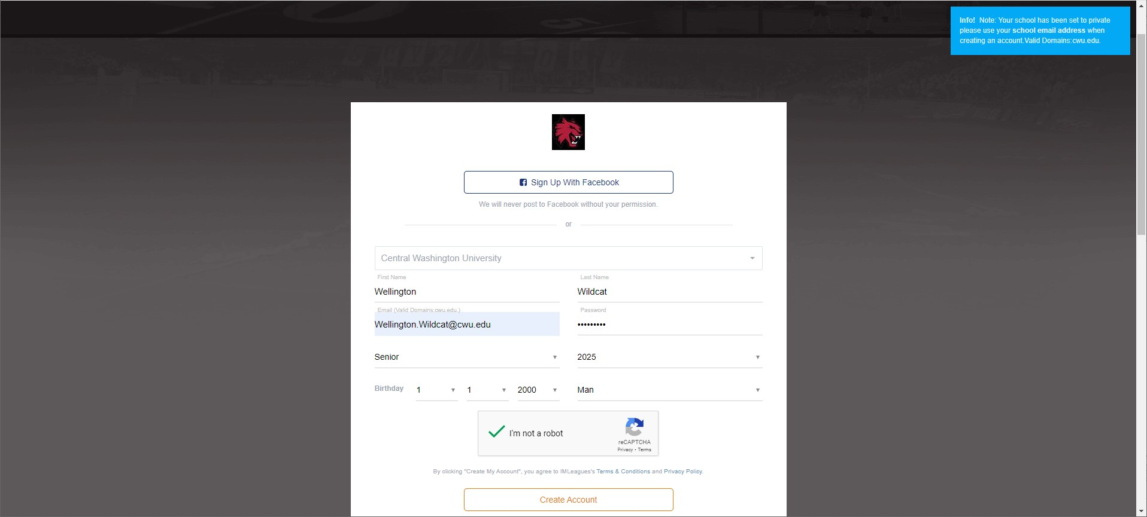
Fill out your CWU Information

Slide 6
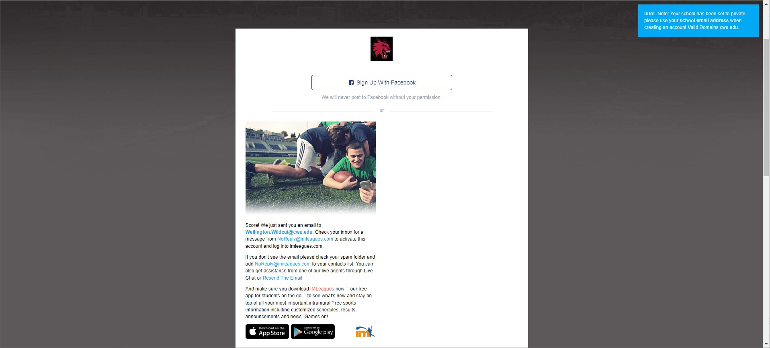
Make sure to confirm your account in your email!

Slide 7
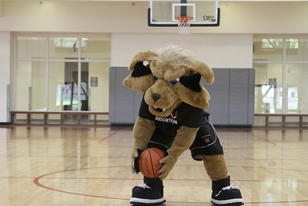
Email IM.Sports@cwu.edu with any questions!

