Slide 1
CWU Swim Club Budget Presentation
President: Nate Harris
Advisor: Carly Kahler
Vice President: Miranda Huff
Treasurer: Paige Moss

Slide 2
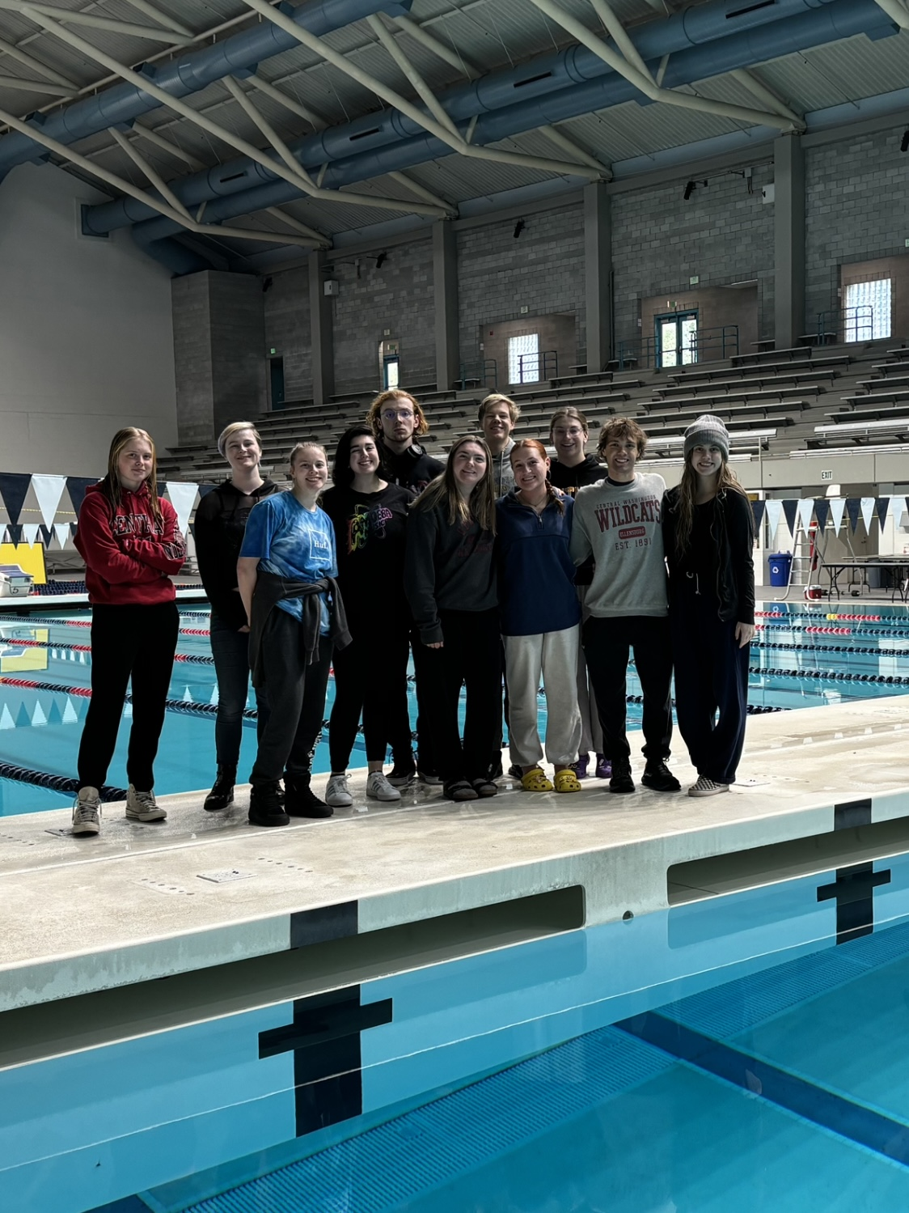
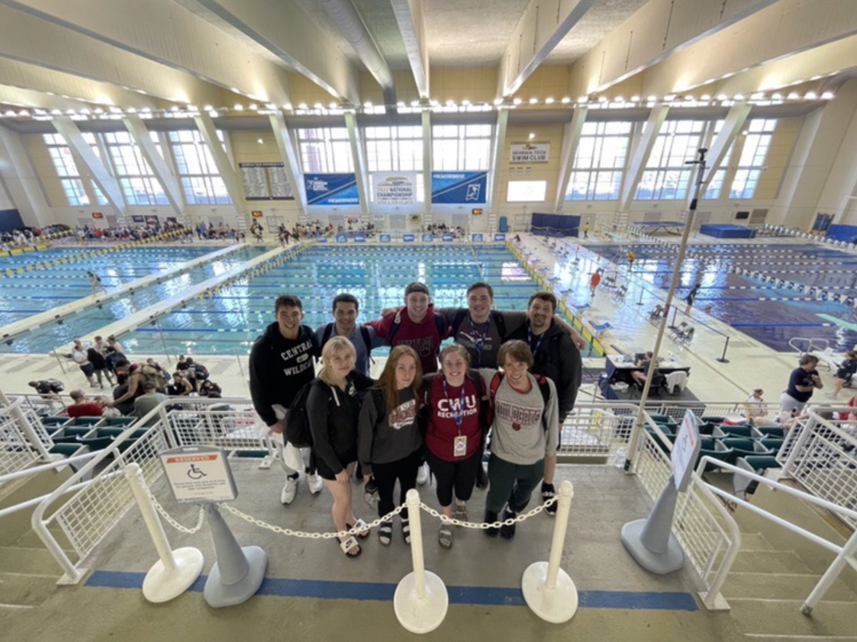
Club Introduction
Club of ~25 members
    16 competed in meets
Only competitive swim club in the Burg
Year-round season
6 swim meets in 2023-2024 season
    2 Hosted, 2 Travel (one day), 2 Travel (overnight)
Compete at USMS Nationals in June 2024
    11 Qualified, 4 Competing
Nationals, April 2022
KCAC Swim Meet, Nov 2023

Slide 3
Roll Over Funds
SURC Account Funds: $4,355.13
    At start of 23/24 school year
Foundation Funds: $1075.00

Slide 4
Revenue
Club Dues
    $150 per year or $75 per quarter
    Total: $2,215.00
Allocated Funds: $3,500.00
Reimbursement from Sport Clubs: $2,190.53
    Swim Caps: $100.00
    Nationals Registration: $508.00
    Nationals Airbnb: $1,082.53
    NCHA Survey: $500.00
Dues and Funds Revenue: $7905.53

Slide 5

Revenue: Fundraisers
Merch Sale
    Original Sale: $440.00
    BSN Merch Sale: $836.74
    Funds raised: $83.67
May 18th home meet entry fee
    $10 per athlete, total $170
Fundraiser Revenue: $693.67
Fundraising Ideas:
    Merch sale during home competition
    Bake Sale
    Monthly Drink Special with CWU Dining

Slide 6
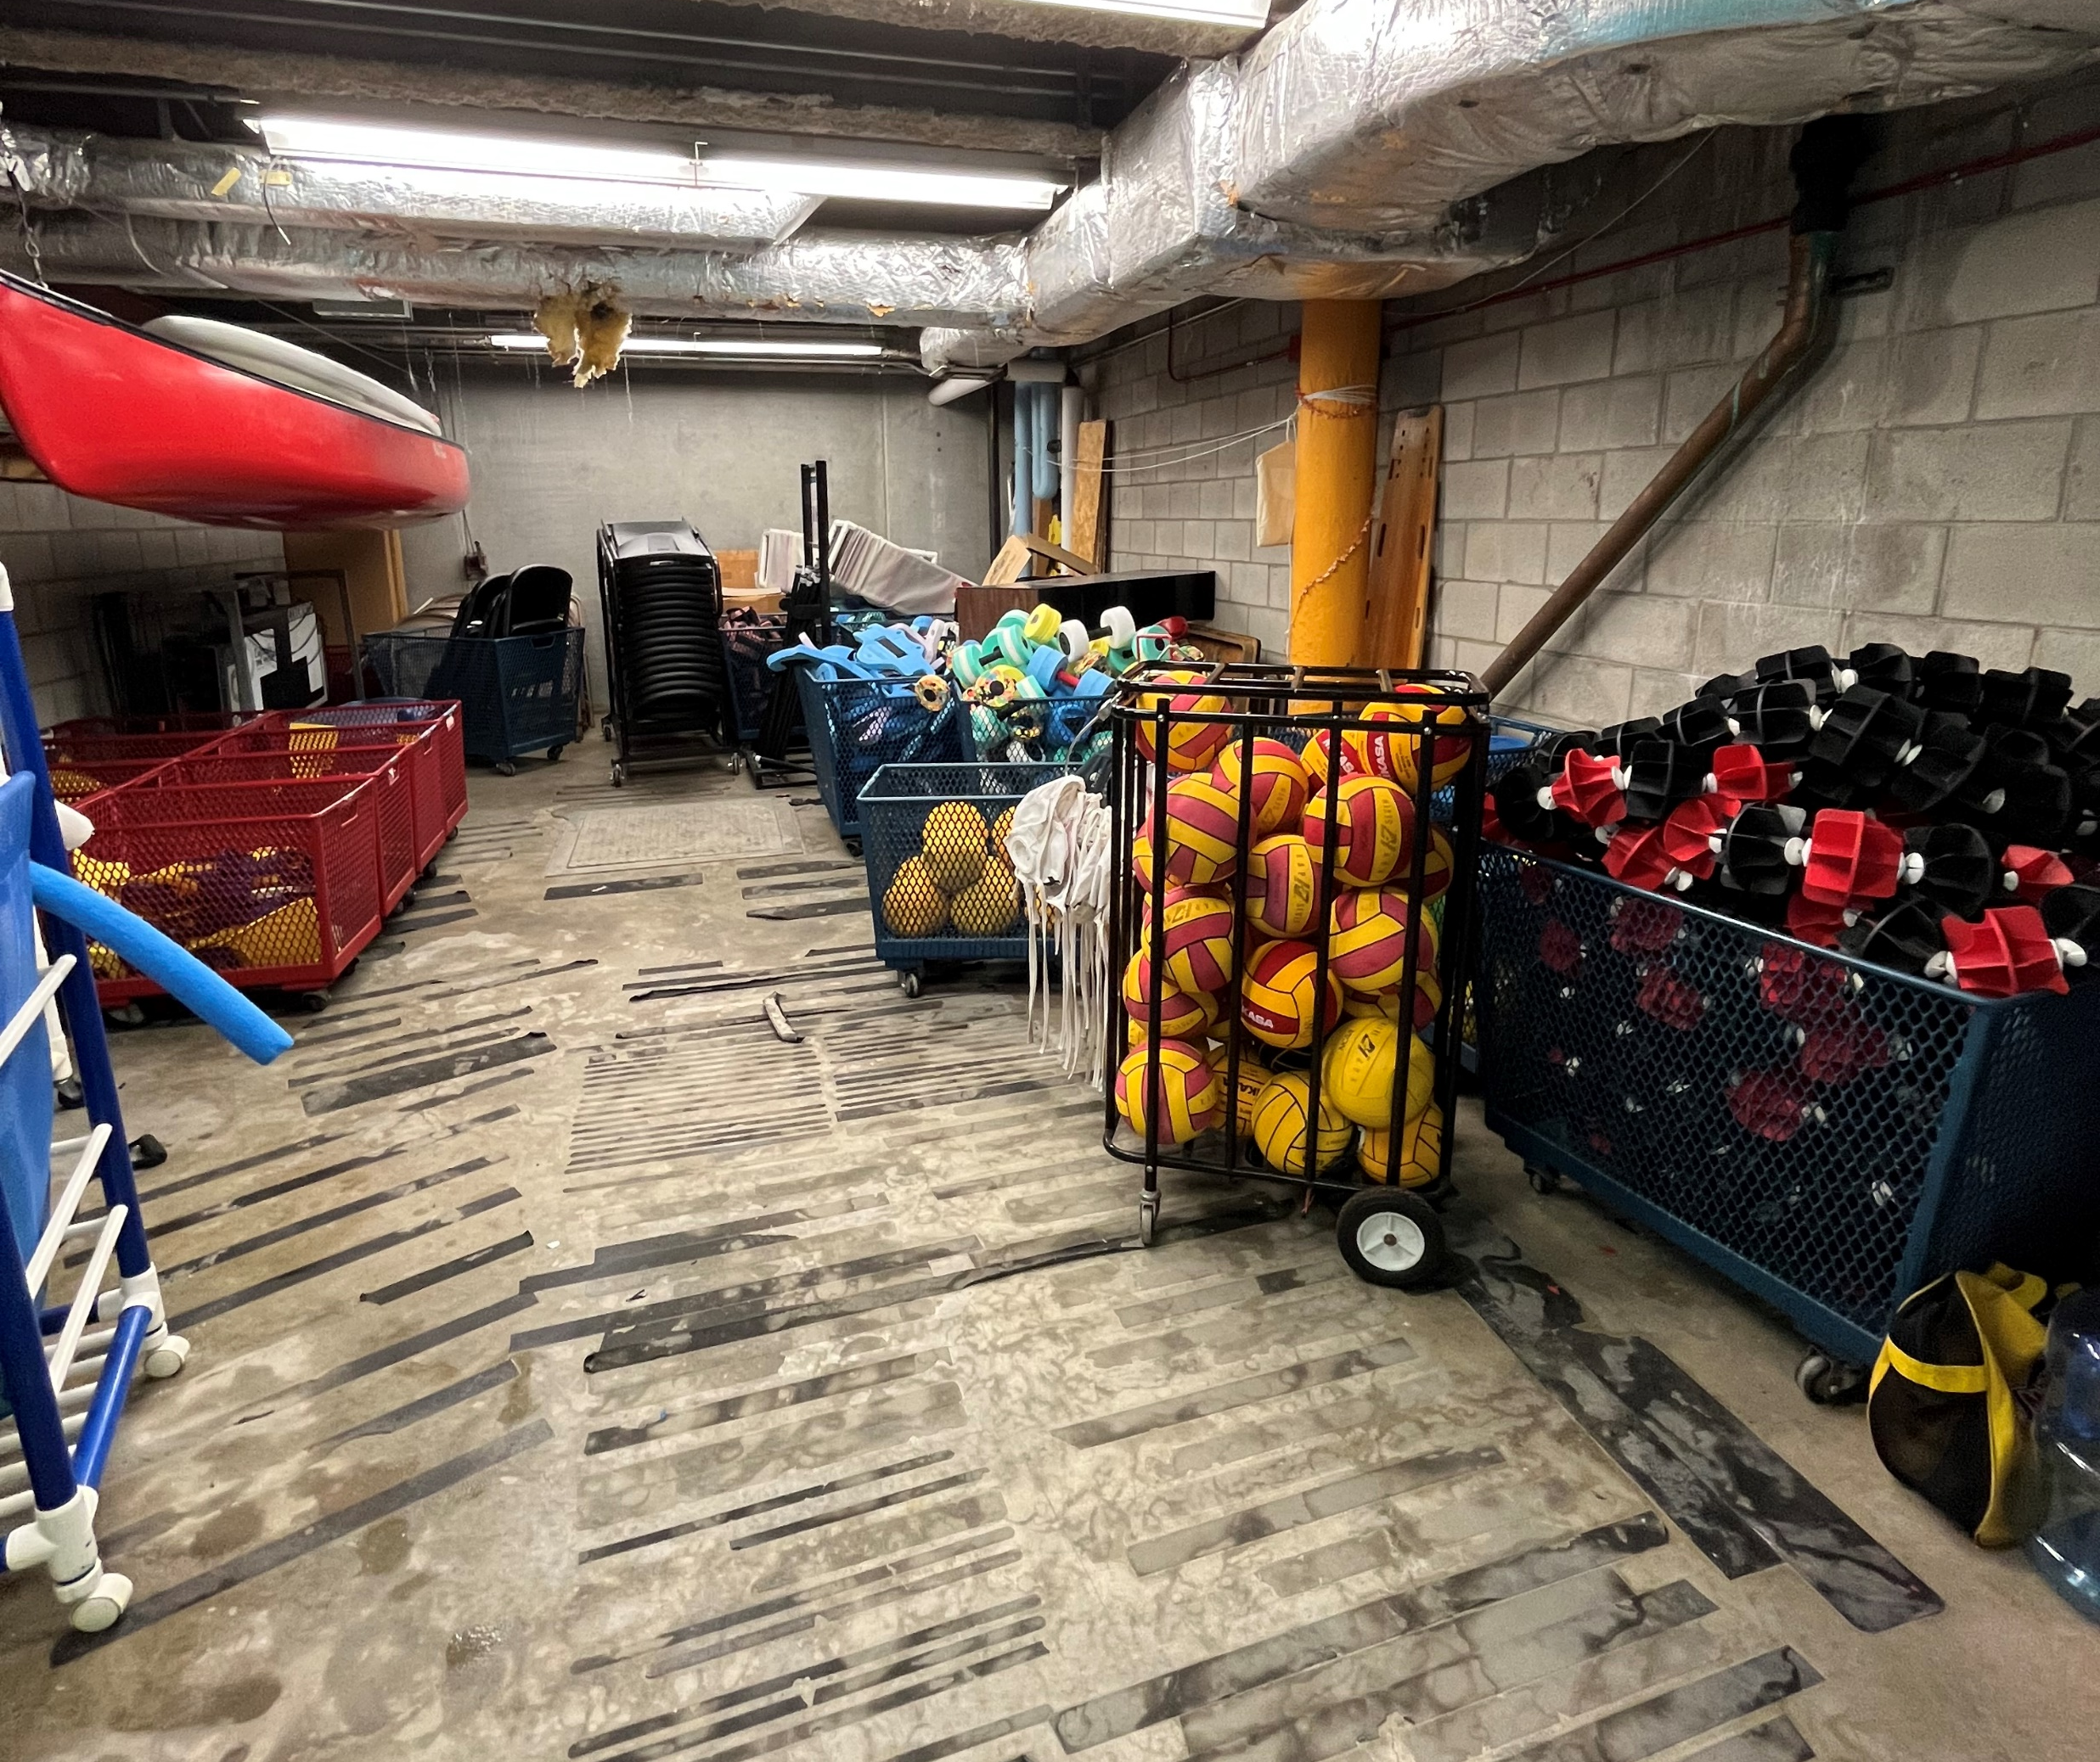
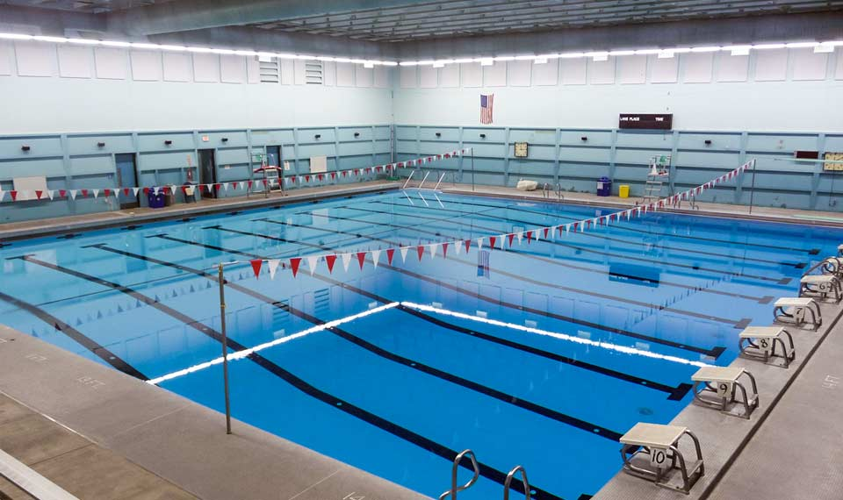
Expenses: Expressed Need
Equipment
CWU Pool
    Has all equipment we need: kickboards, pull buoys, lane lines, diving blocks
    10 lane, indoor, 25-yard x 25-meter facility
    Lifeguard wages covered by CWU Recreation
    We are grateful for CWU Pool
Swim Caps
    BSN bulk 48 qty, $4.99 each.
    Total: $239.52
Swim Meet Manager 8.0: $315.00
    Heat Sheet Software, 2 year long license
In future: team suits? Record board?

Slide 7

Expenses: Expressed Need
League Registration
Register a club with US Masters Swimming: $70.00 / year
US Masters Swimming membership
    Part way through calendar year: $115 per person (to end of next year)
    Beginning of calendar year: $70 per person
    Club dues cover this
12 Swimmers @ $115 = $1380.00
4 Swimmers @ $70 = $280.00
Club registration total: $1,730.00

Slide 8
Expenses: Expressed Need
Competition Registration
Most competitions have entry fee
To reduce costs, club members pay meet entry fee
Total competition registration: $1405.00
Nov 18-19 in Federal Way
    $49.00 + $2.00 per event (11 swimmers, 33 events)
    Total: $605.00
Jan 20 in Moses Lake
    $35.00 per swimmer (8 swimmers)
    Total: $280.00
Feb 24-25 in Coeur d’Alene
    $35.00 per swimmer (12 swimmers)
    Total: $420.00
April 27 in Mercer Island
    $10.00 per swimmer (10 swimmers)
    Total: $100.00

Slide 9
Expenses: Expressed need
Travel
Nov 18-19 in Federal Way
    Hotel + Rental Cars: $1,104.14
Jan 20 in Moses Lake
    No hotel/rental cars
Feb 24-25 in Coeur d’Alene
    Hotel: $424.56
April 27 in Mercer Island
    No hotel/rental cars
Hotel and Rental Car Total: $1,528.70

Slide 10

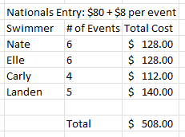
Expenses: Expressed need – Nationals!
June 20-24 in Indianapolis, Indiana
For 4 swimmers:
    Competition Registration: $508.00
    Flights: $3252.76
    Airbnb: $1082.53
    Rental Car: $500 (estimated)
    Gas: $150 (estimated)
Nationals Cost: $5,493.29
*registered after initial deadline; +$20 fee*
*

Slide 11
Expenses: Non-Expressed Need
Total: $1070.46
Need | Cost
Home Meet Food Catering for Volunteers | $235.06
Gas reimbursement for 2023-2024 | $435.40
Old swim league registration | $250.00
Covering meet fees | $150.00

Slide 12
Summary
Revenue
Dues: $2,215.00
Fundraising: $693.67
Allocated Funds: $3,500.00
Sport Club Reimbursements: $2,190.53
Total: $8,599.20
Expenses
Equipment: $554.52
League Dues: $1,730.00
Competition Dues: $1,405.00
In-Season Travel: $1,528.70
Nationals: $5,343.29
Volunteer Catering: $235.06
Gas: $435.40
Covered Fees: $400.00
Total: $11,631.97
Expressed Need
Equipment: $554.52
League Dues: $1,730.00
Competition Dues: $1,405.00
In-Season Travel: $1,528.70
Nationals: $5,343.29
Total: $10,561.51

Slide 13
Projected Expenses for 24/25
Equipment: $500.00
League Dues: $70.00
USMS Membership for 20 Swimmers: $1,760.00
    (12 members x $70) + (8 members x $115)
Travel (Based on 23/24 year): $2,000.00
    3 trips x $500/hotel
    $500 for gas
Nationals: $6,500.00
    Based on 23/34 budget but with 6 competitors
Total Estimated: $10,830.00

Slide 14
Looking to the future
CWU Sport Club Swimming requests $4,500.00 in allocated funds for the 24/25 school year.
Club has increased in growth
    More members
    More competitions
Increase club dues from $150 to $200 / year
Current budget supports regular season, but not Nationals
If any changes, current budget couldn’t support season
    Rental cars, lifeguard wages = we can’t support season
Send more swimmers to Nationals
    11 Qualified, 4 Going

